Slide 1
Welcome to the
Sanitation Safety Planning
Training of trainers
Step-by-step risk management for safely managed sanitation systems

Slide 2
Trainer self-introduction
Name and last name
Your picture
Profession
Who you are, where are you from
who do you work for
Your experience with SSP
Your e-mail
Your organizations’ email
Your contact number
WELCOME SESSION

Slide 3
Participants introduction
Tell us who you are!
Name
Profession
Organization
WELCOME SESSION

Slide 4
Objectives of our workshop
At the end of the training
Understand the value of SSP, and how it is a tool to implement the 2018 WHO Guidelines on Sanitation and Health.
Carry out each step of the Sanitation Safety Planning methodology.
Identify future SSP sites, those who should be involved, and know how to best prepare for SSP.
Initiate and sustain a Sanitation Safety Planning process in a locality.
Participants will have acquired the skills, knowledge and resources to:
WELCOME SESSION

Slide 5
Training methodology
Hands-on
Inputs
Working in groups
You will form groups with the people sitting with you in your tables.
You all will be developing a SSP for a locality..
You will keep notes for yourself in your individual notebook.
You will also work in table-group exercises to allow discussions and brainstorming.
You will report back to plenary.
At the end, your group will have a consolidated SSP.
Lectures with explanation of each step of the SSP methodology.
Examples from your SSP manual and the 2018 WHO Guidelines on Sanitation and Health.
Plenary discussions.
WELCOME SESSION

Slide 6
Agenda
Time | Day 1 | Day 2 | Day 3
9:00 - 9:15 | Welcome to the workshop and presentation of participants | Recap | Recap
9:15-9:30 |  | Step 2.4: Gather supporting information Step 2.5: Confirm the system description (45 min lecture) (45 min group work) | Module 4: Develop and implement an incremental plan (30 min lecture) (60 min group work)
9:30- 10:45 | Introductory session (30 min lecture) (15 min presentation of case study) (30 min group work)
10:45 – 11:00 | Coffee Break
11:00 –12:30 | The value of SSP (20 min discussion) | Step 3.1 Identify hazards and hazardous events (30 min lecture) (60 min group work) | Module 4 (cont.): Develop and implement an incremental plan (30 min group work) Groups sharing in plenary (30 min) Module 5: Monitor control measures and verify performance (30 min lecture)
 | Module 1: Prepare for SSP (30 min lecture) (40 min group work)
12:30 – 13:30 | Lunch Break
13:30 – 15:00 | Step 2.1: Map the system (25 min lecture) Step 2.2: Characterize the system flow (5 min lecture) (60 min group work Step 1 and Step 2) | Step 3.2 Identify and assess existing control measures (30 min lecture) (30 min group work) Step 3.3 Assess and prioritize the exposure risk (30 min lecture) | Cont. Module 5: Monitor control measures and verify performance (60 min group work) Module 6: Develop supporting programs and review plan (10 min lecture) (20 min group work)
15:00 – 15:15 | Coffee Break
15:15 – 16:45 | Step 2.3: Identify exposure groups (15 min lecture) (45 min group work) Groups sharing in plenary (30 min) | Cont. Step 3.3 Assess and prioritize the exposure risk (60 min group work) Groups sharing in plenary (30 min) | Plenary for exploring SSP opportunities or to develop SSP roadmaps (60 min) Closing session (45 min for evaluation and presentation of certificates)
16:45 – 17:00 | Day 1 close | Day 2 close
WELCOME SESSION

Slide 7
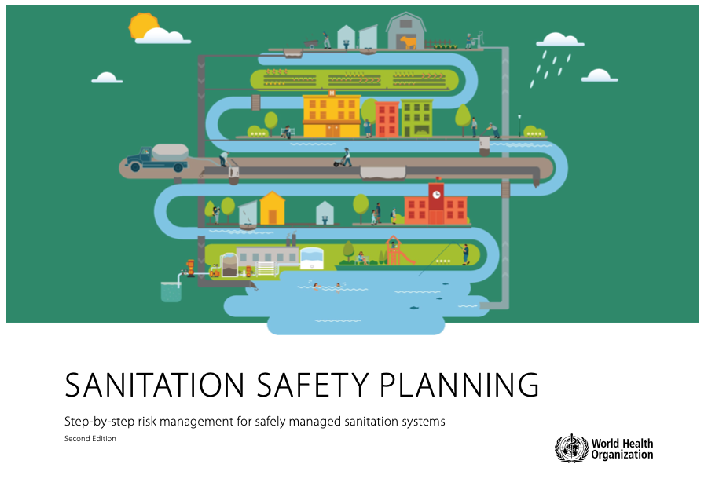
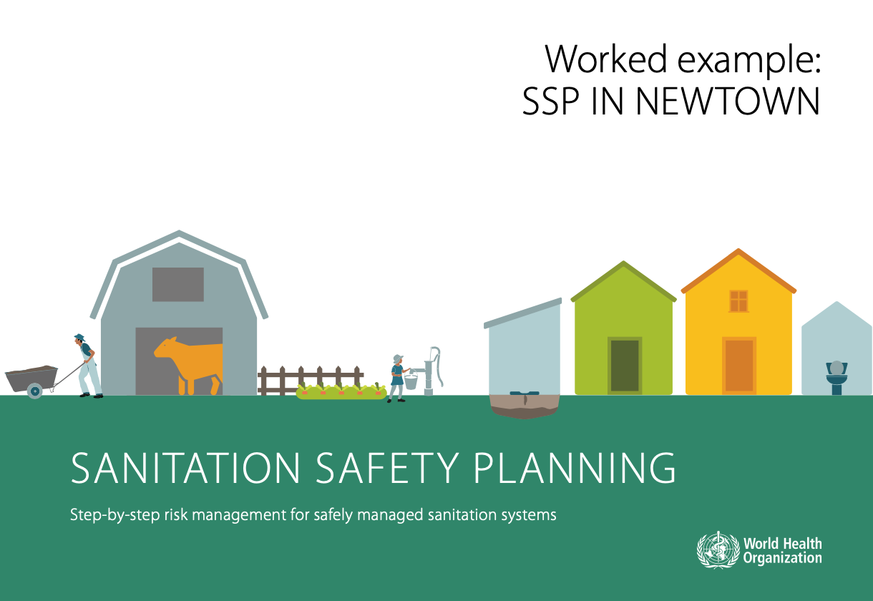
Resources
SSP Manual
SSP Worked example
WHO Guidelines on Sanitation and Health
Participant’s Worksheets
Table group Worksheets
SSP knowledge Hub
WELCOME SESSION

Slide 8
THANK YOU
Let’s start!

