Slide 1
Introduction to
Sanitation Safety Planning
Step-by-step risk management for safely managed sanitation systems

Slide 2
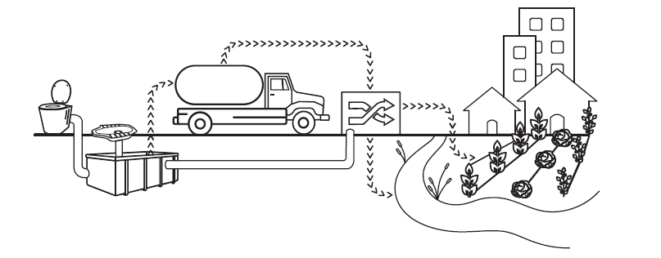
Safe
Sanitation
According to the WHO Guidelines on Sanitation and Health
Access to and use of facilities and services for the safe disposal of human urine and faeces.
Safe sanitation system
An arrangement of technologies and practices that:
Separates human excreta from human contact at all steps of the sanitation service chain;
Fulfils minimum requirements of design, construction and O&M to ensure safety along each step;
Is associated to hygiene practices;
Is embedded in an implementation framework for safe service delivery.
INTRODUCTION

Slide 3
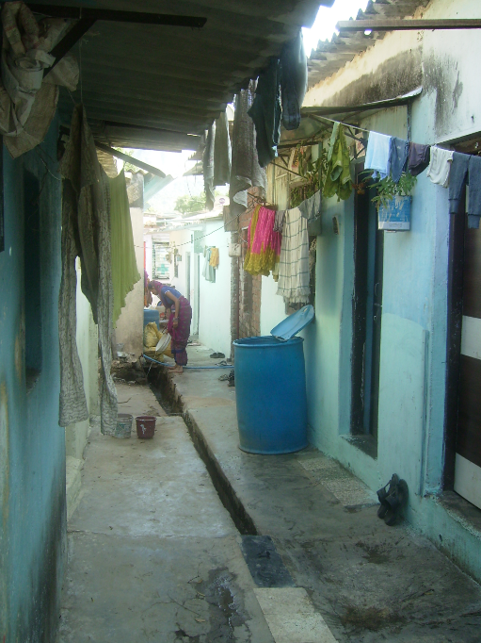
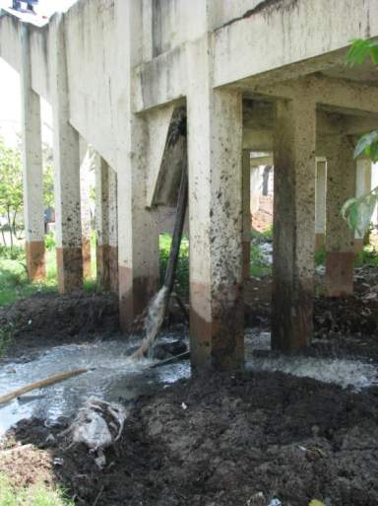
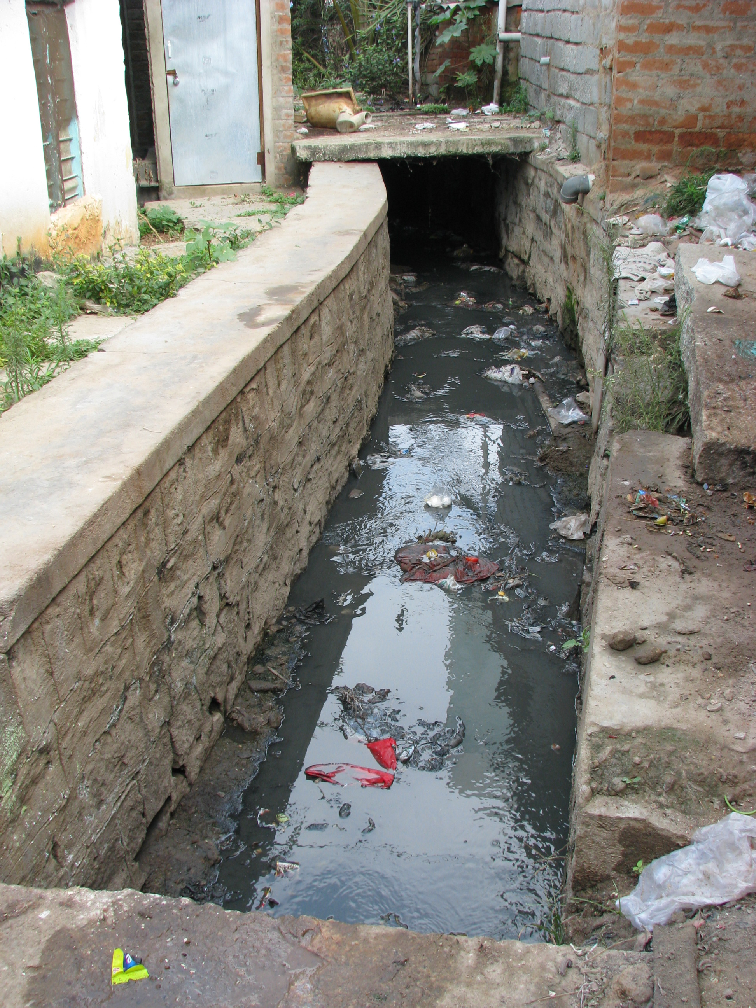
Significance of sanitation
for human health
Rapid urbanization
Photos: L. Barreto Dillon
Challenging and costly operation and maintenance
Adaptation to climate change required
INTRODUCTION

Slide 4
Heath impact of unsafe sanitation
Direct impact (infections)* | Sequelae (conditions caused by preceding infection) | Broader well-being
Faecal-oral infections Diarrhoeas (incl. cholera) Dysenteries Poliomyelitis Typhoid Helminth infections Ascariasis Trichuriasis Hookworm infection Cysticercosis Schistosomiasis Foodborne tremetodes Insect vector diseases (vectors breed in faeces or water contaminated with faeces) Lymphatic filariasis West Nile Fever Trachoma | Stunting/ growth faltering - related to repeated diarrhoea, helminth infections, environmental enteric dysfunction Consequences of stunting -obstructed labour, low birthweight Impaired cognitive function Pneumonia - related to repeated diarrhoea in undernourished children Anaemia - related to hookworm infections | Immediate: Anxiety (shame and embarrassment from open defecation and shared sanitation) and related consequences Sexual assault (and related consequences) Adverse birth outcomes (due to underuse of healthcare facilities with inadequate sanitation) Long-term School absence Poverty Decreased economic productivity Anti-microbial resistance
INTRODUCTION

Slide 5
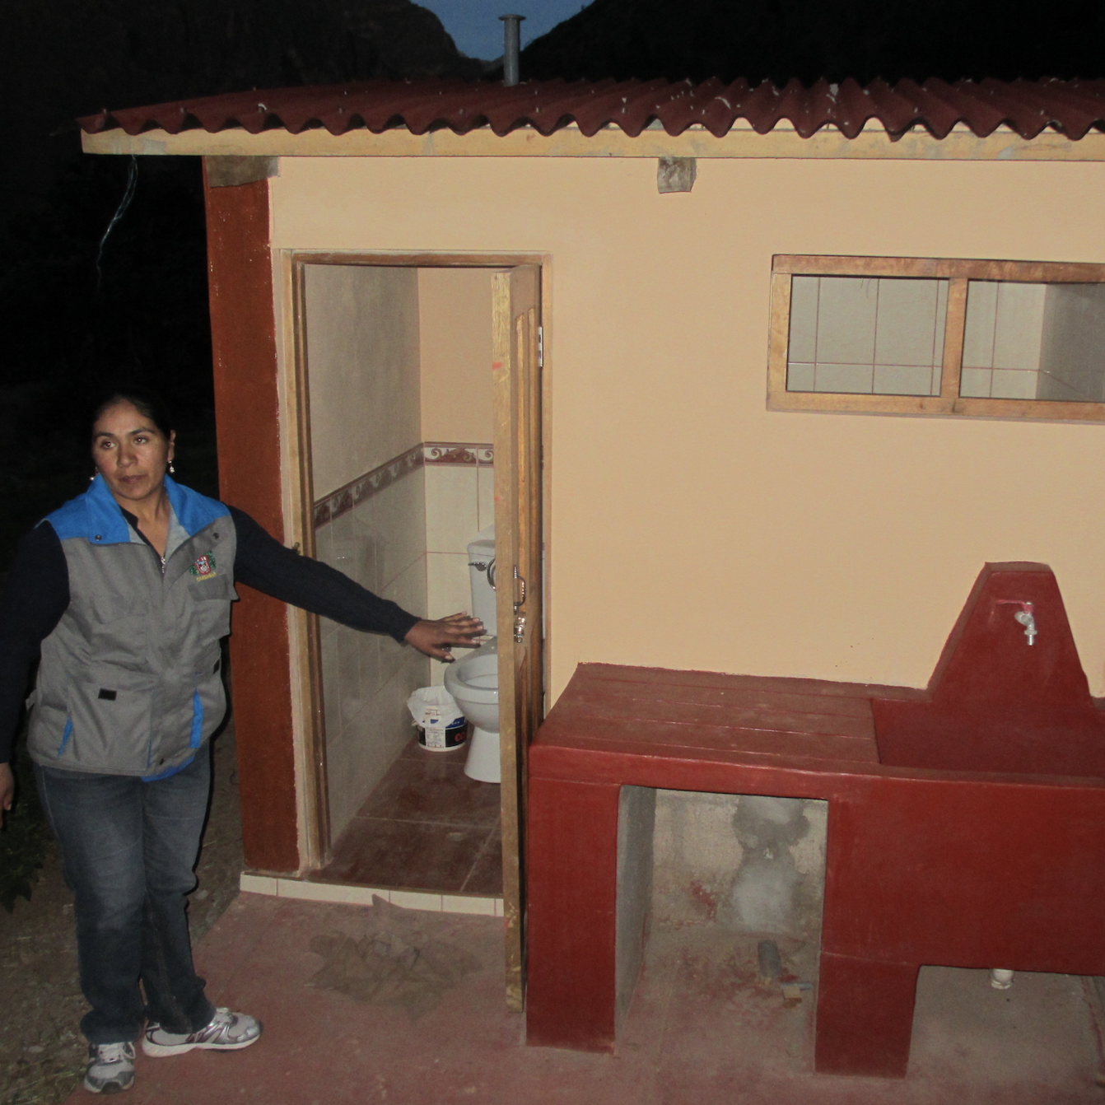
Sanitation as a development issue
Human right to sanitation
Entitles everyone to sanitation services that provide privacy and ensure dignity, and that are physically accessible and affordable, safe, hygienic, secure, socially and culturally acceptable.
General Assembly Resolution 70/169: The human rights to safe drinking water and sanitation. United Nations, New York, USA.
Photo: L. Barreto Dillon
INTRODUCTION

Slide 6
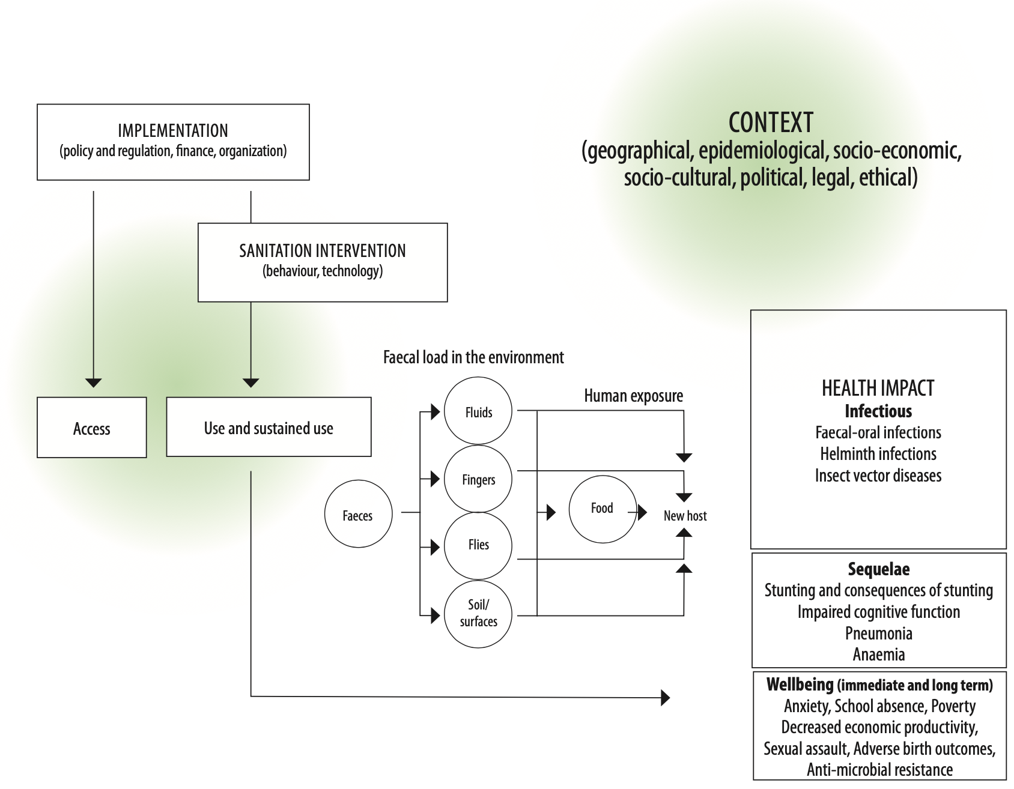
Sanitation impact on health
Pathways through which sanitation influences health
INTRODUCTION

Slide 7
Evidence on effectiveness
Overall, greater access to sanitation is associated with significant lower odds of diarrhoea and other infections.
-Absence of open defecation is associated with healthier populations.
-Evidence of a protective effect of sanitation on infectious diseases and nutrition.
-Evidence of association with wider health outcomes, including cognitive development, personal wellbeing, especially among women and girls.
However, the health impact is lower than expected
INTRODUCTION

Slide 8
Reasons for low health impact
-Many interventions do not reach levels of toilet access and use in the community that are high enough to remove pathogens from the environment.
Disease reduction will not be detected unless the coverage of sanitation use at community level is high (>70%)
-Many sanitation systems do not effectively prevent contamination of the environment (failures in containment, transport, treatment, etc.) hence have limited impact on exposure.
INTRODUCTION
Notes:
However, there are reasons for low health impact

Slide 9
Why are new Guidelines needed?
Evidence on sanitation shows less health impact than expected.
Ministries of Health role in sanitation has declined over the last 50 years.
Sanitation is critical to get out of response-mode (e.g. Cholera), to sustain progress and eliminate disease
There is a lack of public health guidance on how to maximize health gains from sanitation systems (behaviour change, technology, policy, planning & management, disease control).
Notes:
Evaluations of sanitations intervention show less health impact than expected

Slide 10
WHO 2018 Guidelines on Sanitation and Health
Authoritative health-based guidance on sanitation that results in better health.
Evidence · Recommendations · Guidance · Tools · Resources
Objectives
Ensure that sanitation systems are designed and managed safely to protect human health from microbial hazards contained in human excreta.
Maximize the health impacts of sanitation interventions.
Articulate the role of health sector in sanitation.
INTRODUCTION
Notes:
Overall purpose of the guidelines in to promote safe sanitation systems and practices to promote health.

Slide 11
Guidelines structure
Introduction, scope and objectives | Chapter 1: Introduction
Recommendations and actions | Chapter 2: Recommendations and good practice actions
Implementation guidance | Chapter 3: Safe sanitation systems Chapter 4: Enabling safe sanitation service delivery Chapter 5: Sanitation behavior change
Technical resources | Chapter 6: Microbial aspects Chapter 7: Methods Chapter 8: Evidence on the effectiveness and implementation of sanitation interventions Chapter 9: Research needs Annex I: Sanitation system factsheets Annex II: Glossary of sanitation terms
INTRODUCTION

Slide 12
Recommendations
Derived from comprehensive evidence review and wide expert and end user input
1. Ensure universal access and use of toilets that safely contain excreta
Elimination of open defecation.
Prioritize universal access to toilets, while planning for equitable progress.
Entire community coverage with a minimum level of service.
Using demand side and supply side approaches concurrently to ensure adoption and sustained use.
Shared and public toilet facilities can be promoted for households as an incremental step when individual household facilities are not feasible
INTRODUCTION
Notes:
Based on a comprehensive evidence review, 4 recommendations were derived:

Slide 13
Recommendations
Derived from comprehensive evidence review and wide expert and end user input
2. Ensure universal access to safe systems along the entire sanitation service chain
Safety must be ensured along the entire sanitation service chain, including toilet, containment, transport, treatment, end use/disposal.
The selection of technologies and services should be context specific.
Incremental improvement based on local level risk assessment (e.g. Sanitation Safety Planning)
INTRODUCTION

Slide 14
Recommendations
Derived from comprehensive evidence review and wide expert and end user input
3. Sanitation should be addressed as part of locally delivered services and broader development programmes and policies
To increase efficiency and health impact, sanitation should be provided and managed as part of a package of locally delivered services (solid waste, transport, etc).
Sustainability and health impacts through coordination with water and hygiene measures, such as water supply, hygiene, animal waste, child faeces.
INTRODUCTION

Slide 15
Recommendations
Derived from comprehensive evidence review and wide expert and end user input
4. The health sector should fulfil core functions to ensure safe sanitation to protect public health
Increasing health sector engagement in core functions, such as coordination, investment, development of norms and standards (but not taking on functions that are better done by others)
INTRODUCTION

Slide 16
Implementing recommendations
Ensuring that we maximize the health benefit of sanitation interventions
We need to ensure that:
Systems and services are selected to respond to the local context.
Investments and system managements are based on local level risk assessments along the entire sanitation chain.
Incremental improvements are based on local level risk assessment.
Communities, sanitation workers, consumers and farmers are protected.
What we can do as local practitioners?
INTRODUCTION
Notes:
So, what these recommendations mean for us?

Slide 17
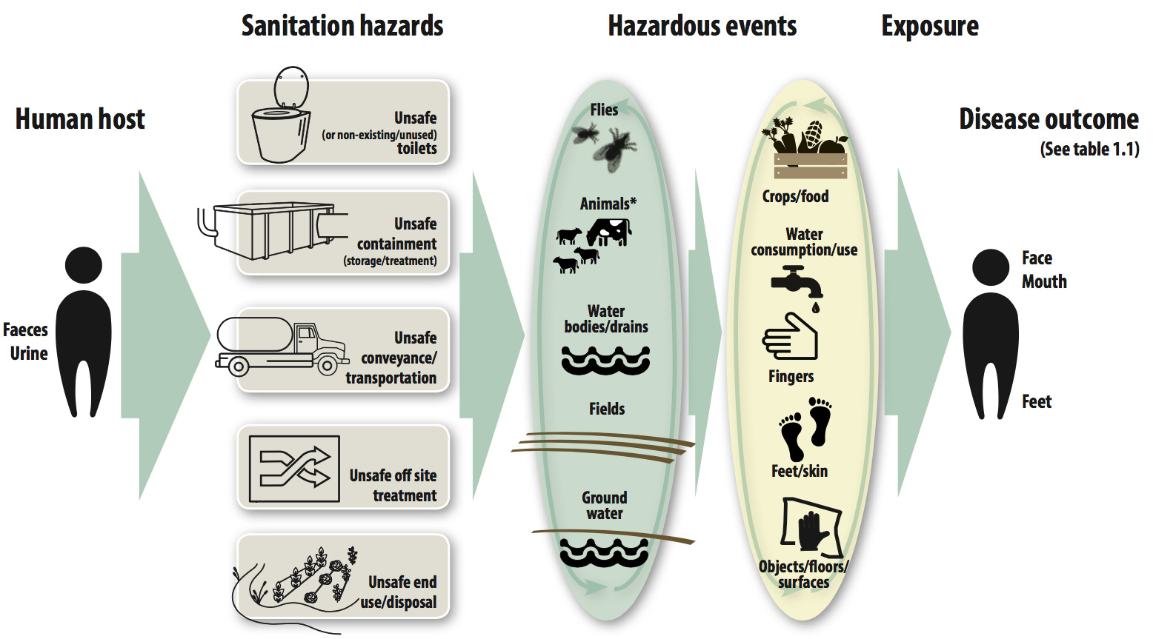
Implementing recommendations
Risk assessment and management
INTRODUCTION
Notes:
How do we do that?
We conduct a risk assessment so we understand…

Slide 18
Sanitation Safety Planning - SSP
WHO recommended approach
SSP is a risk-based management tool for sanitation systems that:
helps with systematically identifying and prioritizing health risks along the sanitation chain;
guides management and investments in sanitation systems according to risk;
identifies operational monitoring priorities and regulatory oversight mechanisms that target the highest risks
SSP provides assurance on the safety of sanitation-related products and services
INTRODUCTION

Slide 19
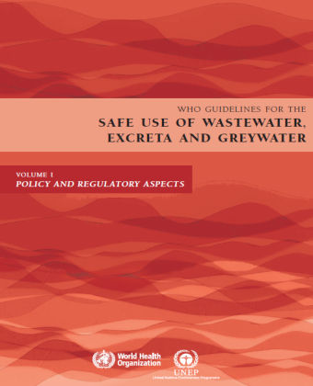
WHO 2006 Guidelines for the safe use of wastewater, excreta and greywater
SSP was first published to make the 2006 WHO Guidelines on reuse more widely adopted.
These guidelines are concerned with the health implications of reusing wastewater and aim to protect the farmers, local communities and consumers, maximizing the health benefits of safe reuse.
Today, SSP is used for the entire sanitation system.
INTRODUCTION

Slide 20
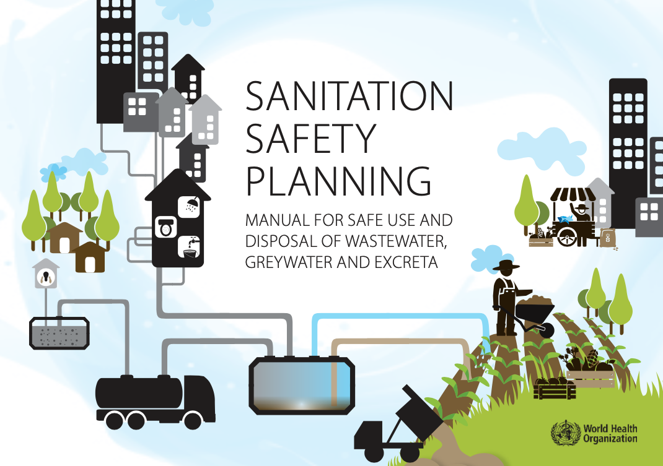
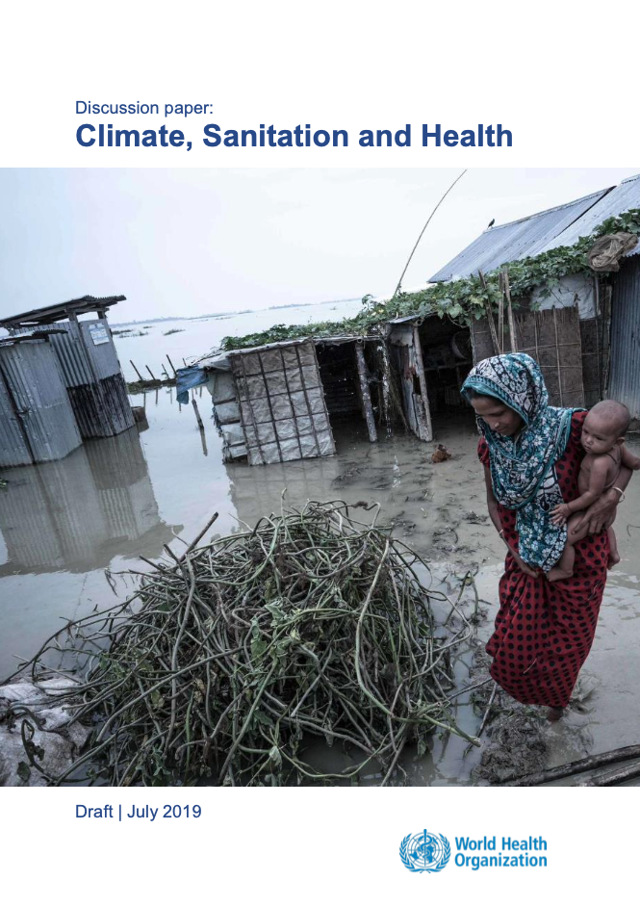
SSP manual – Second Edition, 2022
Key updates in this second edition of Sanitation safety planning include:
simplification of the SSP process;
reorientation to support recommendations on local-level risk assessment and management in the WHO Guidelines on sanitation and health, covering all steps of the sanitation chain, with or without safe end use; and
inclusion of climate risks
Notes:
This edition provides more in-depth information to strengthen climate resilience, including identification of climate-related risks (such as those caused by water scarcity, sea level rise and extreme weather events), and associated management and monitoring options (Kohlitz, 2019). Proactive management is central to SSP. Considering climate impacts improves the preparedness of local authorities for an uncertain future. These principles also apply to other future shocks and emergencies, such as disasters, epidemics and pandemics.

Slide 21
How does SSP works?
Operational, monitoring and management phase
System assessment phase
Carry out a risk–based assessment.
Identify the highest risks.
Identify disease pathway and affected people.
Identify hazards and hazardous events.
Implement control measures to reduce the highest risks.
Identification and prioritization of control measures.
Define monitoring and validation mechanisms.
INTRODUCTION

Slide 22
Benefits of Sanitation Safety Planning
Maximizes health benefits of sanitation interventions
Prioritizes efforts
Sets a plan for incremental improvements
Target limited resources to the highest health risks
Coordinates efforts
“SSP brings back the sanitation focus to health”
INTRODUCTION

Slide 23
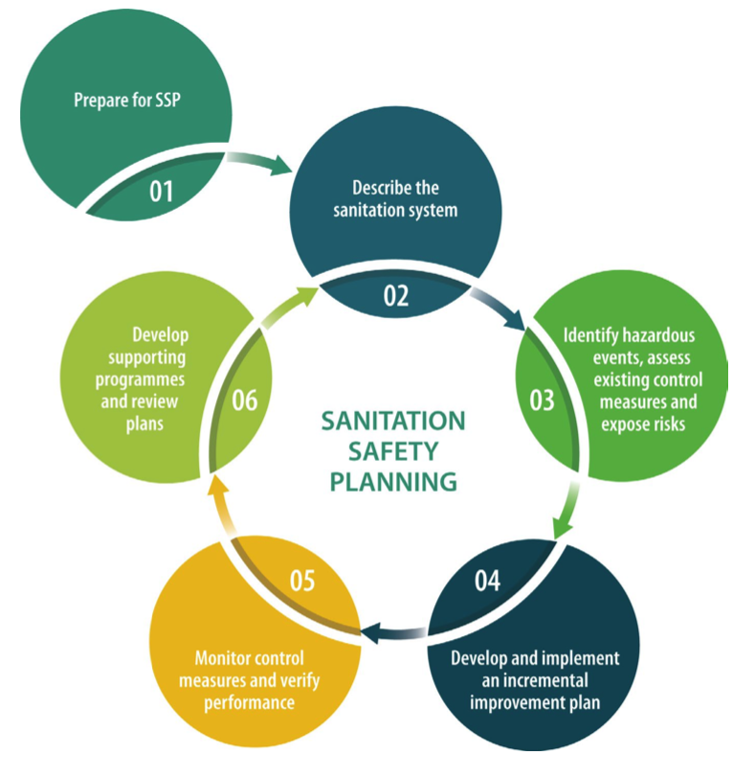
SSP Modules
Where should SSP be done? Who should be involved and what are their roles?
How does the sanitation service chain work?
What could go wrong? What existing control measures are in place and how effective are they? How significant are the risks?
How should SSP be supported? How can we adapt to changes?
Is the system operating as intended?
What needs to be improved and how?
INTRODUCTION

Slide 24
Results of Sanitation Safety Planning
Products
Outcomes
Maximization of health impact of sanitation solutions.
Progressive implementation towards sanitation targets.
Built local capacities of stakeholders, so they initiate and maintain the risk-based sanitation management approach.
Prioritized, incremental improvement plan.
Operational monitoring plan for regular monitoring and periodic verification.
INTRODUCTION

Slide 25
SSP in a nutshell
is the WHO recommended approach for local risk assessment and management for sanitation systems;
helps to maximize health benefits and minimize health risks;
guides efforts to where it will have the most impact;
helps to coordinate efforts of the many stakeholders along the sanitation chain, and stimulates policy dialogue.
INTRODUCTION

Slide 26
Group Work
Let’s divide ourselves in groups per table
You and your group are part of an Expert Consultation Group
You are going to provide recommendations to the SSP Steering Committee
You should suggest implementation measures that should be prioritized in Coppentown, a small community in the country of Sanitola
INTRODUCTION

Slide 27
Welcome to Coppentown, Sanitola
Municipality of 50,000 pp in the outskirts of a metropolitan city
Photo: L. Barreto Dillon
INTRODUCTION

Slide 28
Coppentown case study
Water supply; surface water source upstream
Photo: L. Barreto Dillon
INTRODUCTION

Slide 29
Coppentown case study
20% of the population is connected to a combined sewer system
Photo: 20 minutos
Photo: E. Terán
INTRODUCTION

Slide 30
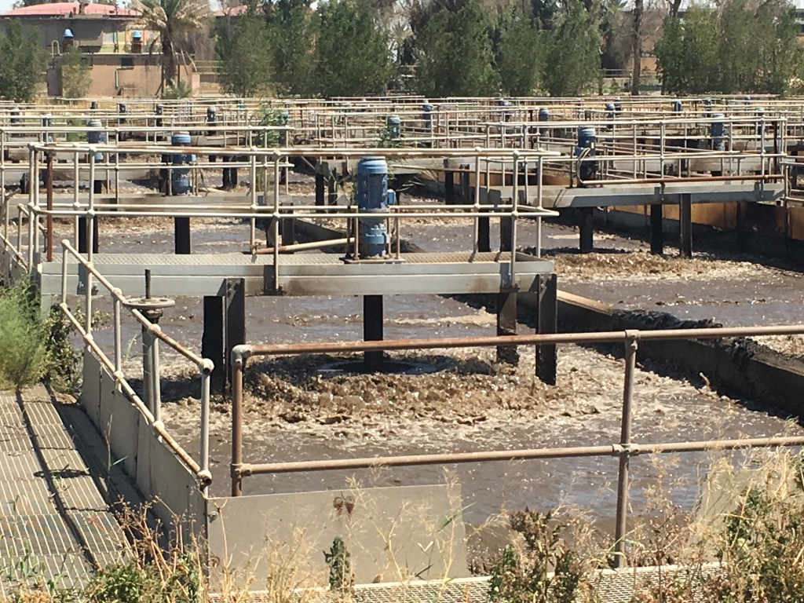
Coppentown case study
Mixed wastewater is transported by gravity to a conventional WWTP
Photo: L. Barreto Dillon
INTRODUCTION

Slide 31
Coppentown case study
Treated wastewater is disposed in the river
Photo: L. Barreto Dillon
INTRODUCTION

Slide 32
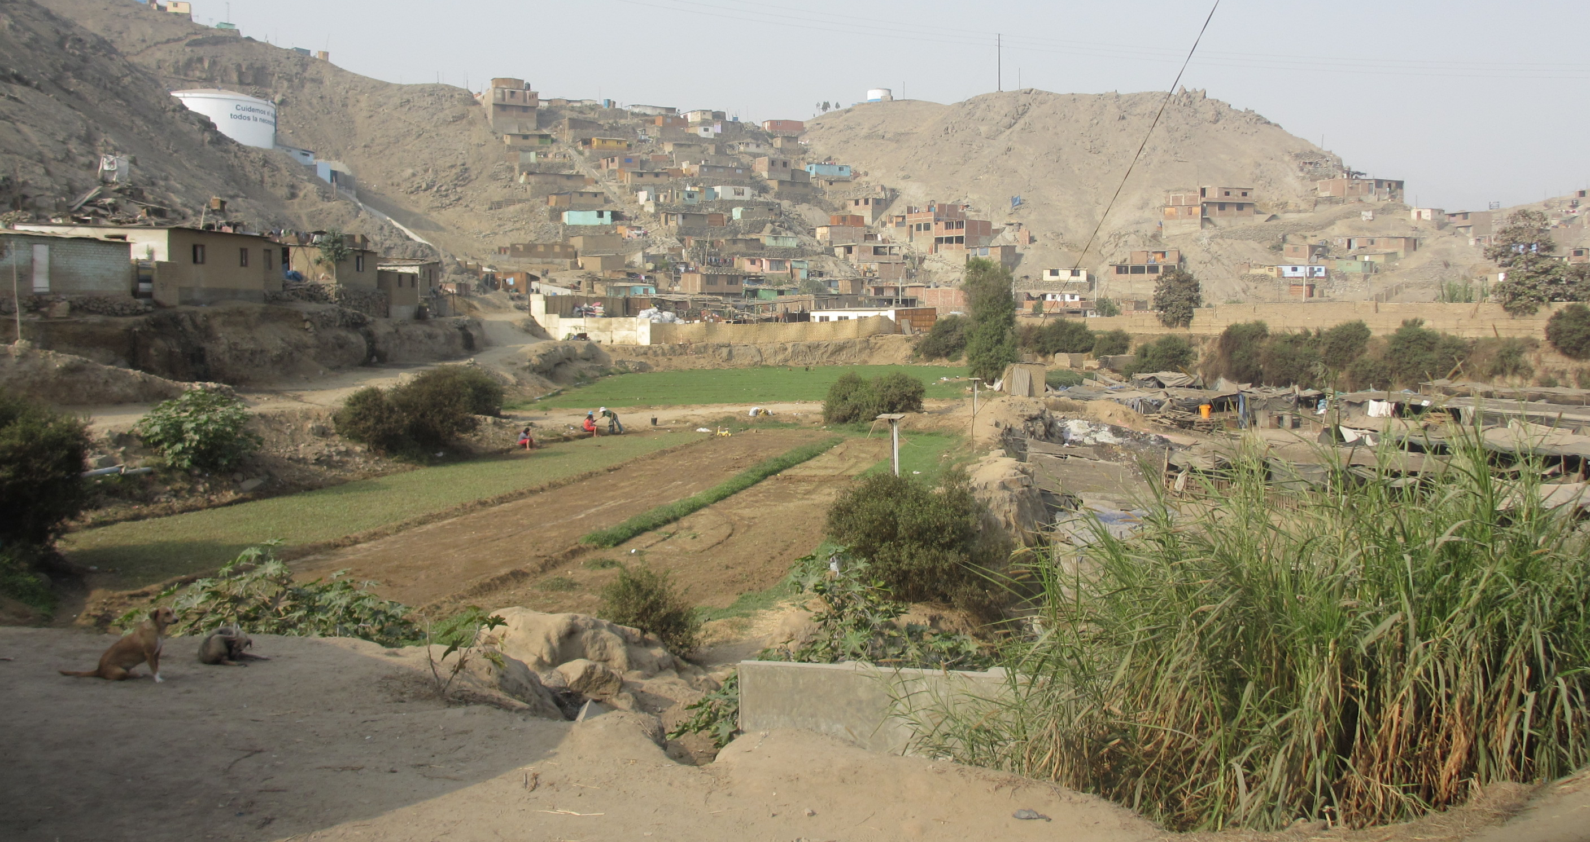
Coppentown case study
Irrigation for neighbouring farmers
Photo: L. Barreto Dillon
INTRODUCTION

Slide 33
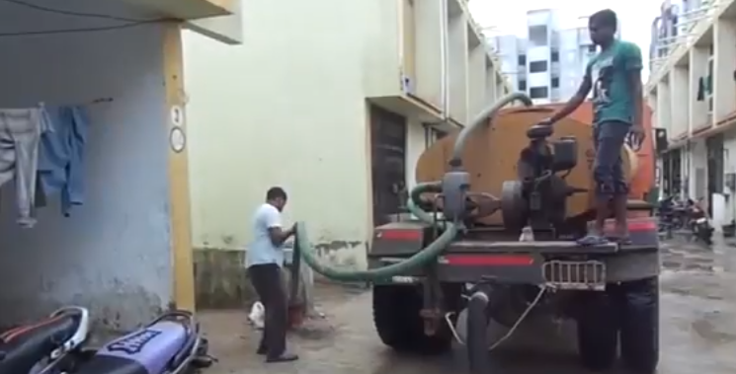
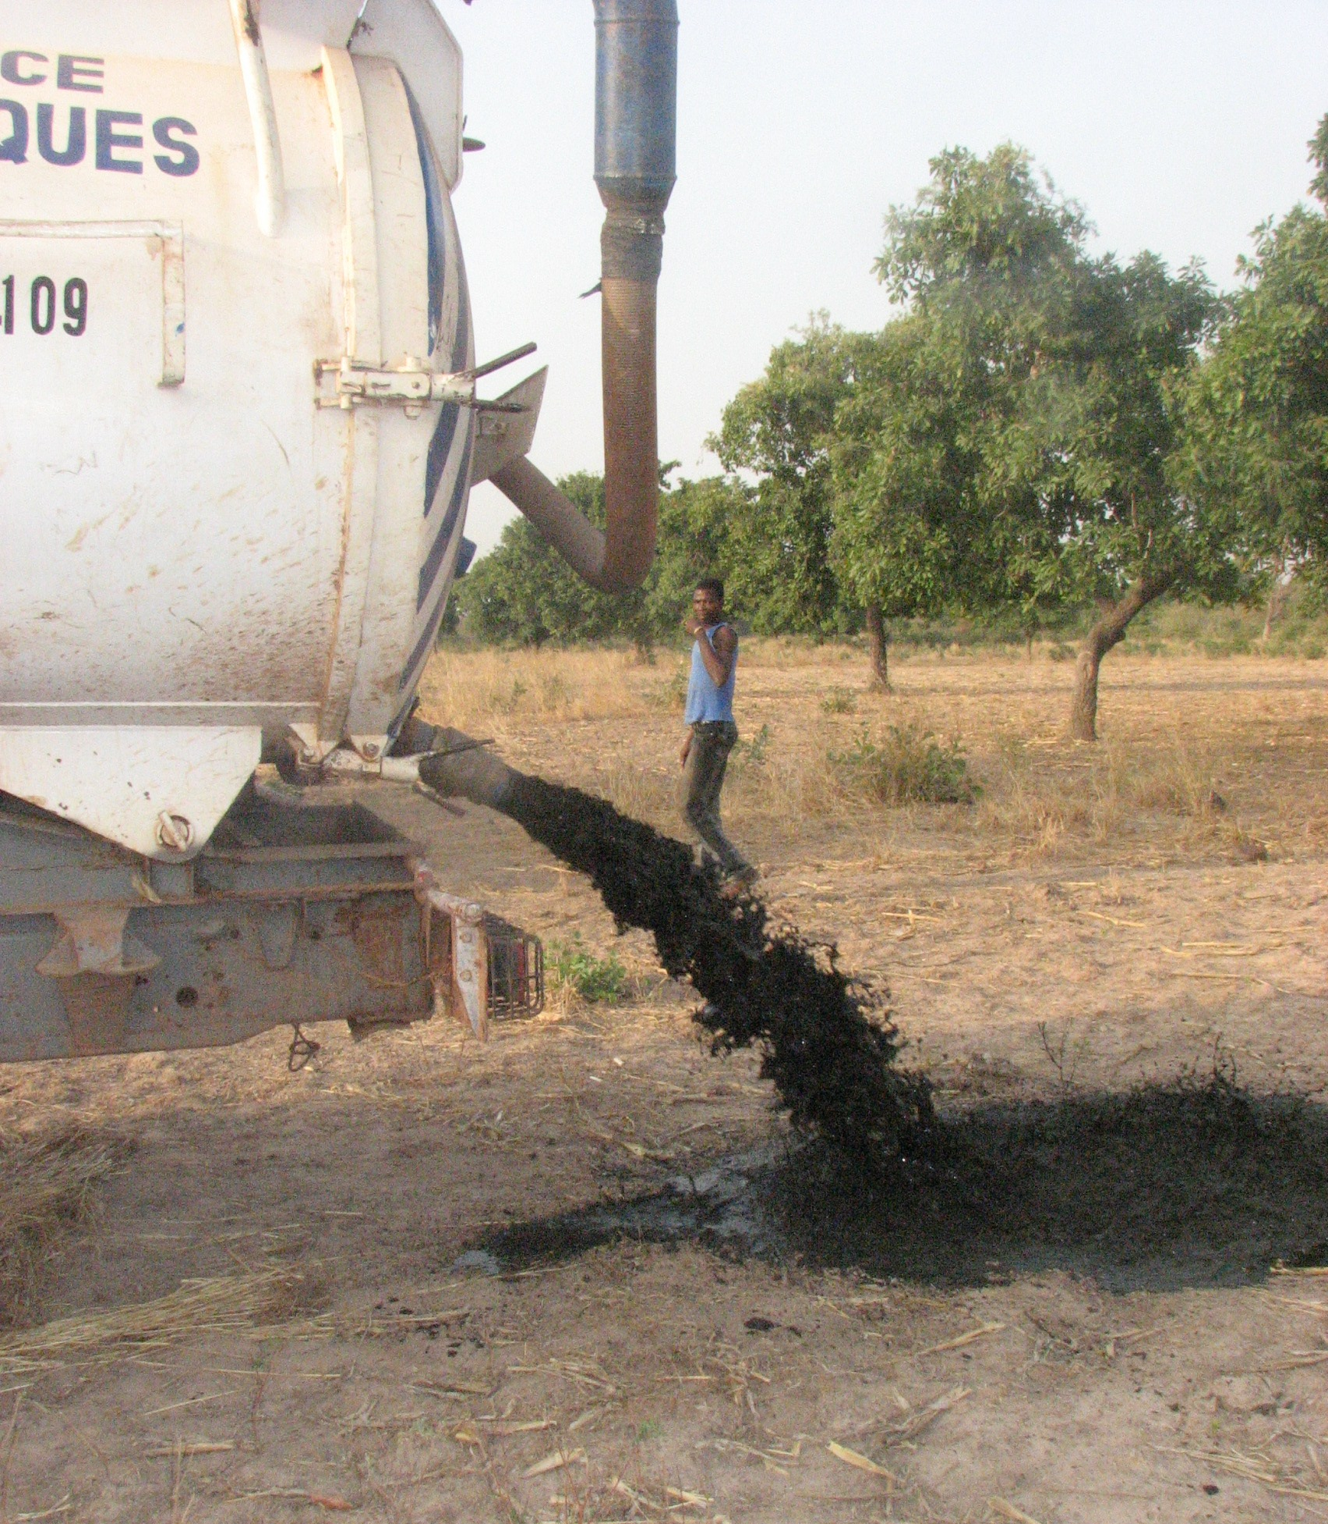
Coppentown case study
80% of the population uses on-site sanitation
Source: Urban Management Centre India (up), The Hindo (down)
Source: SuSanA Secretariat, Flickr
INTRODUCTION

Slide 34
Coppentown case study
Reuse of faecal sludge
Source: www..fsmindia.org
INTRODUCTION

Slide 35
Coppentown case study
Evidences
Kick-off of SSP
Steering Committee was created.
SSP team has been working on it for the past months.
SSP aims to ensure that the entire sanitation service chain is safely managed, diminishing the incidence and impact of sanitation-related diseases of communities, workers, farmers and consumers.
20% of Coppentown inhabitants are affected by gastro-intestinal disorders.
Farmers report skin diseases.
Incidence of infection diseases among sanitation workers.
INTRODUCTION

Slide 36
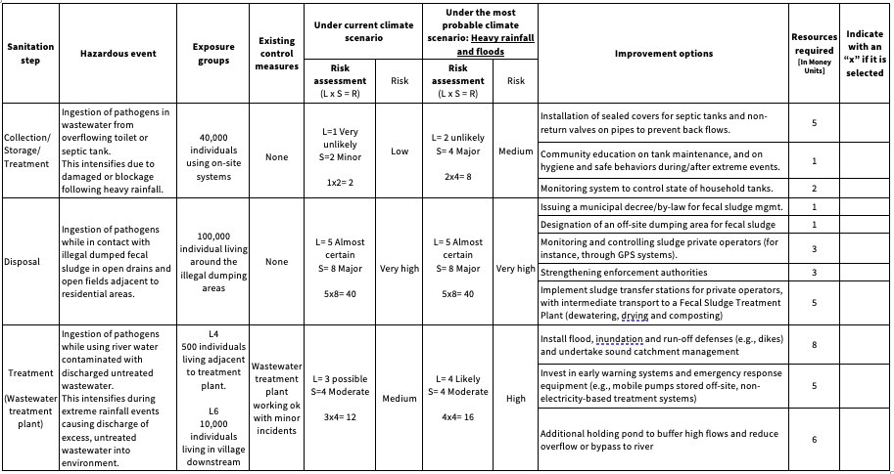
Coppentown case study
INTRODUCTION

Slide 37
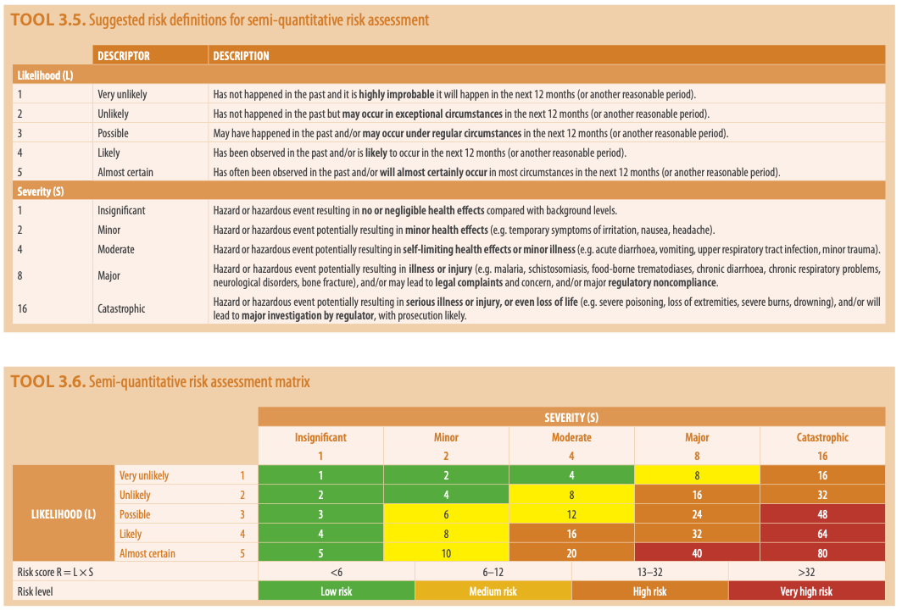
Coppentown case study
SSP Manual
Page
58
Semi-quantitative Risk Assessment Method
Likelihood (L) x Severity (S) = Risk
INTRODUCTION

Slide 38
Group Work
You have received the risk assessment table prepared by the SSP local team
Knowing that the Steering Committee only has 10 Money Units, which improvement options should be prioritized?
Why?
In your participants worksheets you will find this exercise at introductory session.
INTRODUCTION

Slide 39
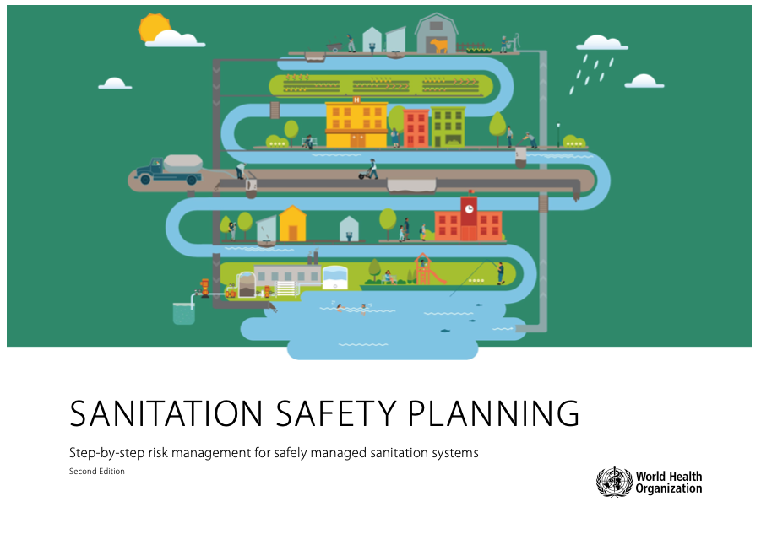
Back to plenary
Let’s us discuss
How can the local risk assessment help to prioritize sanitation interventions?
How would you describe the value of Sanitation Safety Planning?
INTRODUCTION

Slide 40
THANK YOU

