Slide 1
SSP Manual
Pages
9 to 19
MODULE 1:
PREPARE FOR SANITATION SAFETY PLANNING

Slide 2
1.1 Define the SSP area and lead organization
1.2 Assemble the SSP team
1.3 Establish SSP priorities
Agreed SSP area, leadership and priorities
A multidisciplinary team representing the sanitation chain for development and implementation of SSP.
PREPARE FOR SANITATION SAFETY PLANNING

Slide 3
SSP Manual
Pages
10 to 12
STEP 1.1
Define the SSP area and lead organization
This step helps to drive and sustain the SSP process, and ensures that the scope is manageable and understood by all stakeholders.
SSP could be carried out…
… within the service area of a sanitation utility or a service provider
… within an administrative area

Slide 4
STEP 1.1
Define the SSP area and lead organization
When SSP is initiated by a municipality, district or administrative unit
The SSP area is determined by the area administered by the local authority.
All the existing sanitation systems and all sanitation steps within the sanitation service chain should be included.
The lead organization should be the local authority with the mandate for oversight of sanitation service provision.
A team leader should be appointed to drive the SSP process
SSP Manual
Example 1.1
Page 11

Slide 5
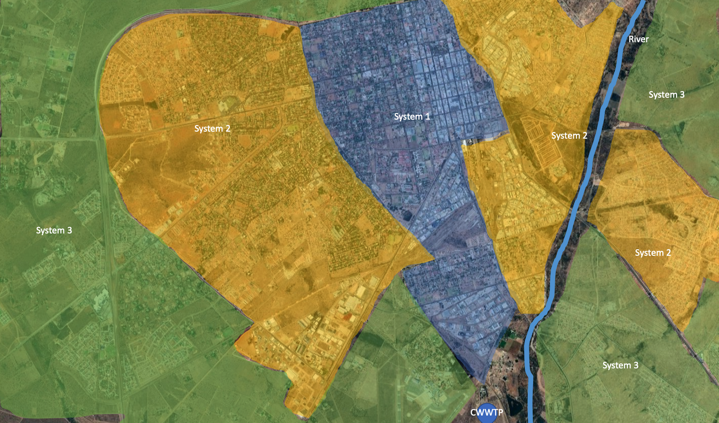
STEP 1.1
Define the SSP area and lead organization
EXAMPLE: When SSP is initiated by a municipality, district or administrative unit (1/3)
-System 1: Flush toilets with sewerage and offsite wastewater treatment (area in blue)
-System 2: Flush toilets with septic tanks and effluent infiltration and offsite fecal sludge disposal (area in yellow)
-System 3: Dry or flush toilets with onsite disposal or offsite disposal (area in green)

Slide 6
STEP 1.1
Define the SSP area and lead organization
When SSP is implemented by sanitation service providers
SSP Manual
Examples 1.2
to 1.4
SSP is implemented to ensure that:
-the sanitation systems under their responsibility are safely operated.
-their products (e.g. treated water, dried sludge, fertilizers, etc.) do not pose health risks during disposal or use.

Slide 7
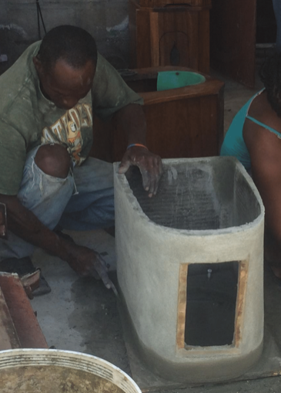
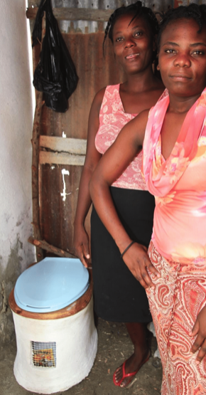
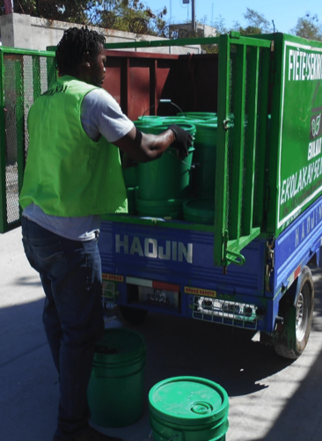
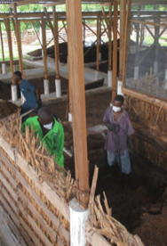
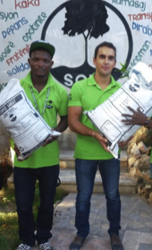
STEP 1.1
Define the SSP area and lead organization
EXAMPLE: When SSP is implemented by sanitation service providers
SSP Manual
Example 1.3
Page 11
Container-based sanitation (CBS) system in a densely populated area in Cap Haitian in Haiti: area and lead organization
Photos: Emmanuel Antoine, SOIL
TEAM LEADER: A program officer

Slide 8
STEP 1.1
Define the SSP area and lead organization
Two or more administrative areas are involved:
SSP Manual
Example 1.5
Page 12
Sanitation activities are in different administrative areas. For example:
-A wastewater treatment plant (WTP) is in an urban area.
-The WTP effluent is reused in agricultural lands located in a different administrative area and overseen by a different authority.
TEAM LEADER: A coordination team

Slide 9
SSP Manual
Pages
12 to 17
STEP 1.2
Assemble the SSP team
To ensure broad stakeholder commitment to design and implement the entire SSP process.
In sanitation systems this is particularly important, as responsibility along the sanitation chain is seldom the responsibility of one organization.
SSP requires clear and active leadership to succeed.

Slide 10
STEP 1.2
Assemble the SSP team
Appoint a SSP team leader
The team leader should have:
Organizational and interpersonal skills
A team leader should be identified and appointed at the outset who will play a critical role in:
-communicating about SSP;
-mobilizing stakeholders; and
-leading development, implementation and updates of the SSP.
Authority
Time
Sufficient knowledge
If the skills are not available locally: explore opportunities for external support

Slide 11
SSP Manual
Example 1.7
Page 14
STEP 1.2
Assemble the SSP team
Form the SSP team
The team should be able to:
The team should include:
managers within the relevant organizations
Key representatives of organizations in charge of sanitation steps outside the responsibilities of the lead institution;
people with public health expertise;
representatives of key exposure groups;
External experts and independent members (universities, etc.)
Recognize all the hazards and hazardous events
Rate the risk
Drive improvements in all areas of sanitation

Slide 12
STEP 1.2
Assemble the SSP team
Mix of skills in technical, health and climate topics
Health Authorities (e.g. Environmental Health and Public Health Authorities)
WHO Guidelines on Sanitation and Health, Recommendation 4:
The health sector should fulfil core functions to ensure safe sanitation to protect public health. Mandate of local health authorities includes:
Health protecting norms and standards
Health surveillance and response
Sanitation in health programme delivery
Sanitation behaviour change
WHO Guidelines
Chapter 2
Pages 18-20
Climate change specialists
Climatology
Hydrology
Disaster or emergency management

Slide 13
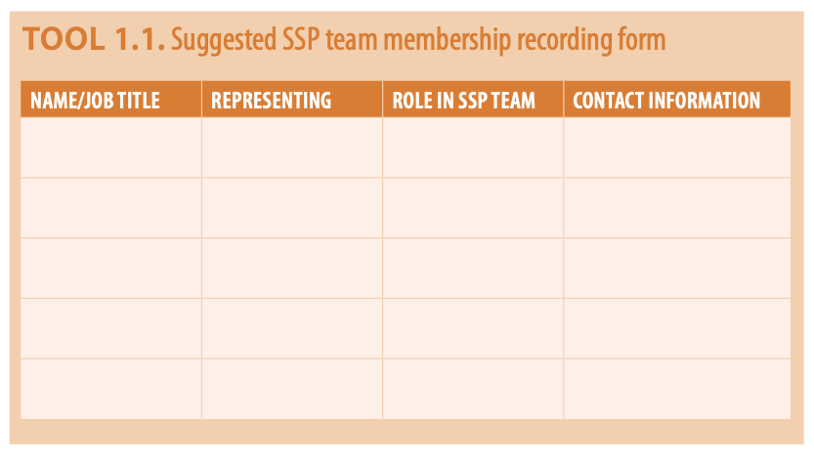
SSP Manual
Tool 1.1
Page 15
STEP 1.2
Assemble the SSP team
Define and record roles of the individuals on the team
Responsibilities should be divided among the team members at the start of the process, and roles clearly defined and recorded.

Slide 14
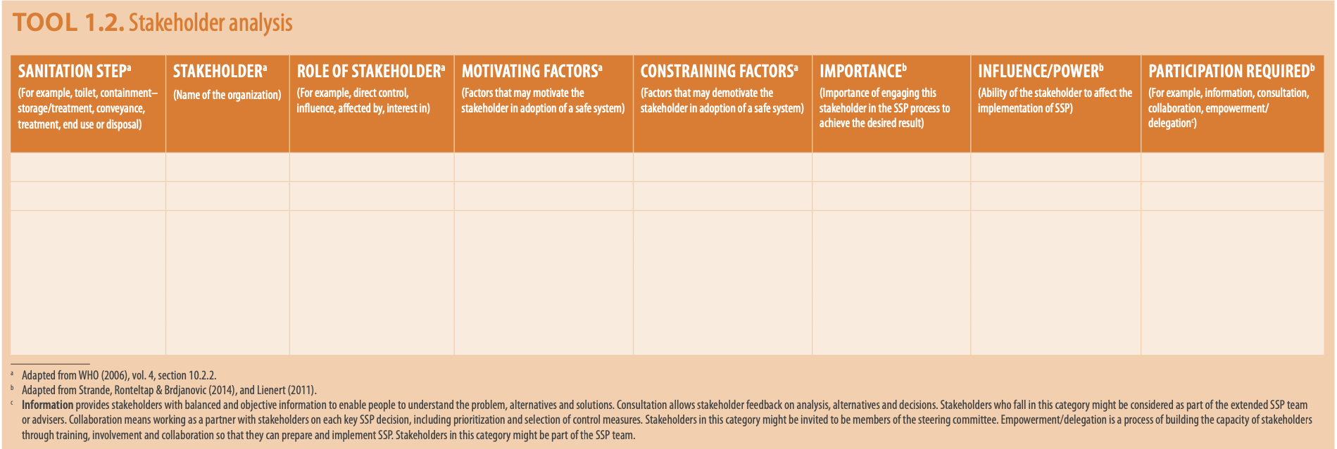
SSP Manual
Tool 1.2
Page 16
STEP 1.2
Assemble the SSP team
Stakeholder analysis for large or complex SSPs
Process of identifying and characterizing stakeholders, and planning for their participation.
Stakeholders are individuals or organizations that: have direct control, have some influence, are affected by and are interested in sanitation systems.

Slide 15
SSP Manual
Example 1.9
Page 17
STEP 1.2
Assemble the SSP team
SSP Steering Committee for large or complex SSPs
Representative body with combined oversight of each step of the sanitation service chain, from toilet, including on-site containment, to conveyance through sewers or vacuum trucks, to treatment and disposal or reuse.
Senior representatives from relevant authorities
Senior representatives of the implementation partners
WHO Guidelines on Sanitation and Health :
Establish local government coordination groups with senior representation from all relevant local government departments and implementation partners to align and coordinate sanitation activities.
WHO Guidelines
Chapter 2
Pages 21-22

Slide 16
STEP 1.2
Assemble the SSP team
SSP Steering Committee for large or complex SSPs
Steering committees provide:
Leadership and oversight of the entire process.
Agreed priority areas for SSP.
Engagement with, and get commitment of, senior management of the lead organization.
Secured financial and resource commitment.
Policy dialogue and amendment as needed to create an enabling environment for safe sanitation service delivery.

Slide 17
STEP 1.2
Assemble the SSP team
Management and financial considerations
The SSP effort will require an in-kind commitment of time and some direct costs during the preparation phase for:
sampling and testing
data collection
field investigations
Management support will be needed for the SSP process to allocate staff time and any start-up funding needed

Slide 18
SSP Manual
Pages
17 to 19
STEP 1.3
Establish SSP priorities
This step establishes the priority sanitation challenges for SSP and makes the SSP process manageable.
Risk-based tools can be used to analyse the situation, to identify and reach agreement on SSP priorities:
Excreta flow diagrams (SFDs)
The SaniPath Exposure Assessment Tool

Slide 19
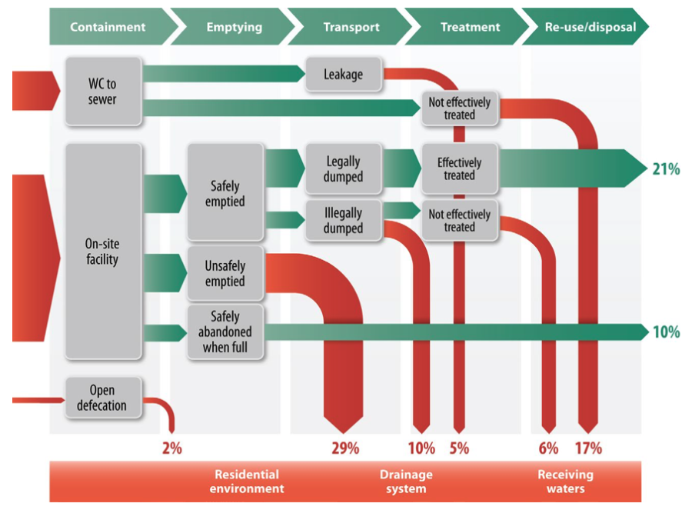
STEP 1.3
Establish SSP priorities
Excreta flow diagrams (SFD)
These help to establish priorities by graphically showing proportions of excreta in a city or town that are not safely managed at each step of the sanitation chain:
SSP Manual
Guidance Note
1.2. Page 18
Red or green arrows signal where the greatest risks lie and help city stakeholders identify the highest risks for management using SSP
Source: Blackett, Hawkins & Heymans (2014) (example of an SFD in Dakar, Senegal).

Slide 20
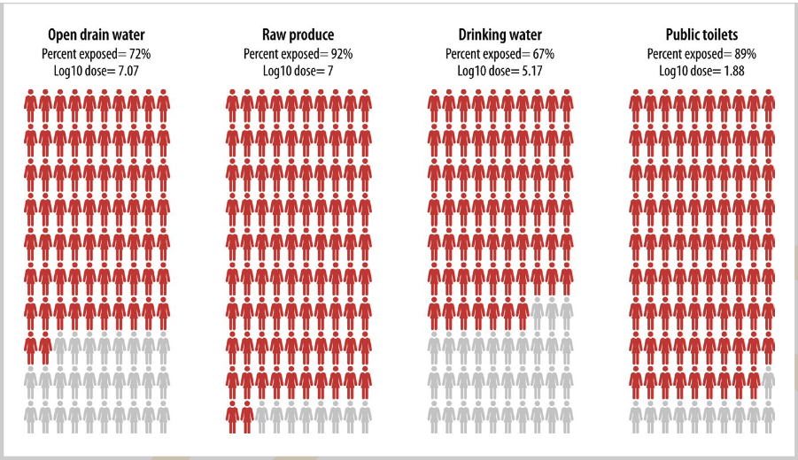
STEP 1.3
Establish SSP priorities
The SaniPath Exposure Assessment Tool
This helps to establish priorities by identifying the primary pathways (e.g. open drain, produce, drinking-water) of exposure and the magnitude of contamination in a locality.
SSP Manual
Guidance Note
1.3. Page 19
People plots allows easy visual comparison of exposure across different pathways, neighbourhoods or populations. Each red figure represents 1% of the population that is exposed to faecal contamination.
Source: For more information, visit the Sanipath Portal (https://www.sanipath.org) hosted by the Center for Global Safe WASH at Emory University

Slide 21
WHO Guidelines
Chapter 2
Pages 11-16
STEP 1.3
Establish SSP priorities
WHO Guidelines recommendations
1. Universal safe toilets that contain excreta
2. Safe sanitation chain
Prioritize:
Areas with high frequency of open defecation.
Communities where toilets are poorly constructed, unsafe and do not safely contain excreta.
Entire communities: everyone should be using a toilet to achieve health gains.
Include:
Shared and public toilets, in case household level access is not possible.
Schools, health care facilities, workplaces and public places.
Include:
Full sanitation chain from waste generation to reuse or disposal: toilet, containment, transport, treatment, end use/disposal.
All waste streams at all points of the sanitation system, in particular the waste streams that receive inadequate or unknown treatment (for instance, faecal sludge).
Consider:
Sanitation workers, who are at high risk from faecal pathogens exposure.

Slide 22
STEP 1.3
Establish SSP priorities
Other considerations:
Districts and neighbourhoods with high reported or suspected sanitation- related diseases.
Communities where toilets are poorly constructed, unsafe and do not safely contain excreta or drainage systems are inadequate.
Nonregulated sanitation service chains (e.g. faecal sludge management), and waste streams that receive inadequate or unknown treatment.
Sanitation systems that historically, or can be envisaged to, have a high susceptibility to climate-related events (e.g. sewer overflows near recreation areas or water supplies, overflowing of pit latrines).
Water supply catchments and intakes affected by wastewater, excreta or greywater.
Areas with high formal or informal wastewater use activities (e.g. agriculture, aquaculture).

Slide 24
Module 1: Prepare for SSP
Step 1.1. Define the SSP area and lead organization
SSP area
The SSP area is determined by the territorial division covered by the Newtown municipality.
The two existing sanitation systems and all sanitation steps within the sanitation service chain are considered.
Lead organization
Newtown Sanitation Department (NSD)
Step 1.2. Assemble the SSP team
SSP team leader
Head of Planning of the NSD
SSP core team
Senior engineer who oversees system 1, a senior engineer who monitors system 2, and an Environmental Health Officer who coordinates environmental health programmes in Newtown.

Slide 25
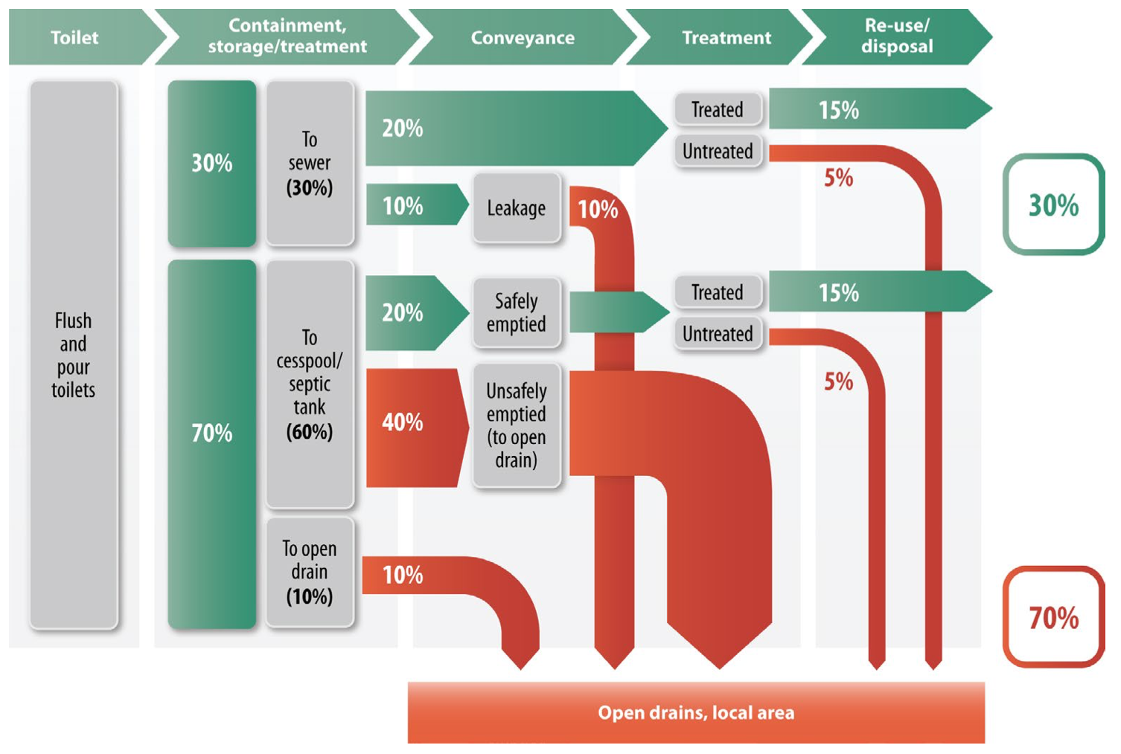
Step 1.1. Define the SSP area and lead organization
The SSP team decided to prioritize system 2 (flush toilets with septic tanks and effluent infiltration, and off-site faecal sludge disposal).

Slide 26
Applying Module 1
Use participant’s worksheet:
Module 1
Within your groups:
Define the area in which you will develop the SSP during this training.
Describe the SSP area.
Decide who should be the leader
Which persons should be in the SSP team?
Work as a group, but record on your individual worksheets.

Slide 27
MODULE 1:
PREPARE FOR SANITATION SAFETY PLANNING

