Slide 1
-PART 1-
SSP Manual
Pages
21 to 32
MODULE 2:
DESCRIBE THE SANITATION SYSTEM

Slide 2
2.1 Map the system
2.2 Characterize the system flows
2.3 Identify exposure groups
2.4 Gather supporting information
2.5 Confirm the system description
A map and description of the sanitation system.
An understanding of the constituents (excreta and mixed waste) in flows at all steps of the sanitation system.
Identification and characterization of exposure groups.
An understanding of the factors affecting the performance and vulnerability of the system
A compilation of all other relevant information.
DESCRIBE THE SANITATION SYSTEM

Slide 3
STEP 2.1
Map the system
To understand the source and path of flows through the system. This is critical in the later assessment of exposure groups at risk.
WHO Recommendations
WHO Guidelines
Chapter 2
Pages 11-16
Recommendation 2: Ensure universal access to safe systems along the entire sanitation service chain.
Consider full sanitation chain from waste generation to reuse or disposal: toilet, containment, transport, treatment and end use/disposal.

Slide 4
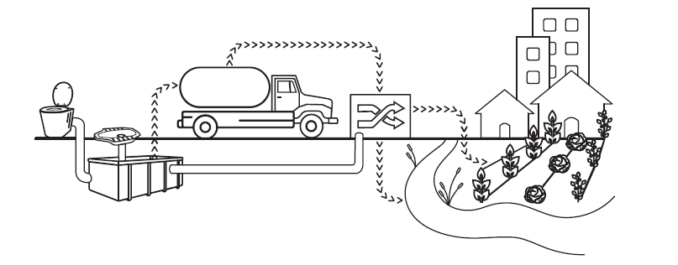
STEP 2.1
Map the system
WHO Guidelines
Chapter 3
Pages 29-58
WHO Recommendations – Chapter 3
Safe sanitation systems
Sanitation systems are a combination of technologies and services that, when linked and properly managed, can form a safe chain.

Slide 5
WHO Guidelines
Chapter 3
Page 31
STEP 2.1
Map the system
Toilet
User interface with the sanitation system, where excreta is captured, and can incorporate any type of toilet seat or latrine slab, pedestal, pan or urinal.
Dry Toilet
Urine Diverting Dry Toilet
Pour-Flush Toilet
Flush Toilet

Slide 6
WHO Guidelines
Chapter 3
Page 34
STEP 2.1
Map the system
Containment-storage/
treatment
Single VIP
Dehydration Vaults
Septic Tank
Composting Chamber
Urine storage tanks
Only relevant to non-sewered sanitation systems and refers to the container, usually located below ground level, to which the toilet is connected.

Slide 7
WHO Guidelines
Chapter 3
Page 39
STEP 2.1
Map the system
Conveyance/emptying
transport
Conventional Gravity Sewer
Small-Bore Sewer
Simplified Sewers
Human-Powered Emptying and Transport
Motorised Emptying and Transport
Movement of wastewater or faecal sludge from a containment technology to off-site treatment, and/or end use/ disposal.

Slide 8
WHO Guidelines
Chapter 3
Page 44
STEP 2.1
Map the system
Treatment
Technologies for containment and storage/treatment of wastewater and faecal sludge on-site.
Technologies for the treatment of wastewater (containing one or more of blackwater, brown water, greywater or effluent) treated off-site.
Technologies for the treatment of sludge off-site.
Process(es) that changes the physical, chemical and biological characteristics or composition of faecal sludge or wastewater so that it is of a quality that is fit for purpose for the intended next use or disposal.

Slide 9
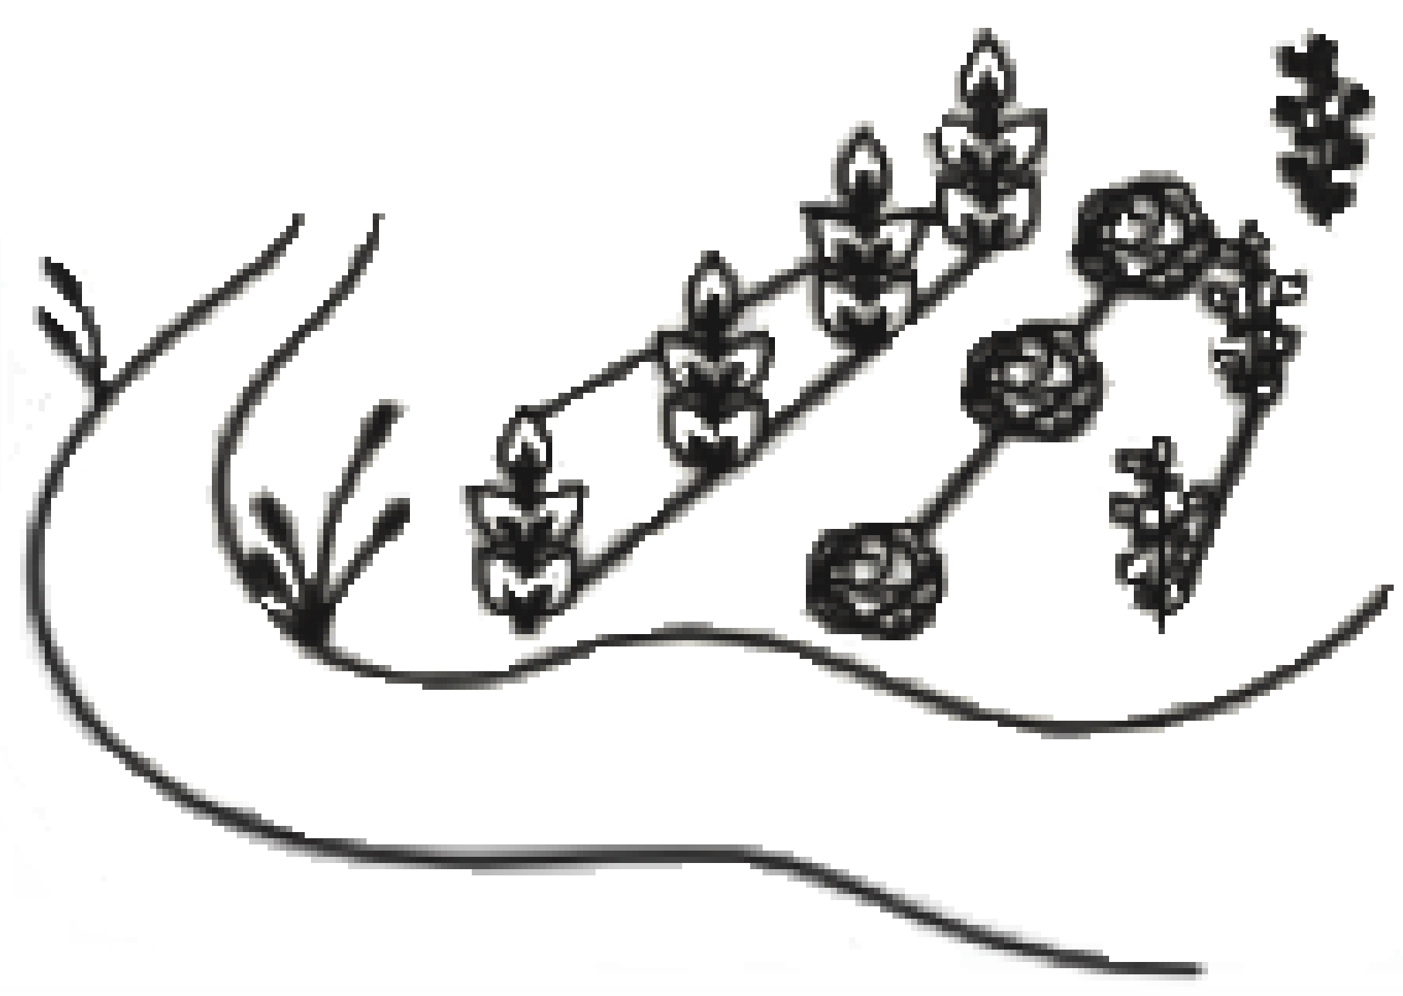
WHO Guidelines
Chapter 3
Page 49
STEP 2.1
Map the system
Application of compost
Irrigation
Aquaculture
Soak pit
Leach field
Land application
Surface disposal
Reuse / disposal
Technologies and methods by which treatment products are ultimately discharged into the environment, either as end use products or reduced-risk materials.

Slide 10
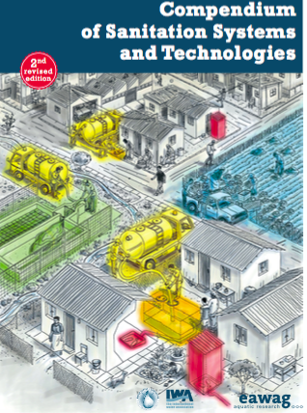
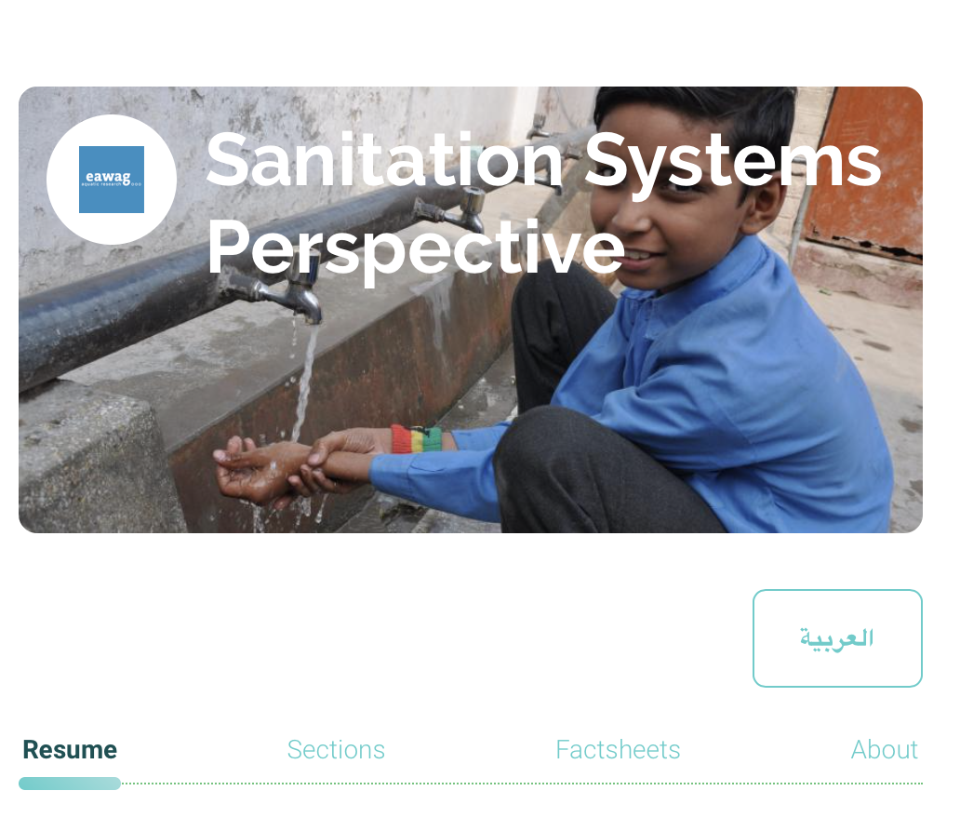
STEP 2.1
TIP
For more information about sanitation systems and technologies
Map the system
Compendium of sanitation systems and technologies
TILLEY, E.; ULRICH, L.; LUETHI, C.; REYMOND, P.; ZURBRUEGG, C. (2014): Compendium of Sanitation Systems and Technologies. 2nd Revised Edition. Duebendorf, Switzerland: Swiss Federal Institute of Aquatic Science and Technology (Eawag).
www.eawag.ch
Sustainable Sanitation and Water Management Toolbox
https://sswm.info/perspective/sanitation-systems-perspective

Slide 11
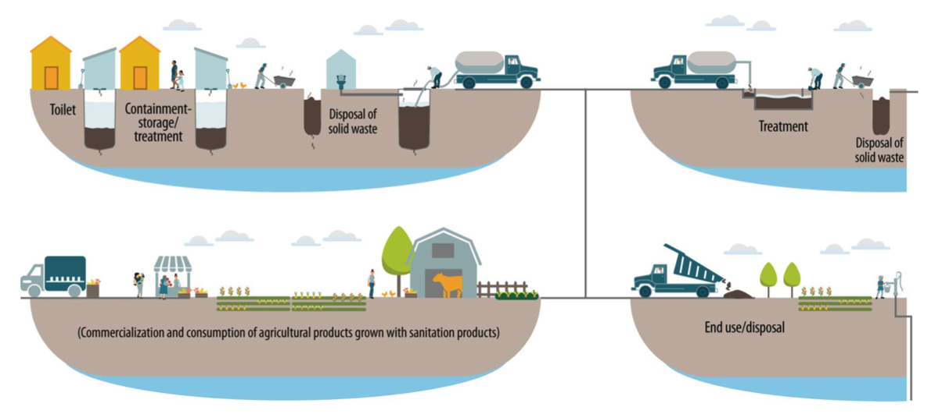
STEP 2.1
Map the system
Simplified drawings or free-flowing sketches
SSP Manual
Example 2.1
Page 25

Slide 12
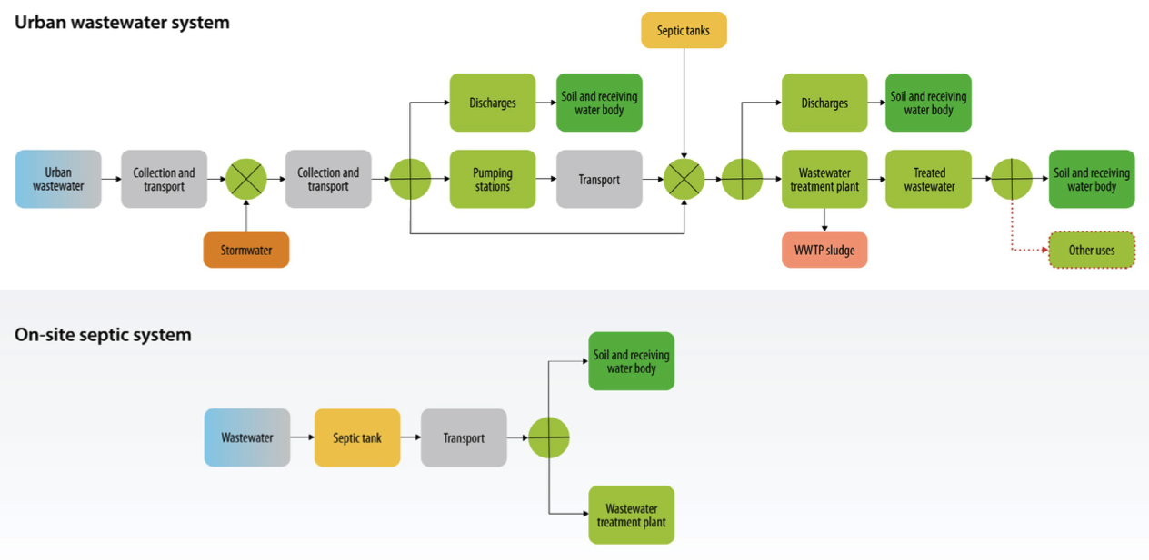
STEP 2.1
System process diagram
Map the system
EXAMPLE: Map of system consisting of a dry or flush toilet with pit, liquid effluent infiltration and off-site treatment of faecal sludge for reuse
SSP Manual
Example 2.2
Page 26

Slide 13
STEP 2.1
TIP
Map the system
Checklist of issues to consider when developing a system map
Identify all the steps of the sanitation service.
Include all sources of system flows.
Ensure that the fate of all used and disposed of parts of the system flows have been accounted for.
Identify areas in which faecal sludge is being dumped legally and illegally.
Identify areas where open defecation is known to occur.
Identify public and shared toilets that serve a considerable proportion of the community.
Include drinking-water sources where this is relevant to the system or could be affected by the sanitation system.
SSP Manual
Guidance Note
2.1
Page 24

Slide 14
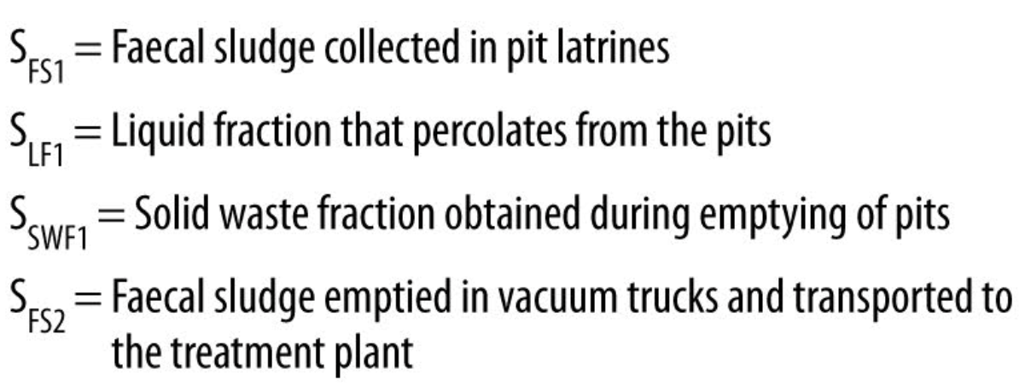
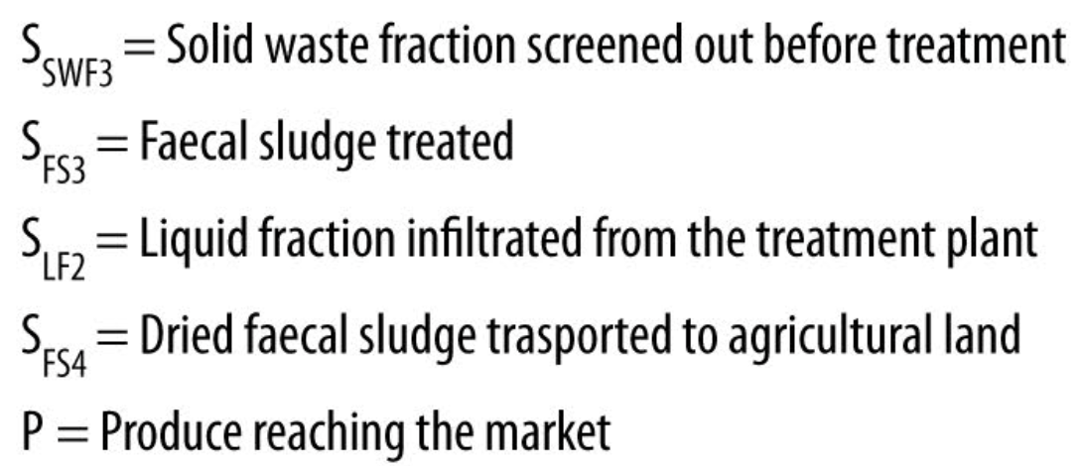
STEP 2.1
Establish the path of different of system flows through the sanitation system
Map the system

Slide 15
STEP 2.2
Characterize system flows
This step involves collecting key quantitative information, and examining the microbiological, physical and chemical constituents of flows along the sanitation system.
SSP Manual
Guidance Note
2.2
Page 28
Factors to consider when characterizing system flows
Focus on excreta-related inflows and effluents in each step of the system.
Key information:
flow rates, where known, including for different seasons, or different levels of rainfall, in the context of potential climate change impacts; and
capacity or design loading of components, where known (e.g. treatment plant flow or loading limits, transfer system capacities).

Slide 16
STEP 2.2
Characterize system flows
SSP Manual
Tool 2.1
Page 29
Use the template to characterize system flows:

Slide 17
STEP 2.2
Characterize system flows
Hazards
A biological, chemical or physical constituent that can cause harm to human health.
Biological
Chemical
Physical
Microbiological pathogens:
Bacteria
Viruses
Protozoa
Helminths
Vector-borne
Heavy metals in sludge or biosolids
Herbicides and pesticides
Sharps (e.g. needles)
Odours
Physical injury from equipment

Slide 18
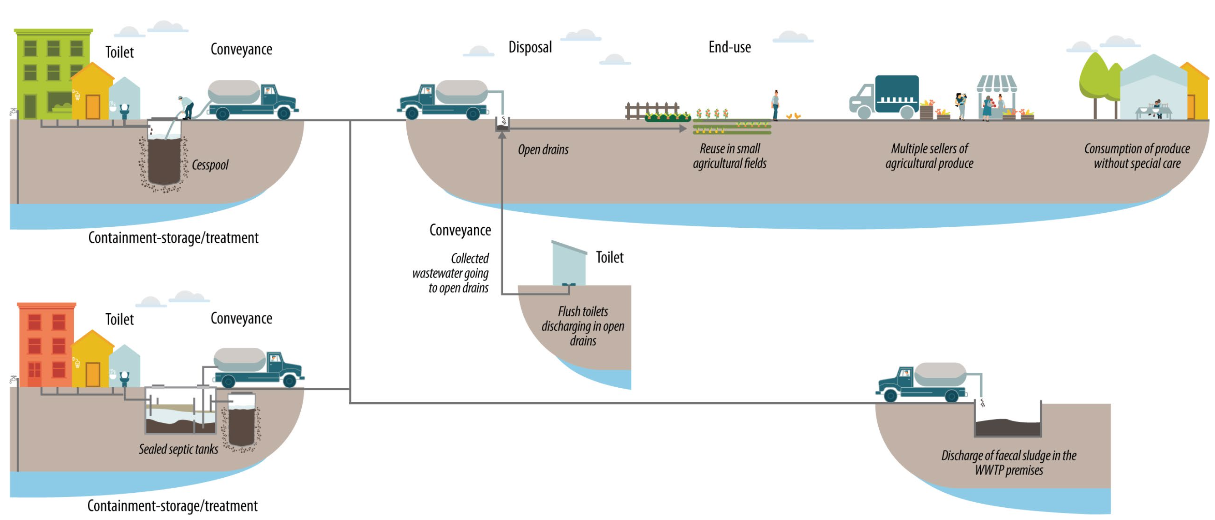
Module 2: Describe the sanitation system
Step 2.1. Map the system

Slide 19
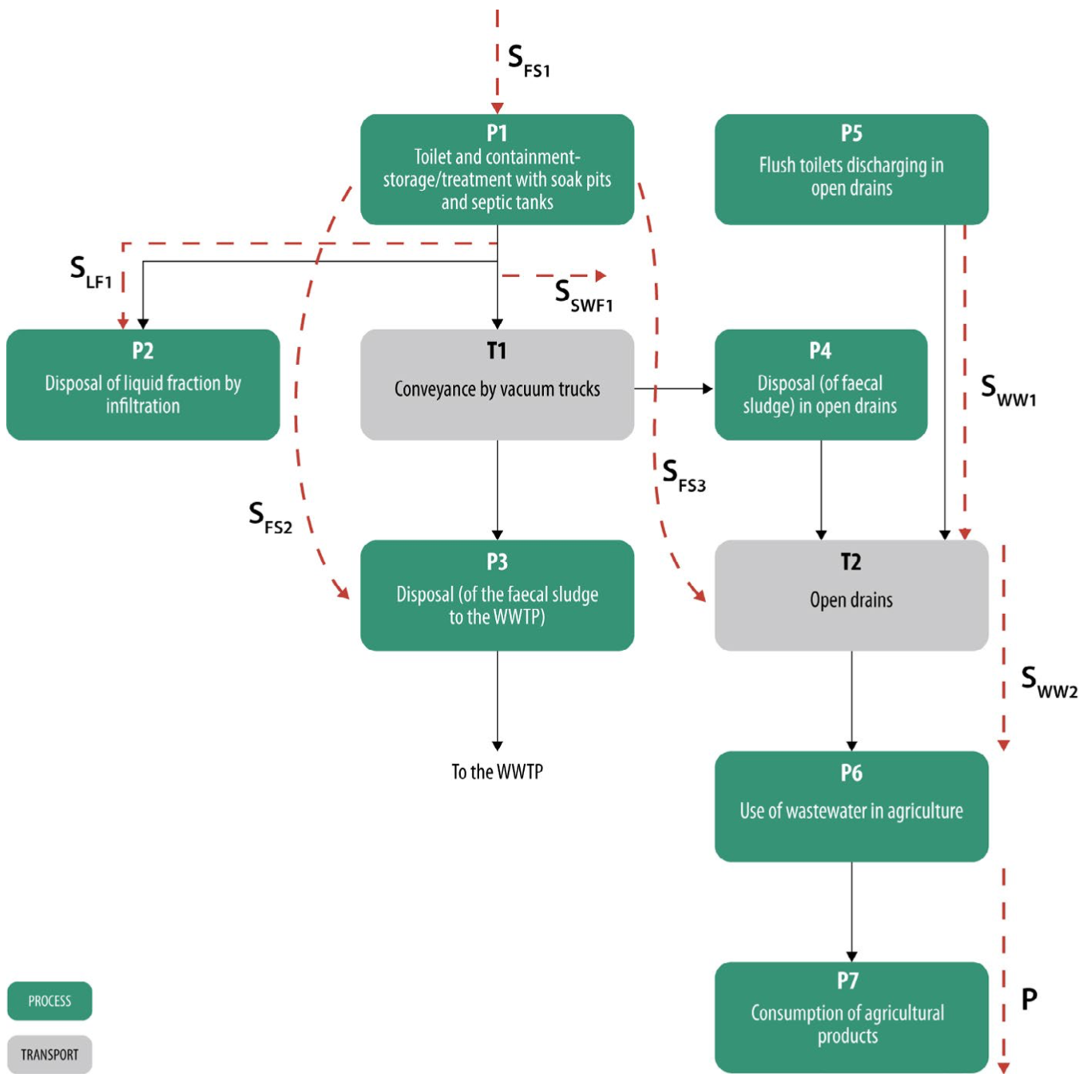
Step 2.1. Map the system

Slide 20
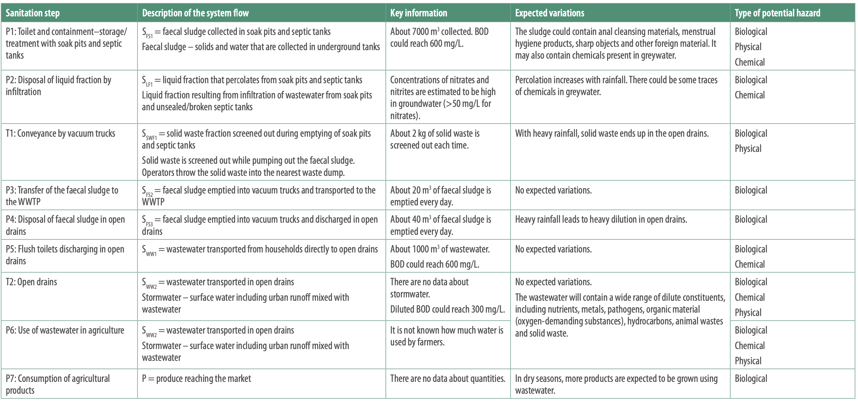
Step 2.2. Characterize system flows

Slide 21
GROUP WORK
Applying Steps 2.1 and 2.2 to your SSP
Use participant’s worksheet 2 for instructions: Module 2
Within your groups:
Map your sanitation system
Establish the path of different waste fractions through the sanitation system
Characterize system flows
Make sure you include all by-product waste streams that are part of your SSP system.

Slide 22
STEP 2.3
Identify exposure groups
This step identifies and characterizes exposed groups in terms of who they are, how many there are, where are they in the system and how exposure occurs.
Exposure groups categories:
People who might be exposed to sanitation –related health hazards.
U= Sanitation systems users
WC= Wider community
SSP Manual
Guidance Note
2.3
Page 30
L= Local community
F= Farmers
W= Sanitation workers
WC= Consumers

Slide 23
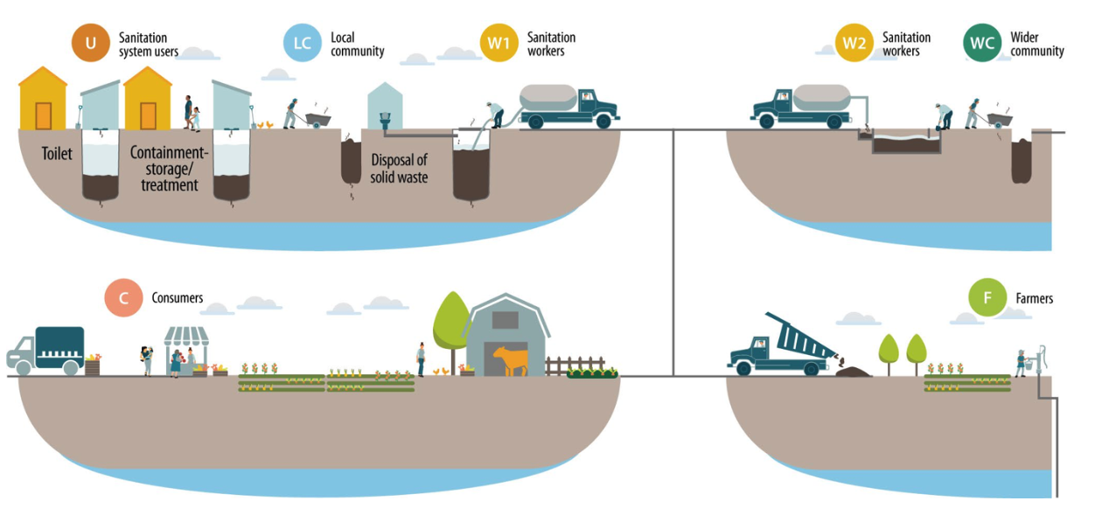
STEP 2.3
Identify exposure groups
SSP Manual
Example 2.4
Page 31

Slide 24
STEP 2.3
Identify exposure groups
Use tool 2.2 to characterize exposure groups
SSP Manual
Tool 2.2
Page 32

Slide 25
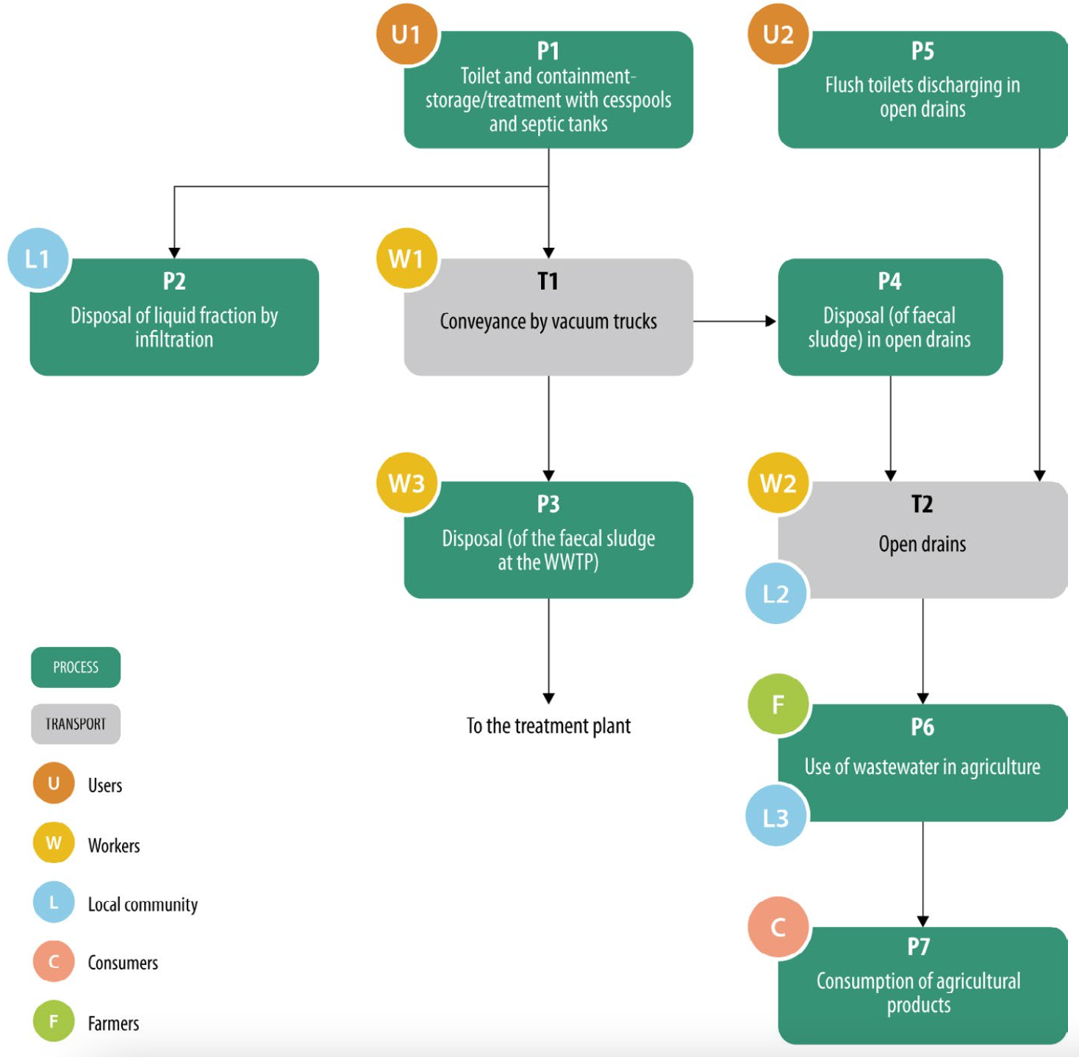
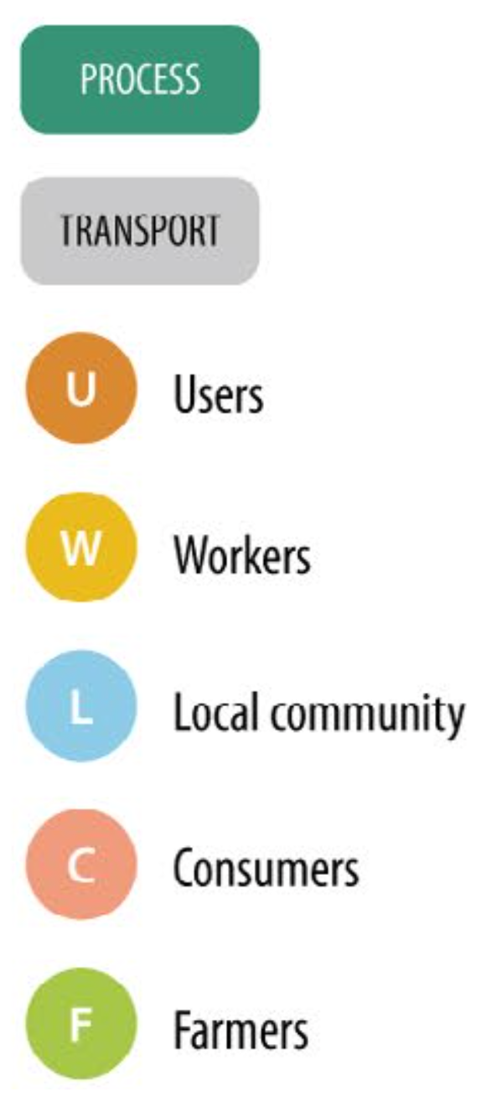
Step 2.3. Identify exposure groups

Slide 26
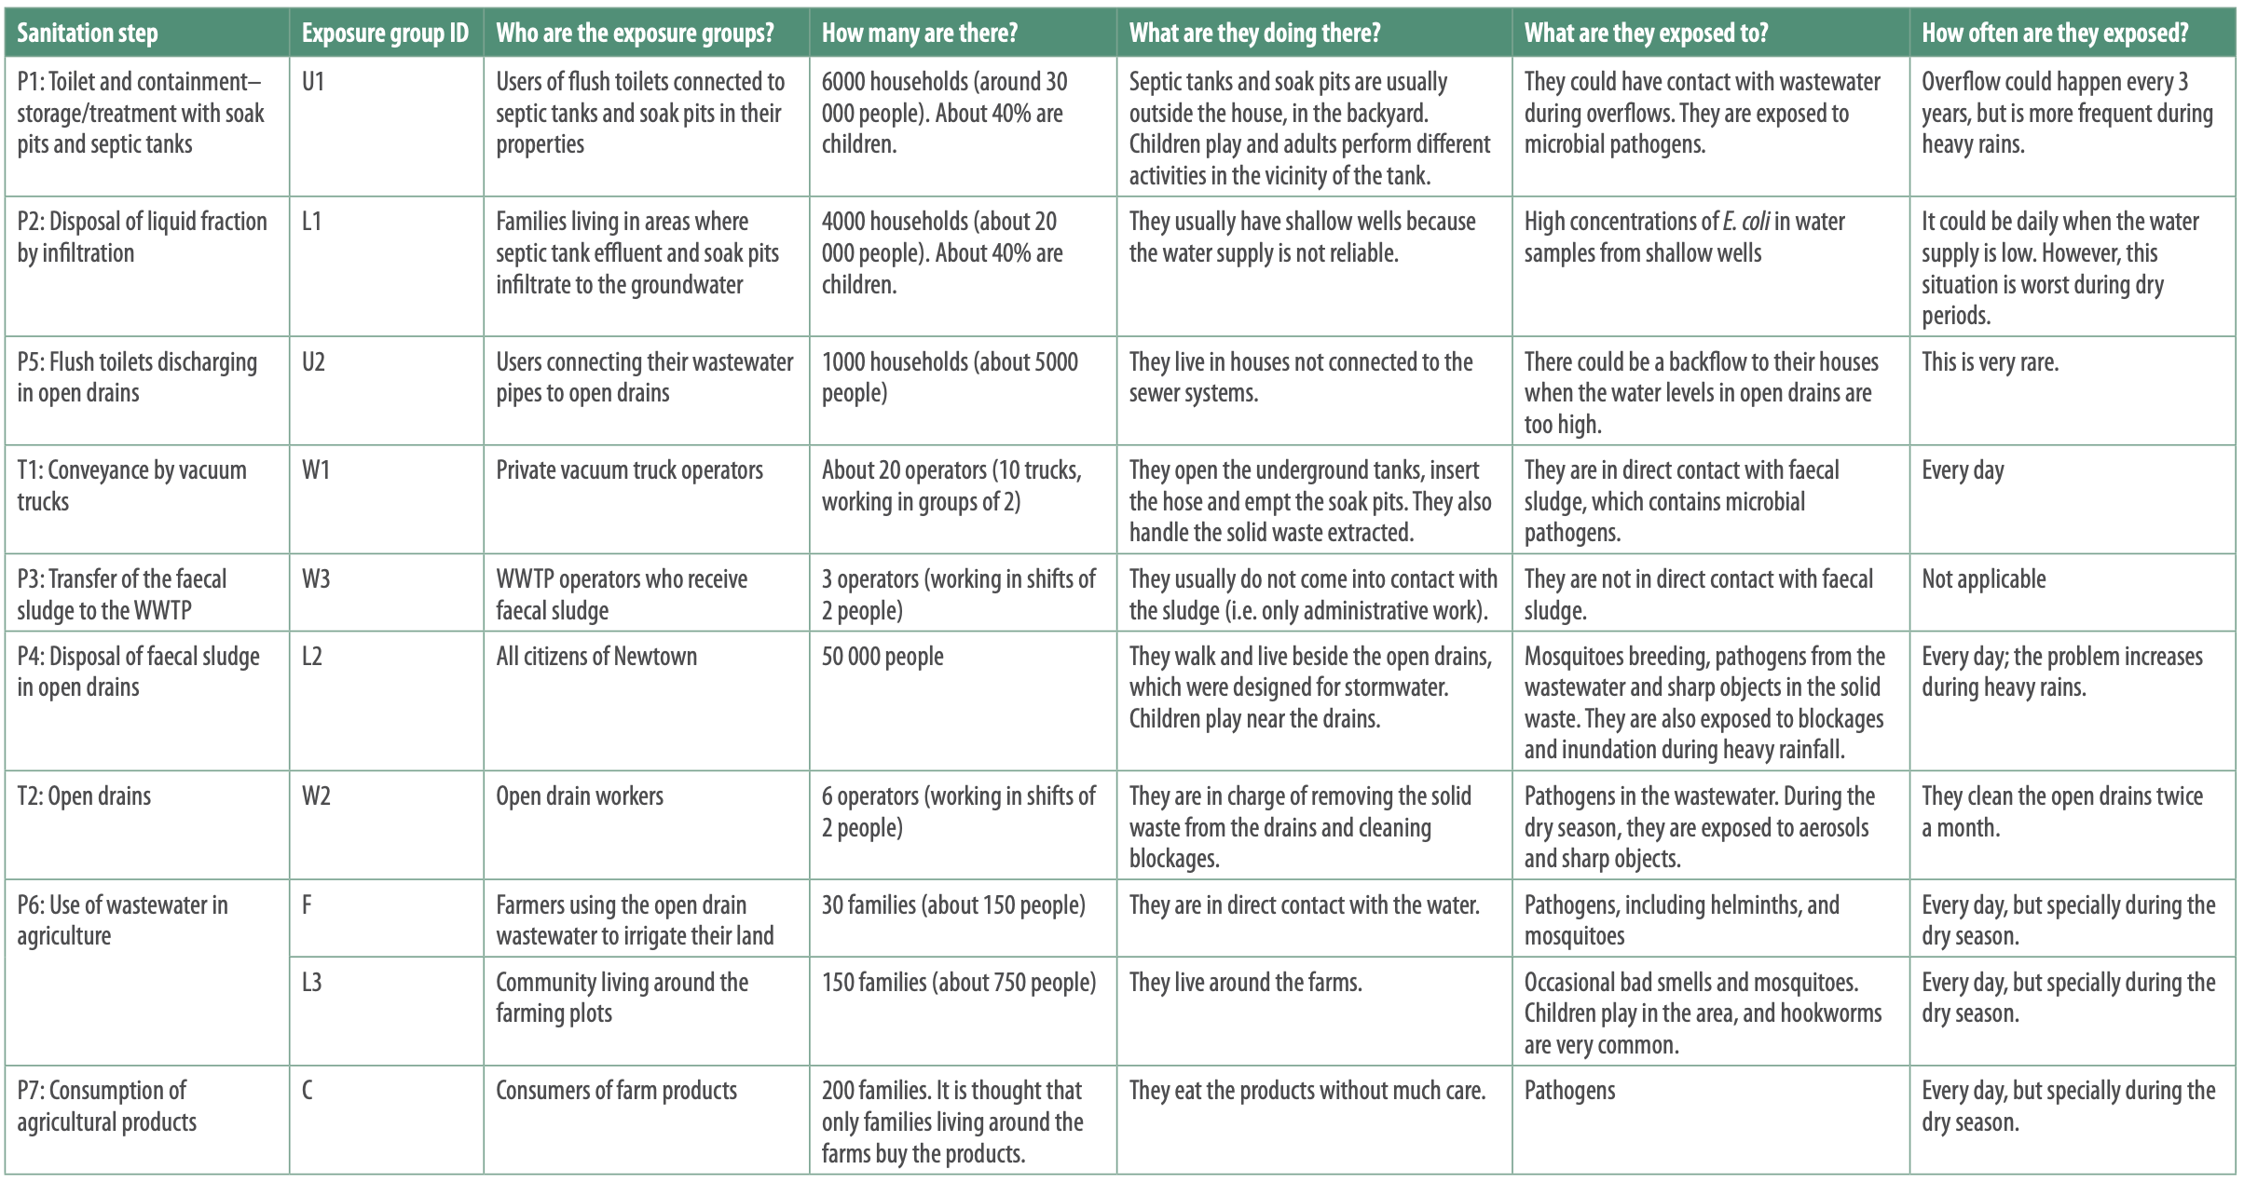

Slide 27
GROUP WORK
Applying Step 2.3 to your SSP
Use participant’s worksheet 2 for instructions. Within your groups:
Identify exposure groups in your maps
Characterize exposure groups.

Slide 28
Sharing groups results of implementation of Module 1 and Steps 2.1 to 2.3

Slide 29
Let’s continue with module 2!
SSP Manual
Pages
32 to 37
-PART 2-

Slide 30
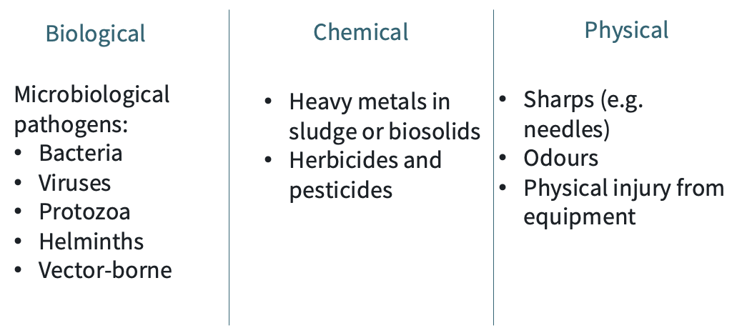
STEP 2.4
Gather supporting information
To identify the relevant health hazards to which our exposure groups are exposed.
For that, we collect and document information about the context (the reality) in which the sanitation system exists.
Potential hazards:
Relevant hazards:
Actual presence of the pathogens in the community
Actual performance of the treatment system… etc.

Slide 31
SSP Manual
Guidance Note
2.4, Page 33
STEP 2.4
Gather supporting information
Examples of data to be collated
Regulatory requirements
Relevant laws and by-laws
Effluent discharge quality standards
Guidelines for climate change preparedness or disaster planning
Demographics and land use patterns
Demographics, land use
Formal and informal settlements
Areas predicted for high population growth
System management and performance
Monitoring and surveillance records
Epidemiological data
Types and amount of products produced
Changes related to climate and weather
Seasonal changes and impacts on loadings
Seasonal crop and harvest data
Additional inflows during heavy rains
Changes in water usage due to scarcity

Slide 32
STEP 2.4
Gather supporting information
Let’s recap:
Waste fractions from Step 2.2
Contextual and health data
Identify relevant health hazards
Potential health hazards
Use epidemiological and environmental data where available.
For example, if helminths have been identified as a potential health hazard, the characterization aims to determine which species are endemic and to what extent.

Slide 33
Excreta related pathogens
WHO Guidelines
Chapter 6
Pages 100-124
Viruses
Bacteria
20 – 100 nm
0.2 – 2 µm
Enteric, transmitted by faecal-oral route.
Cause gastroenteritis, typhoid, E. coli diarrhoea
Cause severe health outcomes and long term effects
Can be excreted in very high numbers and are transported long distance in water.
Predominantly cause gastroenteritis, hepatitis A&E and viral meningitis.
Protozoa
Helminths
Enteric, cause gastroenteritis, Amoebic dysentery, giardiasis.
Production of cysts or oocysts enhance the survival in the environment.
1 – 300 µm
Soil-based and water based-worms.
Ingestion of eggs or skin penetration.
Cause ascariasis, hookworms infections.
3 – 20 µm
hair
Visible

Slide 34
Excreta related pathogens
WHO Guidelines
Chapter 6
Pages 114-119
Environmental transmission of pathogens in faecal waste
Occurrence
Pathogens must be excreted into the environment in sufficient quantities by infected people
Persistence
Pathogens must survive on surface, water, sewage and soil, and remain infectious
Vector or hosts
Presence and abundance of any required vectors or intermediary hosts
Individual’s susceptibility to infections
Immune status, nutritional status, age, pre-conditions
Infectivity
Specific strain and virulence
How do we detect pathogens in the environment?

Slide 35
Excreta related pathogens
WHO Guidelines
Chapter 6
Pages 114-119
Environmental transmission of pathogens in faecal waste
How do we detect pathogens in the environment? (Chapter 6.3.1 WHO Guidelines)
bacteria
viruses
protozoa
Indicator of faecal contamination
E. coli as combined indicator
Also enterococci and bacteroides phage
But
Useful
Feasible
Economical
Not perfect indicators!
In some circumstances, it might be important to identify the source and movement of an specific pathogen.

Slide 36
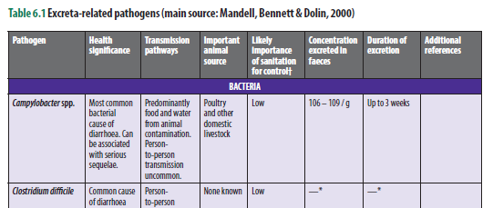
Excreta related pathogens
WHO Guidelines
Chapter 6
Pages 105-113
Table 6.1

Slide 37
Excreta related pathogens
WHO Guidelines
Chapter 6
Pages 114-119
Environmental transmission of pathogens in faecal waste
Testing environmental samples for pathogens
Sample collection and analysis of environmental samples for pathogens can be challenging and expensive.
In many cases, methods for analyzing human pathogens from environmental samples are not yet standardized.
Results could be different depending on the sample preparation and analysis.
You need:
Specialized team with equipment, experience and understanding of analytical methods.
Prepare a research plan, with specific objectives.
Goal:
obtain quantitative information on the concentration of pathogens in the sample.
evaluate the risk associated with contact or ingestion of the environmental sample.
evaluate the effectiveness of a treatment process.
or
Not always feasible. For SSP, E. coli indicator is sufficient.

Slide 38
Excreta related pathogens
Environmental transmission of pathogens in faecal waste
Helminths
This is because:
Helminth infections are context specific.
Species and concentrations of Helminth eggs in waste influence the control measures.
It is important to understand which helminth are endemic in the locality of the SSP.
Examples of helminth infections
Schistosomiasis
Ascariasis
Hookworm infection
Eggs infect snail that lives in standing waters.
Cercarie will swim and penetrate the skin of humans in the water.
Transmitted by the faecal-oral route.
Contamination of produce grown with contaminated water and faecal sludge.
Eggs shed via faeces and the larvae penetrates the skin, usually at the feet.
Transmission route affects risk and required control measures

Slide 39
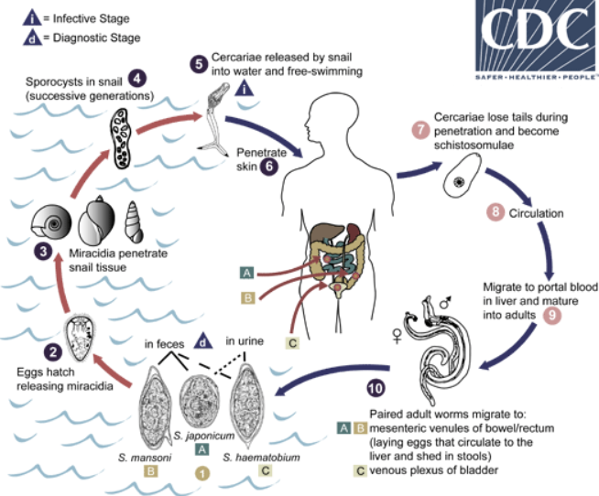
Excreta related pathogens
Helminths: transmission of Schistosomiasis

Slide 40
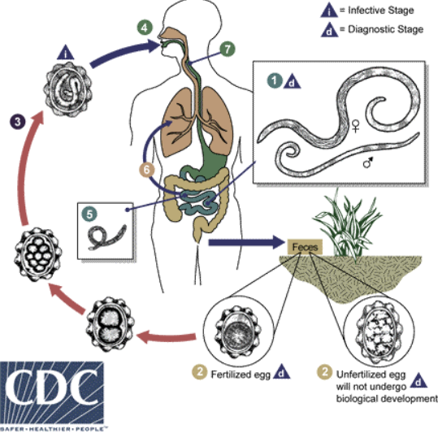
Excreta related pathogens
Helminths: transmission of Ascariasis

Slide 41
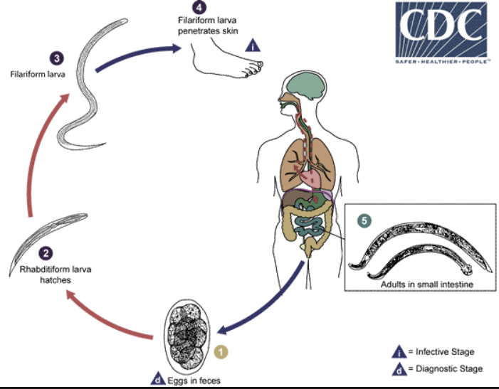
Excreta related pathogens
Helminths: transmission of Hookworm infection

Slide 42
Excreta related pathogens
WHO Guidelines
Chapter 6
Pages 114-119
Environmental transmission of pathogens in fecal waste
Occurrence
Pathogens must be excreted into the environment in sufficient quantities by infected people
Persistence
Pathogens must survive on surface, water, sewage and soil, and remain infectious
Vector or hosts
Presence and abundance of any required vectors or intermediary hosts
Individual’s susceptibility to infections
Immune status, nutritional status, age, pre-conditions
Infectivity
Specific strain and virulence
Why do we need to consider vectors in SSP?

Slide 43
Excreta related pathogens
WHO Guidelines
Chapter 6
Page 104
Environmental transmission of pathogens in faecal waste
Excreta facilitated vector breading (Chapter 6.3.1 WHO Guidelines)
Excreta, water and waste may serve as breeding sites.
Insects can act as vectors of disease by mechanically transporting pathogens in the environment.
Cockroaches:
Flies:
Mosquitos
Breed in excreta, such as pit latrines.
Carry human pathogens High microbial counts.
Enhance faecal-oral transmission, providing pathways from excreta to food or kitchen utensils.
Carry a variety of enteric pathogens, including bacteria and protozoa.
Cause trachoma.
Improper drainage, stagnant water and ponds contribute to their breading.
Wide range of mosquito-borne diseases: dengue, malaria, West Nile virus, chikungunya, yellow fever…
Vector-habitat and mode of transmission must be considered in SSP

Slide 44
STEP 2.4
Gather supporting information
Contextual and health data
Identify relevant health hazards
Waste fractions from Step 2.2
Potential health hazards
What information should we gather for our SSP?

Slide 45
SSP Manual
Guidance Note
2.5, Page 34
STEP 2.4
Gather supporting information
Compiling biological hazard information
What should you collect?
Information about disease conditions and pathogen concentrations:
Enteric (gastrointestinal) and urinary transmitted pathogens that exist in the community
Vector-borne diseases (e.g. mosquito borne malaria and dengue fever, rat borne)
Biological hazard information in relevant waste fractions (minimum: E. coli and helminth eggs)
From which sources?
Desktop literature
Public Health Authority
Consultation of personnel working in health facilities

Slide 46
STEP 2.4
SSP Manual
Guidance Notes
2.6 and 2.7
Gather supporting information
Compiling chemical and physical hazard information
What should you collect?
Collect information on environmental parameters:
Chemical parameters and contaminants of solid and liquid waste streams of interest
Physical hazards that may be present in wastes or are of concern considering the working processes and practices
From which sources?:
Environmental authorities
WWTP utilities monitoring results
Industrial entities or published references
Direct observation

Slide 47
STEP 2.4
SSP Manual
Guidance Note
2.8
Gather supporting information
Compiling key climate information
What should you collect?
Collect information on the local climate and its variability:
Records or history of extreme weather events
Future climate projections
Historical water quality data
Trends in water supply and land use
Assessment on climate hazards for water and other services
From which sources?
Regional climate vulnerability assessment
Community knowledge

Slide 48
STEP 2.4
Gather supporting information
Range and quality of data
Depends on:
What is really needed? Range of relevant information needed.
What is available? Data availability (e.g. secondary data) and quality.
What resources are available? Resource considerations (financial, human, time).
Data that should be sufficient:
Nice to have:
Official health reports, statistics
Literature and research articles
Direct observation
Participatory data collections
Environmental sampling
Epidemiological studies
Environmental assessments

Slide 49
STEP 2.5
Confirm the system description
To ensure that the system description is complete and accurate.
Previous steps probably largely a desk exercise.
There is a need to check through field investigations to ensure that the information is complete and accurate.
Tools: sanitary surveillance, transect walks, focus group tools etc.
Validate claimed treatment efficiency by references, testing programmers etc.
Map, system description and waste fraction characterization need to be updated after validation.

Slide 50
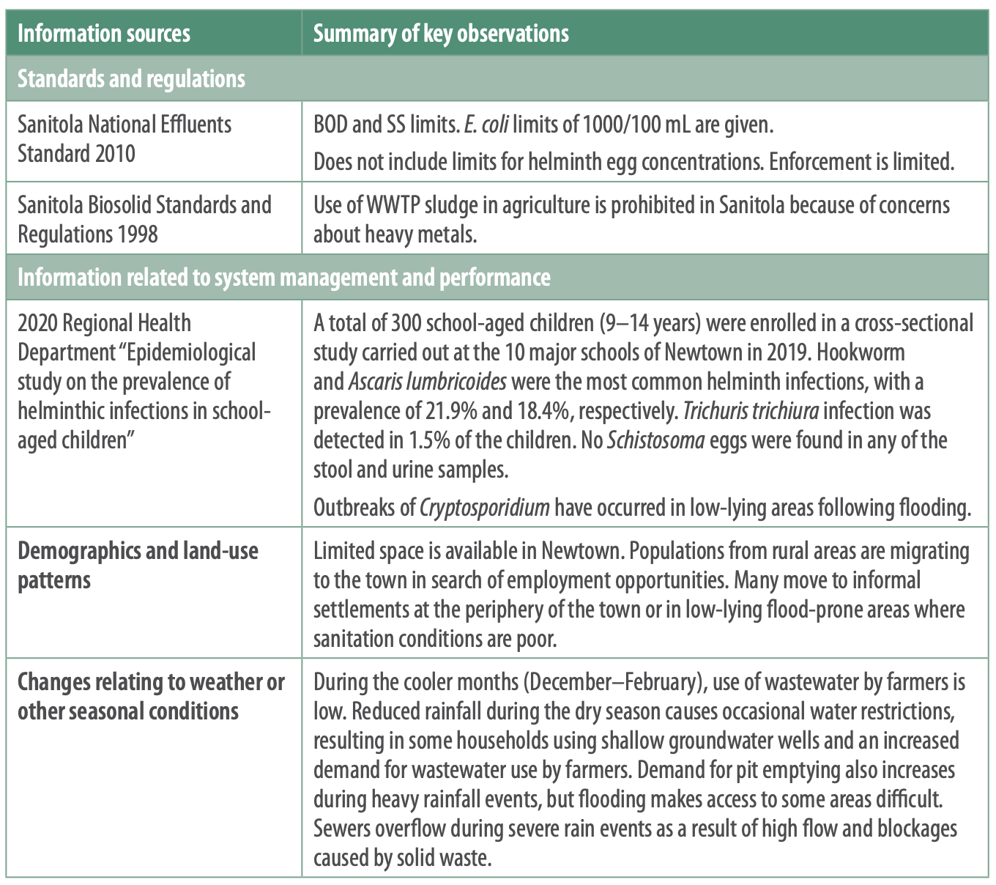
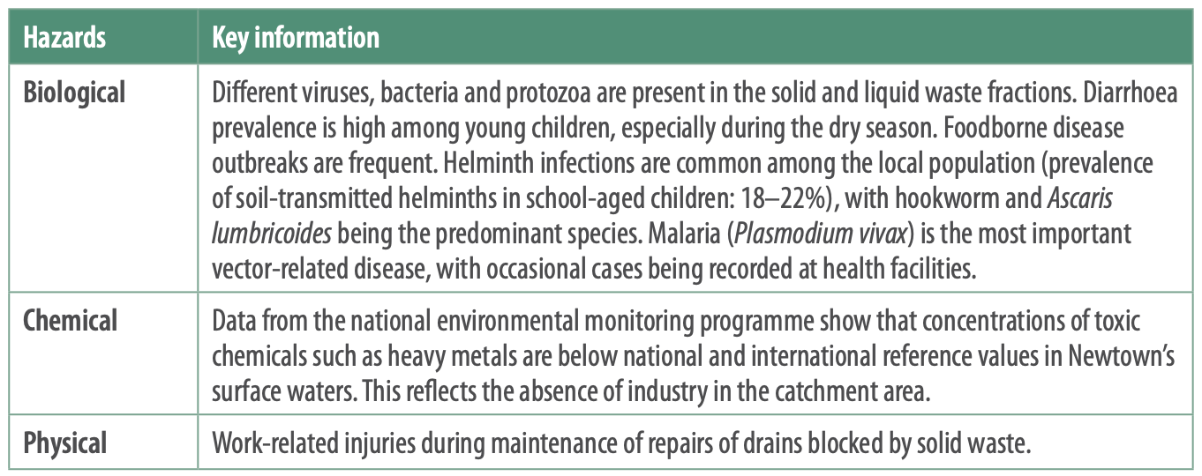
Step 2.4. Gather supporting information
Step 2.5: Confirm the system description

Slide 51
GROUP WORK
Applying Steps 2.4 to 2.5 to your SSP
Using participant’s worksheets for Module 2, within your groups:
Write down any information that will affect SSP development and implementation the system.

Slide 52
MODULE 2:
DESCRIBE THE SANITATION SYSTEM

