Slide 1
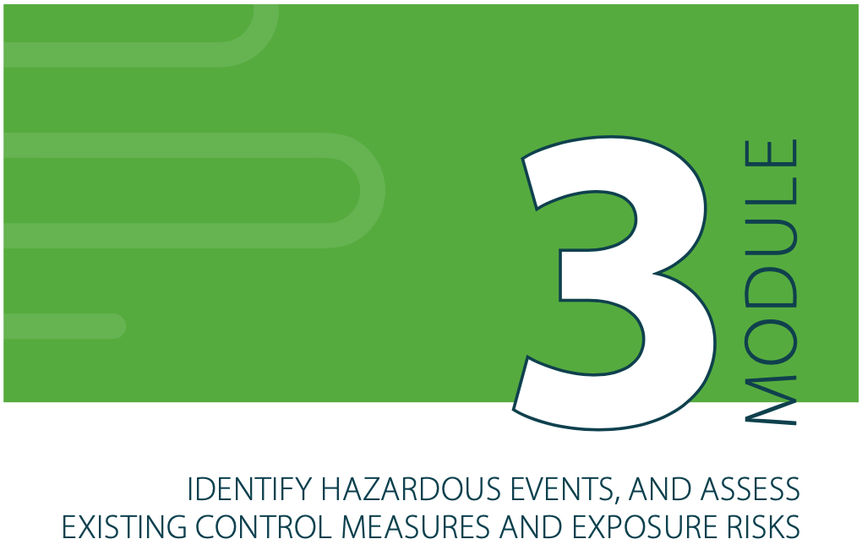
SSP Manual
Pages
39 to 61

Slide 2
MODULE 3
Identify hazardous events, and assess existing control measures and exposure risks
Module 3 answers the question:
“How significant are the risks?”
Ensures that subsequent efforts and investments in system improvements and monitoring respond to highest health risks first.
Module 3 helps us understand how well the hazardous events are already controlled in the system.
Module 3
MODULE 3:
IDENTIFY HAZARDOUS EVENTS AND ASSESS EXISTING CONTROL MEASURES AND EXPOSURE RISKS

Slide 3
3.1 Identify hazards and hazardous events.
3.2 Identify and assess existing control measures.
3.4 Assess and prioritize the exposure risk.
A risk assessment table
A prioritized list of hazardous events.

Slide 4
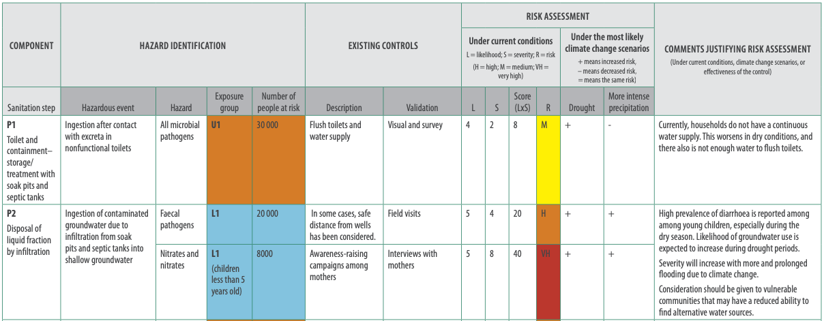
MODULE 3
Identify hazardous events, and assess existing control measures and exposure risks
Output 1: Risk assessment table
hazards
hazardous events
exposure groups
transmission routes
existing control measures
and their effectiveness
A summary of:

Slide 5
MODULE 3
Identify hazardous events, and assess existing control measures and exposure risks
Output 2: A prioritized list of hazardous events
This guides system improvements

Slide 6
MODULE 3
Identify hazardous events, assess existing control measures and exposure risks
How to approach Module 3?
Modules 3 requires:
A technical understanding of the various components.
An appreciation of the pathways that lead to exposure or contamination
An inquisitive mind. Ask:
- How could people be exposed to the hazard?
- How has it caused an exposure in the past?
- Is the hazard an ever-present hazard or is it only related to a specific event?
- What has gone wrong in the past?
- What could go wrong?
SSP is not a linear process!
Modules 3 involves:
Desktop analyses
Field investigations

Slide 7
This step lists circumstances of how the risk occurs during use, operation and maintenance of the sanitation system for the exposure groups.
SSP Manual
Example 3.1
Page 43
Hazard
≠
Hazardous Event (HE)
Any incident or situation that:
Introduces or releases the hazard (i.e. faecal pathogens) to the environment in which people are living or working, or
amplifies the concentration of the hazard in the environment in which people are living or working,
or fails to remove the hazard from the human environment.
A biological, chemical or physical constituent that can cause harm to human health.
SSP Manual
Guidance note
3.1, page 42

Slide 8
Hazard, hazardous event, effect, risk, ...!?
Hazardous event
Hazard(s)
Health effects
Example 1: wastewater channel
Ingestion after contact with wastewater while entering or falling into drains during maintenance
Biological (e.g. bacteria, virus)
e.g. diarrhoea, fever, vomiting
e.g. diarrhoea, skin irritation
Example 2: produce
e.g. cramps, dehydration and shock, helminthiasis
e.g. neurological damage or cancer (in a long term)
Biological (e.g. bacteria, virus, helminths)
Chemical (e.g. heavy metals)
Consumption of wastewater contaminated produce

Slide 9
TIPS
Hazard
≠
Hazardous
Event (HE)
A good hazardous event tells a short story.
The villain is the hazard and the hazardous event (the story) says what happens - how the villain causes harm.
For example:
Workers are exposed to pathogens in
raw sewage in open drains during maintenance activities
How exposed?

Slide 10
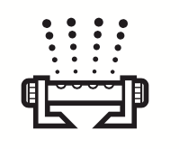
SSP Manual
Guidance note
3.2, page 44
Hazardous events should describe how groups are exposed to hazards. Common exposure routes to consider in SSP:
Ingestion after contact with wastewater/ excreta
Dermal (skin) contact with excreta and wastewater
Ingestion of contaminated water
Vector-borne with flies/mosquitoes/ cockroaches
Consumption of contaminated produce
Inhalation of aerosols and particles

Slide 11
SSP Manual
Page 43
Hazards and hazardous events must be identified at each step along the sanitation chain
Existing – normal operation
Potential – system failure or accident
Seasonal factors
Indirect
Cumulative
e.g. faulty equipment, system overloading, lack of maintenance
e.g. treatment failure (full or partial), power failures, equipment breakdown
e.g. seasonal behaviour changes by farm workers, seasonal farm workers
e.g. hazards that relates to people not directly involved such as effects on downstream communities.
e.g. chemicals in soils.
AND climate related factors

Slide 12
STEP 3.1
More intense and prolonged precipitation
Identify hazards and hazardous events
Climate change:
Increased flooding
Increased erosion, landslides
Changes to groundwater recharge and groundwater levels
Alters the frequency and intensity of hazardous events
Creates new hazardous events
Sea level rise
More variable and declining rainfall or run-off
Saline intrusion in coastal/low-lying zones
Higher risk of inundation, especially from extreme weather events
Longer dry seasons/periods
Droughts reduced surface water flows
Reduced groundwater levels
More variable or increasing temperatures
More frequent or intense storms or cyclones
Higher freshwater temperatures
Hot and cold temperature extremes
Increased flooding
More extreme winds

Slide 13
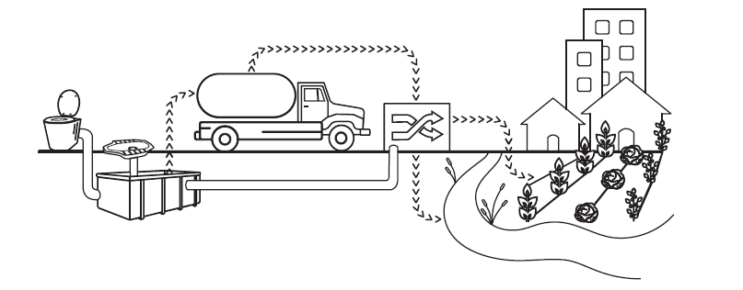
SSP Manual
Guidance note
3.4, page 47
STEP 3.1
Identify hazards and hazardous events
Think about climate-related effects that affect the sanitation system:
Declining water supply impeding function of water-reliant sanitation systems (e.g., flush toilets, sewerage, treatment)
Damage to other infrastructure/systems on which sanitation systems rely
Destruction and damage to sanitation infrastructure
Increased corrosion of piped sewers
Flooding of on-site systems causing spillage and contamination
Higher pollution concentration in wastewater and reduced capacity of receiving water bodies to dilute wastewater
Overflow and/or obstruction of sewerage and septic systems
Proliferation of algal blooms or microbes carried by vectors in water

Slide 14
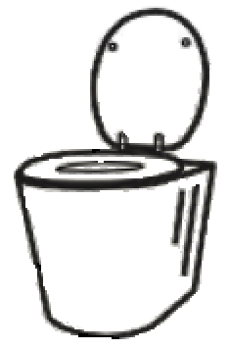
SSP Manual
Example 3.2
Page 44
WHO Guidelines
Chapter 3
Page 31-34
Hazardous events:
Toilet
Vector-borne transmission of pathogens to users, due to wrong design and/or construction of the toilets (e.g., lack of water seal or lid).
Ingestion of pathogens after contact with excreta in toilets, due to lack of maintenance and cleaning.
Ingestion of contaminated groundwater contamination caused by toilet flooding.
Ingestion/asphyxiation after falling in pits due to toilet collapse during inundation.
Existing and potential:
TIPS
WHO Guidelines
Table 3.6 – climate change potential impact on toilets
Page 54
Climate change related:

Slide 15
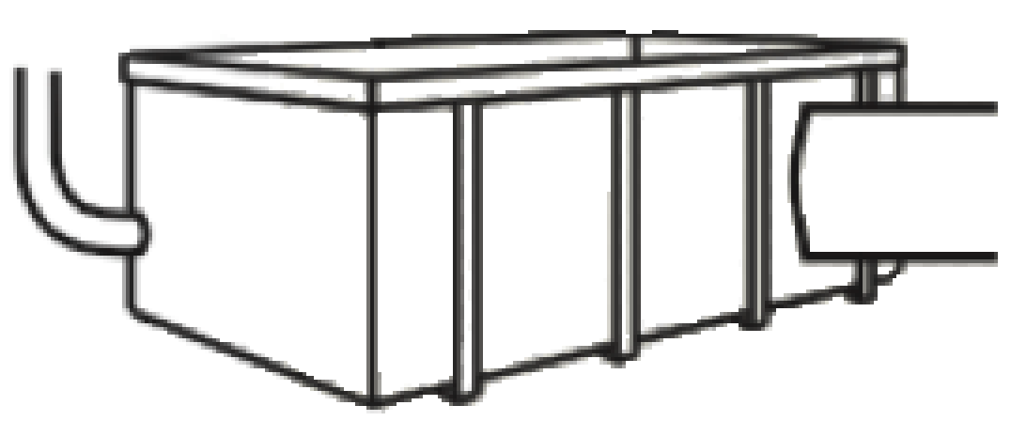
SSP Manual
Example 3.2
Page 44
WHO Guidelines
Chapter 3
Page 34-38
Containment-storage/treatment
Hazardous events:
Ingestion of groundwater contaminated with leachate percolating from pits or septic tanks.
Ingestion of groundwater contaminated with leakage from cracked/damaged septic tanks.
Ingestion of pathogens caused by structural damage to tanks during floods.
Existing and potential:
TIPS
WHO Guidelines
Table 3.6 – climate change potential impact on septic tanks
Page 55
Climate change related:

Slide 16
SSP Manual
Example 3.2
Page 44
WHO Guidelines
Chapter 3
Page 39-44
Transport and conveyance
Hazardous events:
Ingestion of pathogens after contact with excreta during manual emptying of pits using buckets.
Ingestion of pathogens after contact with contaminated soil, caused by discharge of faecal sludge without treatment to open grounds.
Ingestion to pathogens in households during events of back- flooding of raw sewage into buildings caused by extreme rainfall.
Ingestion of pathogens during cleaning of increasing solid deposits caused by reduced water flows in drought periods.
Existing and potential:
TIPS
WHO Guidelines
Table 3.6 – climate change potential impact on sewers
Page 55
Climate change related:

Slide 17
SSP Manual
Example 3.2
Page 44
WHO Guidelines
Chapter 3
Page 44-49
Hazardous events:
Treatment
Inhalation of aerosols while manual handling of the dried faecal sludge.
Ingestion of pathogens in incompletely treated effluent, resulting from discharge of fresh faecal sludge in wastewater treatment ponds, causing overload and failure.
Ingestion of pathogens contained in untreated sewage during extreme weather events or floods damaging wastewater treatment systems.
Existing and potential:
TIPS
WHO Guidelines
Table 3.6 – climate change potential impact on treatment
Page 55
Climate change related:

Slide 18
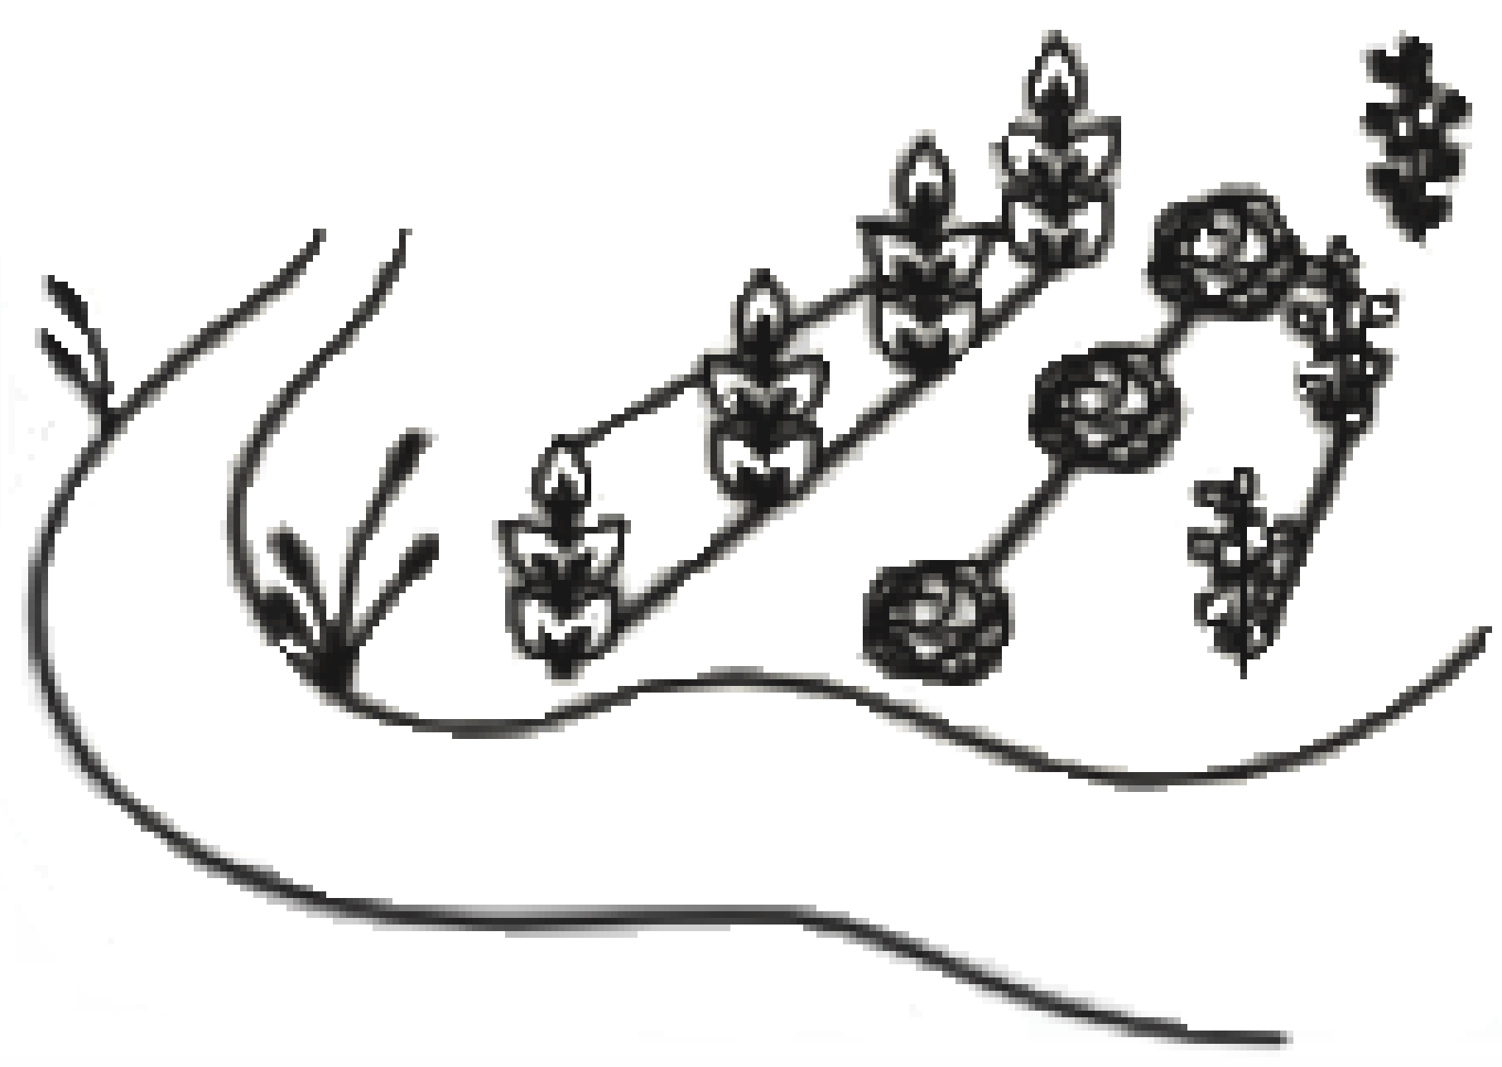
SSP Manual
Example 3.2
Page 44
WHO Guidelines
Chapter 3
Page 49-52
Hazardous events:
End use/ disposal
Ingestion of pathogens in surface waters due to discharge of partially treated or untreated effluent.
Inhalation of particles and aerosols containing pathogens during spray irrigation with partially treated or untreated wastewater on nearby farms
Ingestion after contact with raw sewage during farming activities, caused by increased fresh water scarcity.
Existing and potential:
TIPS
WHO Guidelines
Table 3.6 – climate change potential impact on reuse
Page 56
Climate change related:

Slide 19
TIPS
While identifying hazards and hazardous events
It should be a combination of desk exercises and field investigations.
Define a separate hazardous event for similar events that occur under different circumstances.
Draw on climate projections and existing vulnerability, resilience, and adaptation assessments to include hazardous events that could arise due to climate change.
SP teams may define a specific hazardous event caused by climate change, or estimate how the risks under current conditions increase, decrease or remain the same under different climate change scenarios.

Slide 20
Template for risk assessment

Slide 21
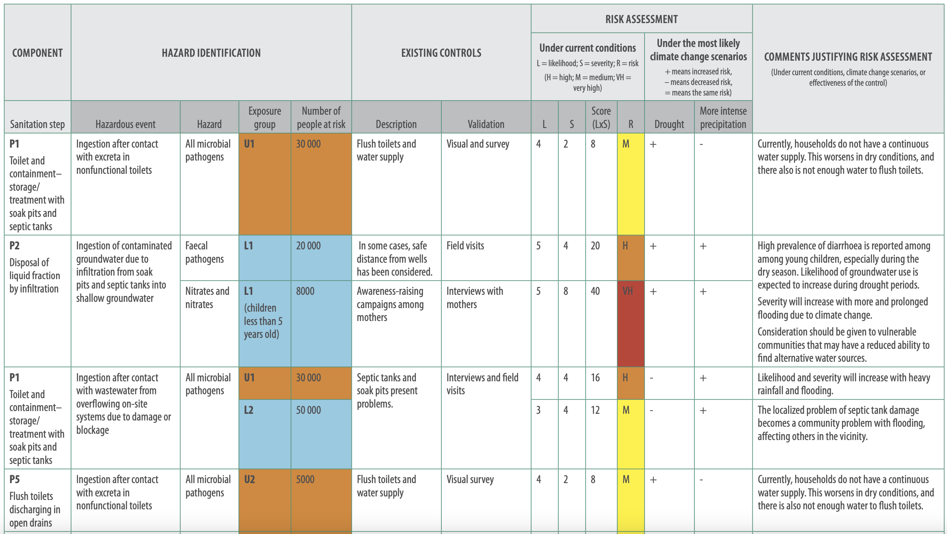

Slide 22
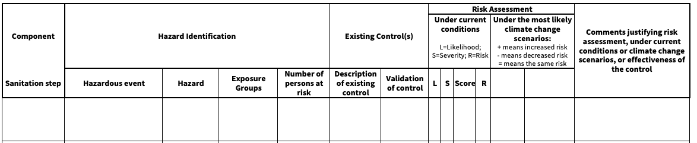
GROUP WORK
Applying Step 3.1 to your SSP
Use table group worksheet Module 3, Step 3.1 for instructions.
Within your groups:
Identify hazards, hazardous events, exposure groups and number of persons in risk.

Slide 23
SSP Manual
Page 49
To determine how well the existing system protects those at risk.
Hazard(s)
Hazardous event
Health effects
Likelihood
Severity
Risk
Risk control
measures

Slide 24
What is a control measure?
A control measure is any action or activity (or barrier) that can prevent or eliminate a sanitation-related hazard or reduce it to an acceptable level.

Slide 25
SSP Manual
ANNEX A1-6
Page 113
What are the typical control measures to protect…
Workers?
Farmers?
Personal protective equipment (e.g. gloves, masks…)
Trainings on safe handling of excreta
Subsurface irrigation
Personal hygiene

Slide 26
SSP Manual
ANNEX A1-6
Page 113
What are the typical control measures to protect…
Consumers?
Local communities?
Additional polishing step at wastewater treatment plant
Household food safety program
Restricted public access to fields or waste-fed aquaculture facilities
Fencing of waste treatment facility to prevent entry of children and animals

Slide 27
STEP 3.2
Identify and assess existing control measures
How do we determine
how effective is a control measure?

Slide 28
STEP 3.2
SSP Manual
Guidance note
3.5, page 49
Identify and assess existing control measures
Consider how effective the existing control measure:
could be, assuming it was always working well
(known as CM validation).
• checking system loading against its design capacity;
• checking historical performance under unusual conditions;
• checking the credited reductions of pathogens for control measures.
is in practice, considering actual site conditions, enforcement of existing rules and regulations and operating practices.

Slide 29
STEP 3.2
Identify and assess existing control measures
Assessing control measures effectiveness in reducing pathogens load
Water supply
Wastewater
E. Coli presence implies water may be contaminated
E. Coli absence implies water very unlikely to be contaminated
We know it is contaminated.
We use the numbers of faecal indicator organisms, to indicate, the removals of faecal contamination.
The larger the removal, the safer the wastewater is for reuse.

Slide 30
STEP 3.2
Identify and assess existing control measures
Log reductions as measure of effectiveness of control measures
Log reduction of organisms is widely used in WHO guidelines and risk quantification literature:
Example:
Original concentration units/100 mL | Concentration after control measure
100 (=10²) | 10 (10¹)
10,000 (=10⁴) | 100 (10²)
10,000 (=10⁴) | 10 (10¹)
10,000 (=10⁴) | 1 (10⁰)
% reduction | Log reduction value
90% | 1
99% | 2
99.9% | 3
99.99% | 4
Notes:
Log reduction of organisms are used to refer to the reduction achieved by a control measure.
Log reduction means how many zeros we can cross out.
Let’s take one example: let’s imagine that a control measure has an effectiveness measured in log reduction of 3 logs. It means that we can cross out 3 zeros, then if the original concentration was 10’000 which is equal to 10 to the power of 4, after the control measure, the concentration will be 10, which is 10 to the power of 1.

Slide 31
STEP 3.2
Identify and assess existing control measures
2006 WHO Guidelines for Safe Use of Wastewater, Excreta and Greywater in Agriculture and Aquaculture
Chapter 5 in volumes 2, 3 and 4
In agriculture uses, we use reductions in E. coli reductions as an indicator for risks of viral, protozoa and bacterial infections.
For helminth pathogens: we use actual counts of helminth eggs.

Slide 32
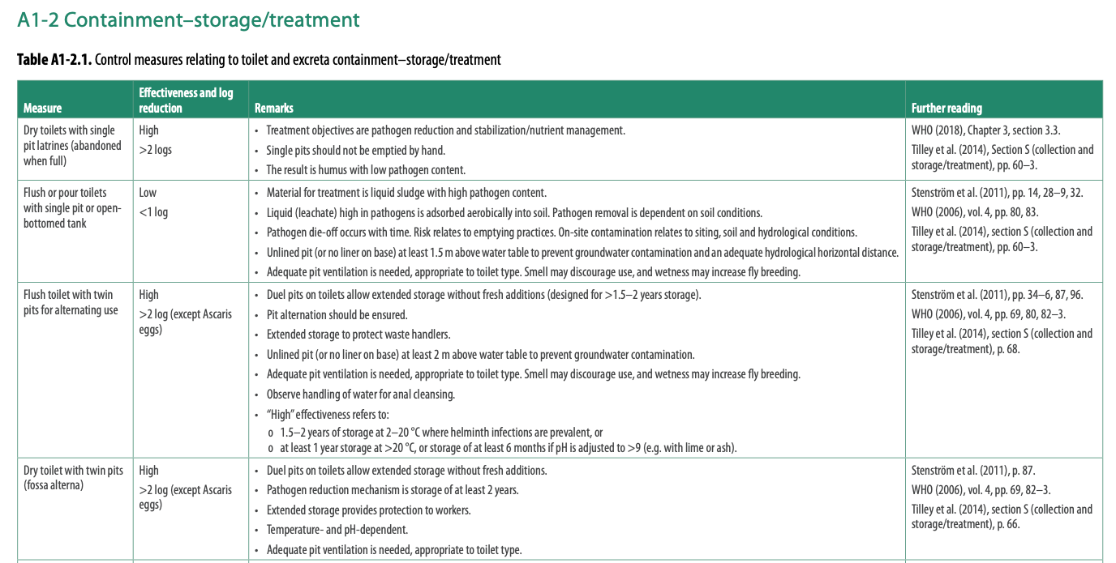
STEP 3.2
SSP Manual
ANEEX 1
Pages 100-112
Identify and assess existing control measures

Slide 33
STEP 3.2
SSP Manual
Guidance note
3.6, page 51
Identify and assess existing control measures
Control measure validation at
each step of the sanitation system

Slide 34
STEP 3.2
SSP Manual
Guidance note
3.6, page 51
Identify and assess existing control measures
Toilet
Control measure
How effective is it in practice?
Installation of toilets
Maintenance of toilets
Are the well constructed? Is the slab made of durable material?
Are they cracked? Damaged?

Slide 35
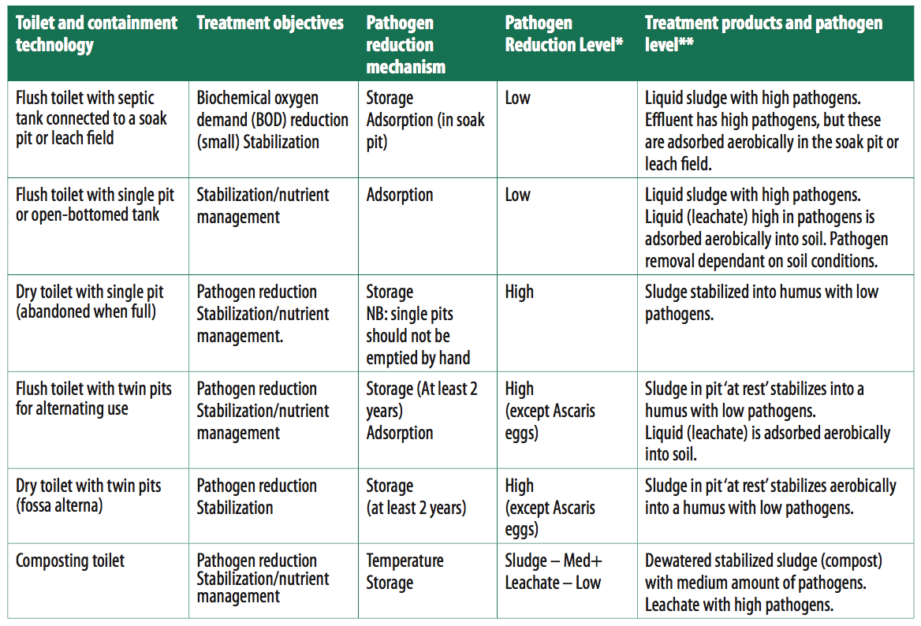
STEP 3.2
Identify and assess existing control measures
Containment-storage/treatment
CM validation: assuming it was always working well
Table 3.1 Treatment performance of containment technologies
WHO Guidelines
Chapter 3
Page 37

Slide 36
STEP 3.2
Identify and assess existing control measures
Containment-storage/treatment
Control measure
How effective is it in practice?
Septic tank
Single pits
Is it sealed? Does the effluent go to a soak pit? Is the groundwater located 2m below?
What is the location of the groundwater? Is it elevated? What happens in rainy season?

Slide 37
STEP 3.2
Identify and assess existing control measures
Control measure
How effective is it in practice?
Conveyance/
emptying and transport
Preventive emptying
Use of protective personal equipment (PPE)
Do HHs really call the emptying trucks before the holding tanks are full?
Do the sanitation workers really use the PPE?

Slide 38
STEP 3.2
Identify and assess existing control measures
Treatment
CM validation: assuming it was always working well
Table 3.2 Established wastewater treatment technologies
Table 3.3 Established sludge treatment processes
WHO Guidelines
Chapter 3
Pages 46 - 47

Slide 39
STEP 3.2
Identify and assess existing control measures
Treatment
Control measure
How effective is it in practice?
A wastewater treatment plant
Use of protective personal equipment (PPE)
Was it designed with the aim of pathogen removal? Is it really working as planned? Is it overloaded? Can the staff operate it? Is it on?
Do the sanitation workers really use the PPE?

Slide 40
STEP 3.2
Identify and assess existing control measures
End use/ disposal
Pathogen level in end use product
Table 3.4 Summary of established end use products
WHO Guidelines
Chapter 3
Page 50

Slide 41
STEP 3.2
Identify and assess existing control measures
End use/ disposal
Control measure
How effective is it in practice?
Restrictions of produce
Use of protective personal equipment (PPE)
Are farmers only growing the products indicated?
Do farmers really use the PPE?

Slide 43
GROUP WORK
Applying Step 3.2 to your SSP
Use table group worksheet Module 3, Step 3.2 for instructions.
Within your groups:
Identify and assess existing controls.

Slide 44
This step uses a structured approach to identify and prioritize the highest risks for which system improvements are needed.
Helps to identify which hazardous events are serious and which are moderate or insignificant.
SSP Manual
Page 52

Slide 45
Risk assessment methods
Simple sanitary inspection
Team-based descriptive
Team-based semi-quantitative
Quantitative methods
Suited for simple sanitation systems (on-site)
Limited data
More experienced and more resourced teams
Specialized studies
Not used by SSP teams
Depend on the judgement of the SSP team.
Choose a method that you are comfortable with and that is feasible

Slide 46
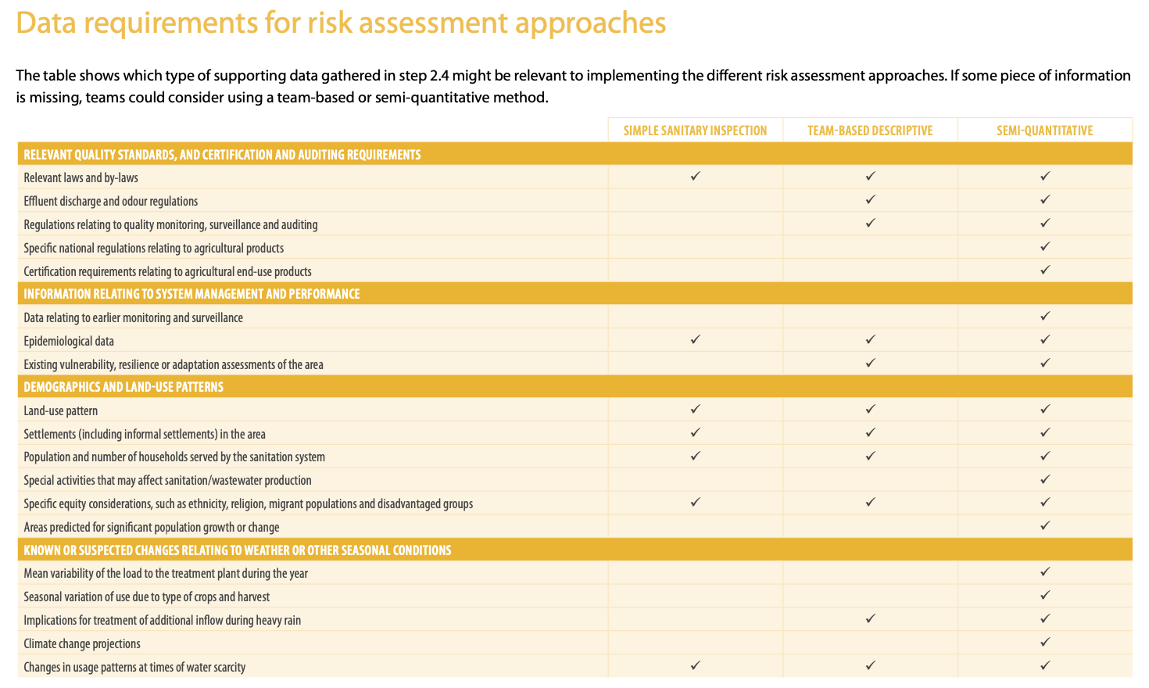
SSP Manual
Guidance note
3.7, page 53

Slide 47
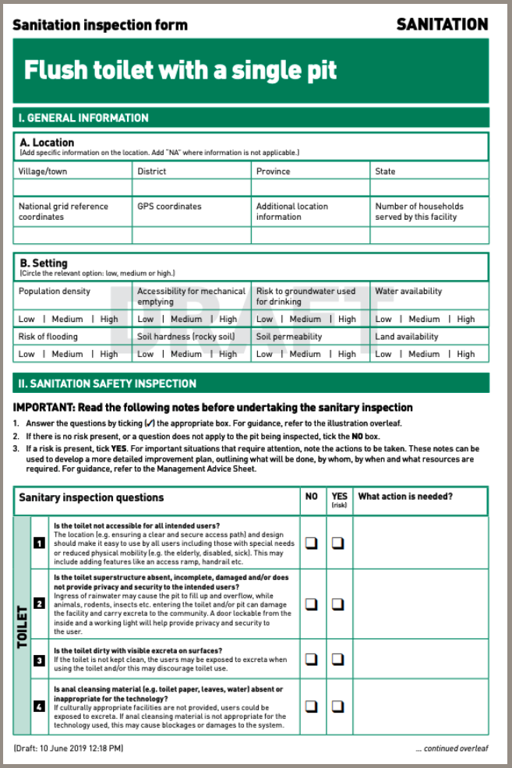
Simple sanitary inspections
Short, standardized observation checklists that can be adapted and used to assess risk factors in a sanitation system
WHO has prepared forms for:
dry toilet with a single pit
flush toilet with a single pit
dry toilet with a double pit
flush toilet with twin pits
flush toilet with septic tank or soak pit
urine-diverting dry toilet with cartridge or storage tank
flush toilet to a simplified or conventional sewerage system.
SSP Manual
Tool 3.2
Page 55
Notes:
These forms are used during field investigations to identify the presence of a predefined risk. As a first step, an SSP team member should note general information about the locality, including the number of facilities. They then judge predefined risks, such as the risk of flooding

Slide 48
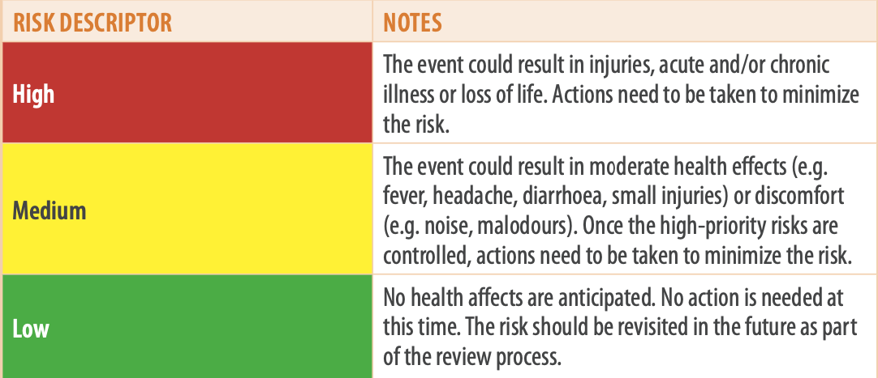
SSP Manual
Tool 3.3
Page 56
Team-based descriptive risk assessment
Based on their judgements, SSP teams classify hazardous events as high, medium or low risk.
Teams can develop their own health-related definitions of risk, or use the following:

Slide 49
SSP Manual
Tool 3.5
Page 58
Semi-quantitative risk assessment
More rigorous risk assessment.
Appropriated for more well-defined regulatory environments.
Teams who are familiar with the WSP methodology.
Likelihood (L) x Severity (S) = Risk

Slide 50
SSP Manual
Tool 3.6
Page 58
Semi-quantitative risk assessment matrix
Likelihood (L) x Severity (S) = Risk

Slide 51
TIPS
Decide on a consistent risk assessment methodology upfront.
Be specific in the risk assessment and relate it to the hazardous event.
Any descriptive and semi-quantitative risk assessment approach needs to be undertaken by several individuals for increasing objectivity of the risk assessment.
Treat control measure failure as a separate hazardous event in its own right, with its own likelihood and severity.

Slide 52
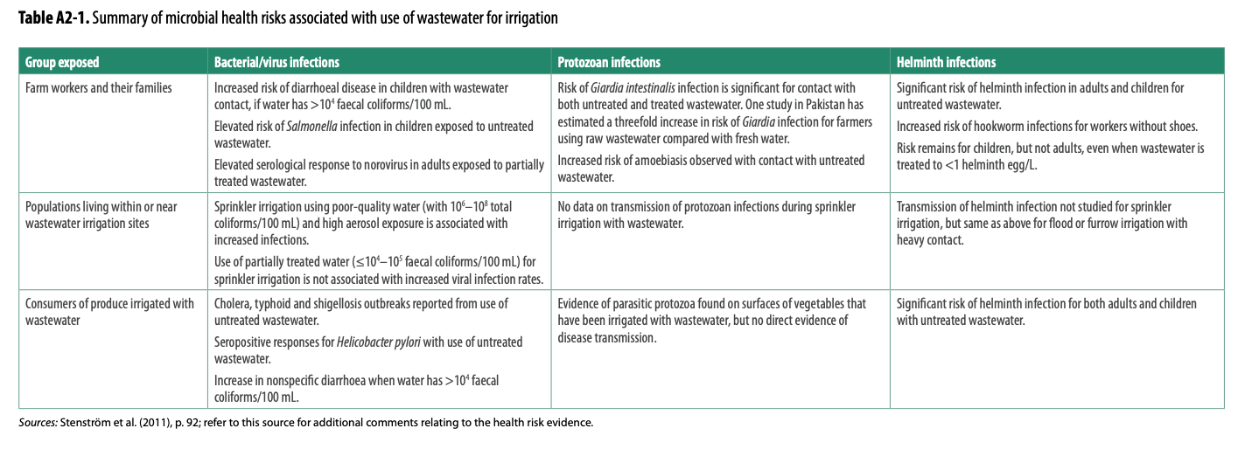
SSP Manual
ANNEX 2
Page 115
When assessing the severity of hazardous events related to the use of wastewater for agriculture, use Annex 2.

Slide 53
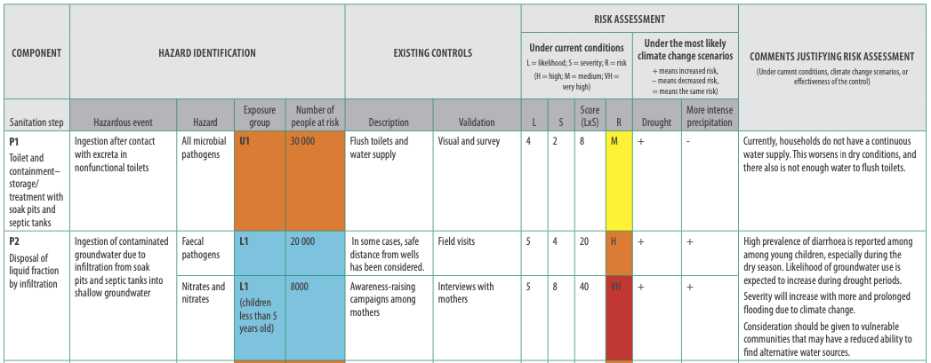
Record the risk assessment for every hazardous event and exposure group

Slide 54
SSP Manual
Guidance note
3.8, page 61
Climate change considerations when assessing risk
Likelihood of hazardous events may change…
Severity of hazardous events may change…
Under drought, sewer overflow frequency may reduce
Discharge of effluent to a river is more significant during drought as the concentration of pollutants would be high
Under storms or cyclones, infrastructure may be damaged
Therefore, we need to:
Consider climate change projections to estimate risk.
When not available, consider different climate scenarios.
Prioritise climate scenarios that results in the largest increase in risk.

Slide 55
SSP Manual
Guidance note
3.8, page 61
Example:
Hazardous event: Ingestion of contaminated groundwater due to leakage from sewers and drains into shallow groundwater
Exposure group: local community
Risk assessment
under current conditions
Likelihood 4 (likely) x Severity 4 (moderate)= Risk 16 (medium)
Under drought/dry conditions scenario
Under floods/wet conditions scenario
+ risk increases
+ risk increases
Under drought, the likelihood of collecting water for drinking from shallow sources increases.
Under flooding scenarios, the quality of groundwater is affected by pollutants.

Slide 56
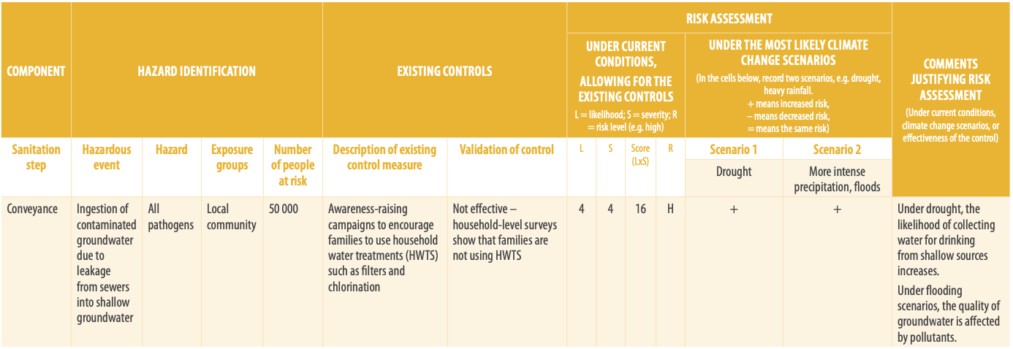
SSP Manual
Guidance note
3.8, page 61
Risk assessment for climate change and climate variability

Slide 57
SSP Manual
Tool 3.8
Page 60
Prioritization of hazardous events
Notes:
Tool 3.8 allows the team to summarize the highest risks. It is essential to consider the number of people who are at risk while prioritizing the hazardous events. These will be addressed in the improvement actions selected in Module 4.

Slide 59
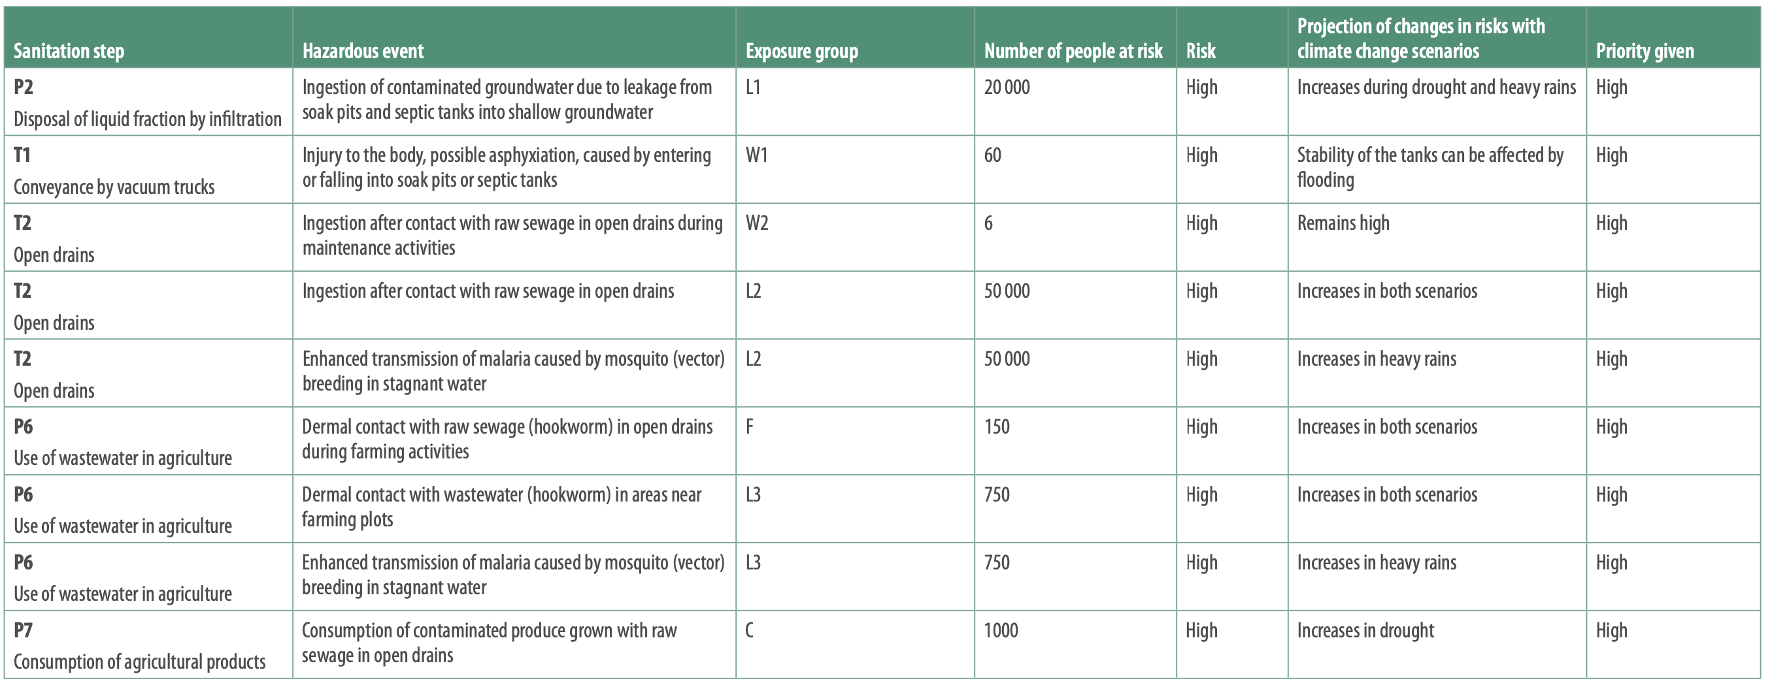
Newtown’s prioritized hazardous events with very high risk
Newtown’s prioritized hazardous events with high risk

Slide 60
GROUP WORK
Applying Step 3.3 to your SSP
Use table group worksheet Module 3 for instructions.
Within your groups:
Assess risk under normal conditions
Choose two climate change scenarios
Assess risk under climate change scenarios
After the assessment, make a list of the prioritised risks

Slide 61
Sharing groups results of implementation of Module 3

