Slide 1
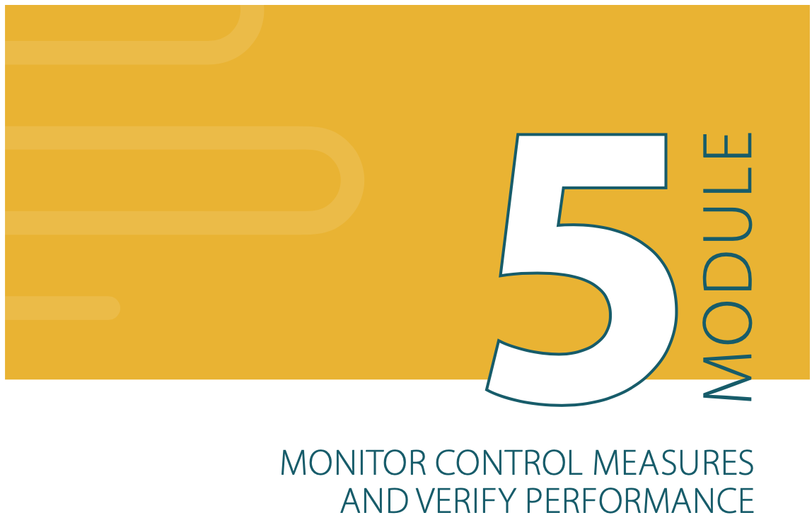
SSP Manual
Pages
81 to 89
MODULE 5:
MONITOR CONTROL MEASURES AND VERIFY PERFORMANCE

Slide 2
Why monitor and verify?
Sanitation systems are dynamic – things change in the short or long term.
Any system can under-perform – leading to unacceptable public health risks and loss of confidence in the service or products.
Need to provide assurance that the entire system is operating as intended.
MODULE 5:
MONITOR CONTROL MEASURES AND VERIFY PERFORMANCE

Slide 3
Module 5 answers the question:
“Is the system operating as planned?”
MODULE 5:
MONITOR CONTROL MEASURES AND VERIFY PERFORMANCE

Slide 4
5.1 Define and implement operational monitoring.
5.2 Verify system performance.
5.3 Audit the system.
• An operational monitoring plan.
• A verification monitoring plan.
MONITOR CONTROL MEASURES AND VERIFY PERFORMANCE

Slide 5
Hazard, hazardous event, effect, risk, ...!?
Hazard(s)
Hazardous event
Health effects
Likelihood
Severity
Risk
Control
measures
Operational Monitoring
How effective are the control measures?
Verification Monitoring
Does the system meet the intended performance outcomes?
MODULE 5:
MONITOR CONTROL MEASURES AND VERIFY PERFORMANCE

Slide 6
To give simple and rapid feedback on system performance, so that corrections can be made quickly, if required.
Operational Monitoring
Routine monitoring to inform management decisions.
Frequent.
Many monitoring points throughout the system.
Simple observations and tests.
Used to manage risks before they occur.
Implemented by service provides
SSP Manual
Page
83

Slide 7
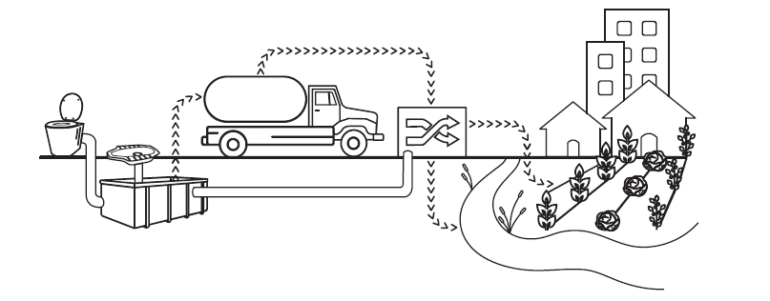
Operational monitoring collects and uses
Simple observations and measurements
Sampling and testing

Slide 8
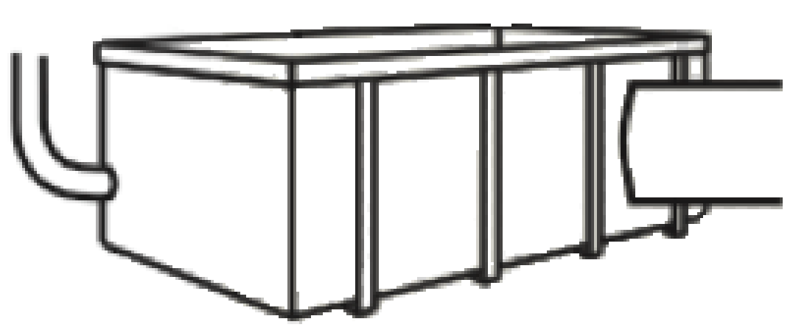
SSP Manual
Guidance note
5.1, Page 83
WHO Guidelines
Section 4.6.2
Page 70
Possible monitoring parameters for each sanitation step:
Containment-storage/treatment
Toilet
Availability, accessibility and privacy of toilet facilities.
Cleanliness.
State of cover slab.
Visible/reported overflows.
Inspection of dwellings and buildings
Routinely, in periodic/ special surveys or in the national census
Inspection of dwellings and buildings
Routinely, in periodic/ special surveys or in the national census

Slide 9
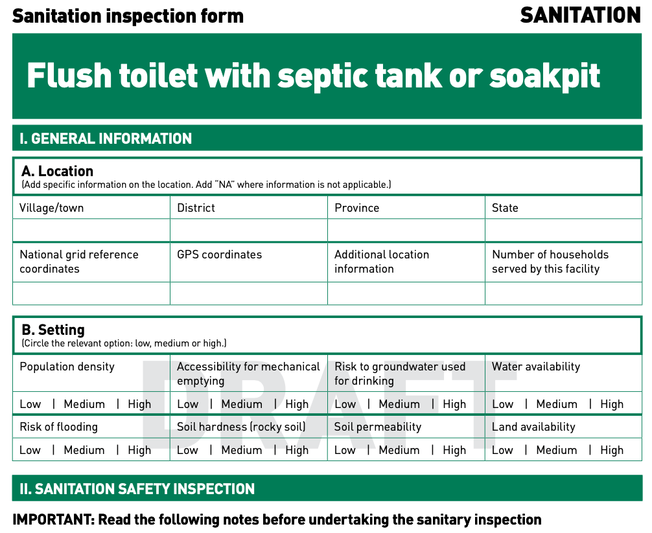
WHO Sanitary Inspection Forms
Short-standardized observation checklists that can be adapted and used by stakeholders to assess risk factors at or near sanitation facilities.

Slide 10
SSP Manual
Guidance note
5.1, Page 83
WHO Guidelines
Section 4.6.2
Page 70
Possible monitoring parameters for each sanitation step:
Transport and conveyance
Treatment
Use of PPE by sanitation workers
Use of the pre-defined roads
Cleanliness of sewers
Flow rate
Retention times
Composting temperatures
Data collected from customers, formal and informal operators and, where relevant, licensing authorities or regulatory bodies.
Data collected from operators and verified by occasional sampling and independent laboratory analysis.

Slide 11
SSP Manual
Guidance note
5.3, Page 86
Possible monitoring parameters for each sanitation step:
End use/ disposal
Correct application / irrigation process.
Duration of withholding periods.
Inspection of nearby farms
Routinely, in periodic surveys

Slide 12
TIPS
Keep in mind…
May not be practical to monitor all control measures.
Decide which control measures need to have operational monitoring (prioritize based on risk assessment).
Critical limits help decide acceptability:
usually numerical limits based on a parameter measurement.
qualitative limits may be appropriate (e.g. “all odours to be acceptable” or “flies not a nuisance”).

Slide 13
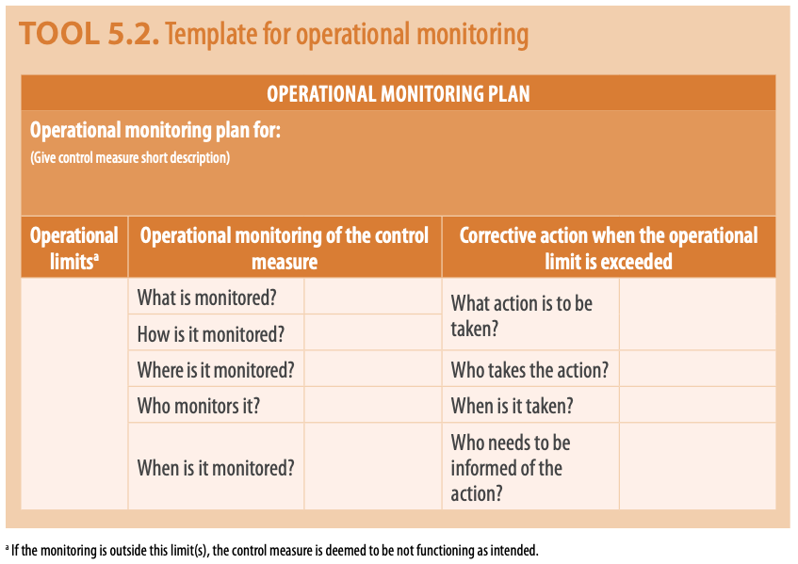
SSP Manual
Tool 5.2
Page 84
Suggested recording format

Slide 14
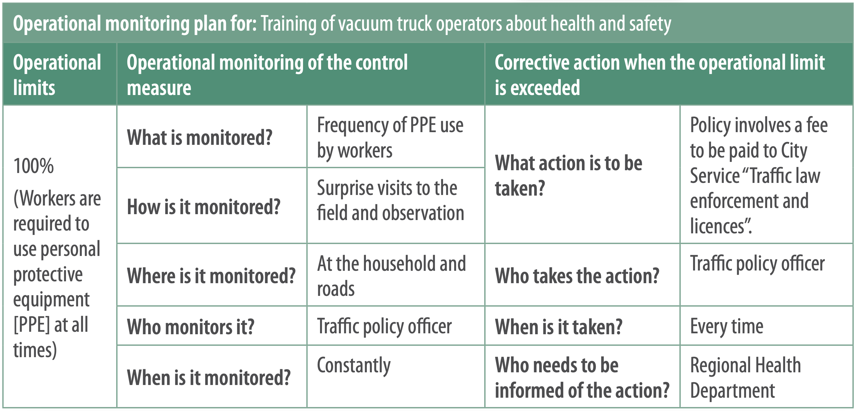

Slide 15
SSP Manual
Page 86
To periodically verify whether the system meets the intended performance outcomes.
Verification
It checks the effectiveness of the implemented control measures.
Periodic.
Few points, but focused on the system-end points (quality of the effluents).
More complicated tests (e.g. E.coli, Helminth eggs).
Used to prove the system works.
Might be undertaken by the operator or surveillance agencies.

Slide 16
SSP Manual
Guidance note
5.2, Page 86
Examples of typical verification data
Toilet
Use of toilet facilities (decrease of open defecation)
Containment-storage/treatment
Pathogen concentration in groundwater
Conveyance
Amount of faecal sludge transported to the faecal treatment system.
Treatment
Microbial testing of effluents, e.g. E.coli and Helminth eggs.
Microbial testing of crops, fish products, and waters at exposure points and system boundaries, e.g. E.coli and Helminth eggs.
End use/ disposal

Slide 17
SSP Manual
Page 88
STEP 5.3
Audit the system
To provide additional independent evidence of the system performance and quality of the SSP.
Audits:
Might not be feasible in the initial stages of SSP implementation.
Check the quality and effectiveness of the SSP implementation.
Ensure that the SSP contribute to health outcomes.
Can be done by internal, regulatory or independent auditors.
Demonstrate that the sanitation safety plan has been properly designed, is being implemented correctly and is effective.

Slide 19
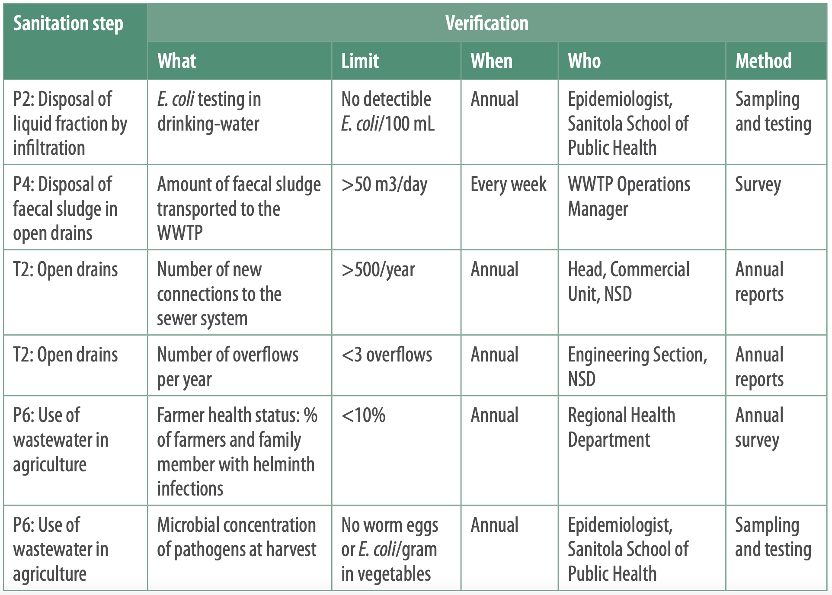

Slide 20
GROUP WORK
Applying Module 5 to your SSP
Use table group worksheet Module 5 for instructions.
Within your groups:
For the 3 selected control measures, prepare the operational monitoring plan.
For the 3 selected control measure, prepare the verification plan.

Slide 21
MODULE 5:
MONITOR CONTROL MEASURES AND VERIFY PERFORMANCE

