Slide 1
SSP Manual
Page 91-94
MODULE 6:
DEVELOP SUPPORTING PROGRAMMES AND REVIEW PLANS

Slide 2
6.1 Identify and implement supporting programs
6.2 Periodically review and update the SSP outputs
Supporting programs that improve implementation of SSP, and inform nation- al-level policy, planning and regulatory instruments
Up to date SSP outputs responding to internal and external changes.
DEVELOP SUPPORTING PROGRAMMES AND REVIEW PLANS

Slide 3
SSP Manual
Example 6.1,
Page 93
Embedding SSP in the day-to-day operations of a local authority, and ensuring the engagement of stakeholders such as service providers, the private sector, decision-makers and academics.
Supporting programmes and regular reviews will ensure that SSP remains relevant and responds to current or anticipated operating conditions.
SSP
Manual
SSP Manual Page 87
Example 6.1 & 6.2 Page 89

Slide 4
Supporting programs
Range of activities and partnerships that enable the successful implementation of the incremental improvements indicated in the SSP.
Sanitation business’s support:
formalization, equity contribution or grants, assistance in obtaining equipment and capital, advance purchase agreements and training in business as well as technical skills to promote efficiency.
Use of SSP results as evidence to revise national policies, plans and regulations:
to demonstrate which aspects are relevant for review and adaptation of sanitation policies and plans.
to inform decisions at the local level.
Photos: L. Barreto Dillon
Research programs:
Support the adaptation of technologies and service models to the local context.

Slide 5
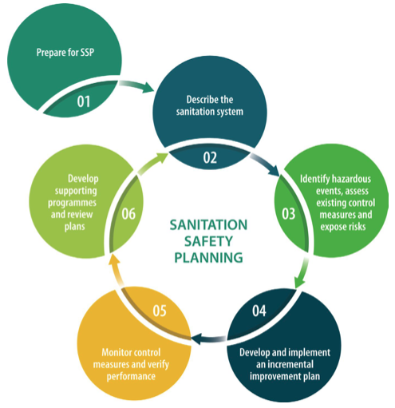
SSP Manual
Example 6.2
Page 94
STEP 6.2
Periodically review and update the SSP outputs
This step helps to respond to a dynamic environment, adapting SSP as new controls are implemented, or new hazards and hazardous events emerge.
Remember:
Sanitation Safety Planning is not linear!
It’s is a continuous process!

Slide 6
STEP 6.2
Periodically review and update the SSP outputs
Reviews
What to consider in reviews
Changes in the sanitation system (e.g., improvements that have been made since earlier SSP).
Changes in the SSP team or key institutions.
Changes in operating conditions.
Updates should be done during:
Regular SSP meetings
Planned and periodic review meetings.
Meetings to discuss an incident or near-miss.

Slide 7
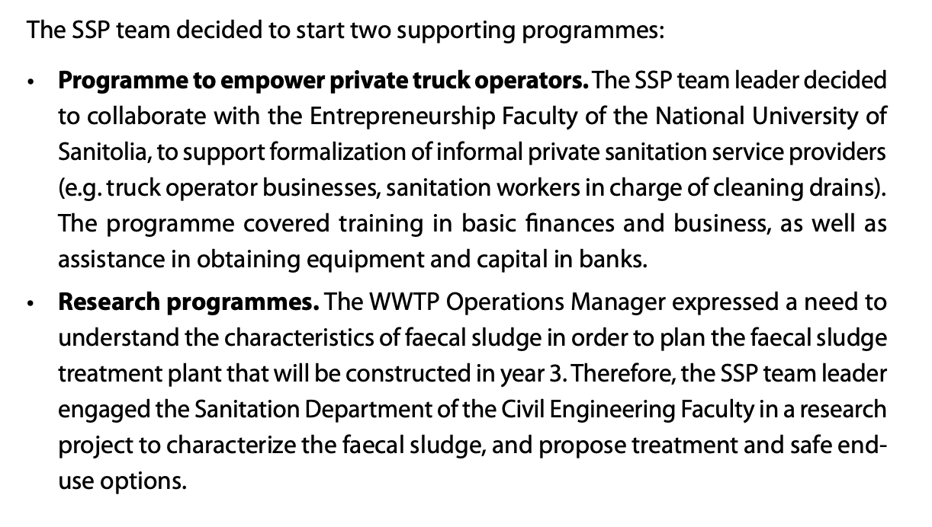
Step 6.1. Identify and implement supporting programmes

Slide 8
GROUP WORK
Applying Module 6 to your SSP
Use table group worksheet Module 6 for instructions.
Within your groups:
Identify two supporting programs

