Slide 1

Kerja kelompok terakhir Anda

Slide 2
Mari kita ingat

Slide 3

Perencanaan Pengamanan Sanitasi - SSP
Pendekatan yang direkomendasikan WHO untuk penilaian dan pengelolaan risiko kesehatan lokal untuk sistem sanitasi
Pendekatan berbasis risiko langkah demi langkah
Membantu dalam implementasi penilaian dan manajemen risiko tingkat lokal
Untuk seluruh rantai layanan sanitasi - mulai dari toilet, penahanan/penyimpanan dan perawatan, pengangkutan, perawatan, dan penggunaan akhir atau pembuangan
SSP memastikan bahwa sistem dikelola untuk memenuhi tujuan kesehatan
Notes:
Sanitation Safety Planning (SSP) is the WHO recommended approach for local risk assessment and management for sanitation systems.
It presents a step-by-step methodology to assist in the implementation of local level risk assessment and management for the entire sanitation service chain - from toilet, containment, conveyance, treatment and end use of disposal.
SSP can be applied to all sanitation systems, such as on-site or off-site sanitation, to ensure that the system is managed to meet the health objective.
SSP ensures that the system is managed to meet the health objectives

Slide 4
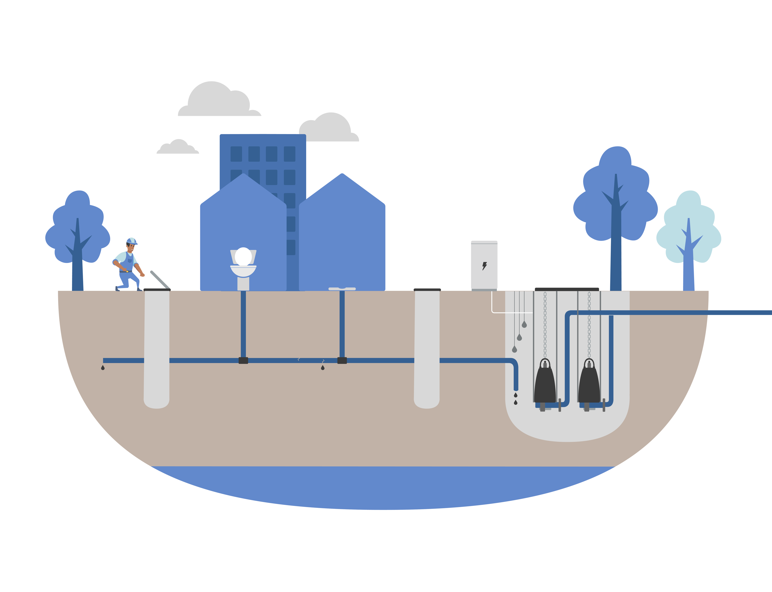
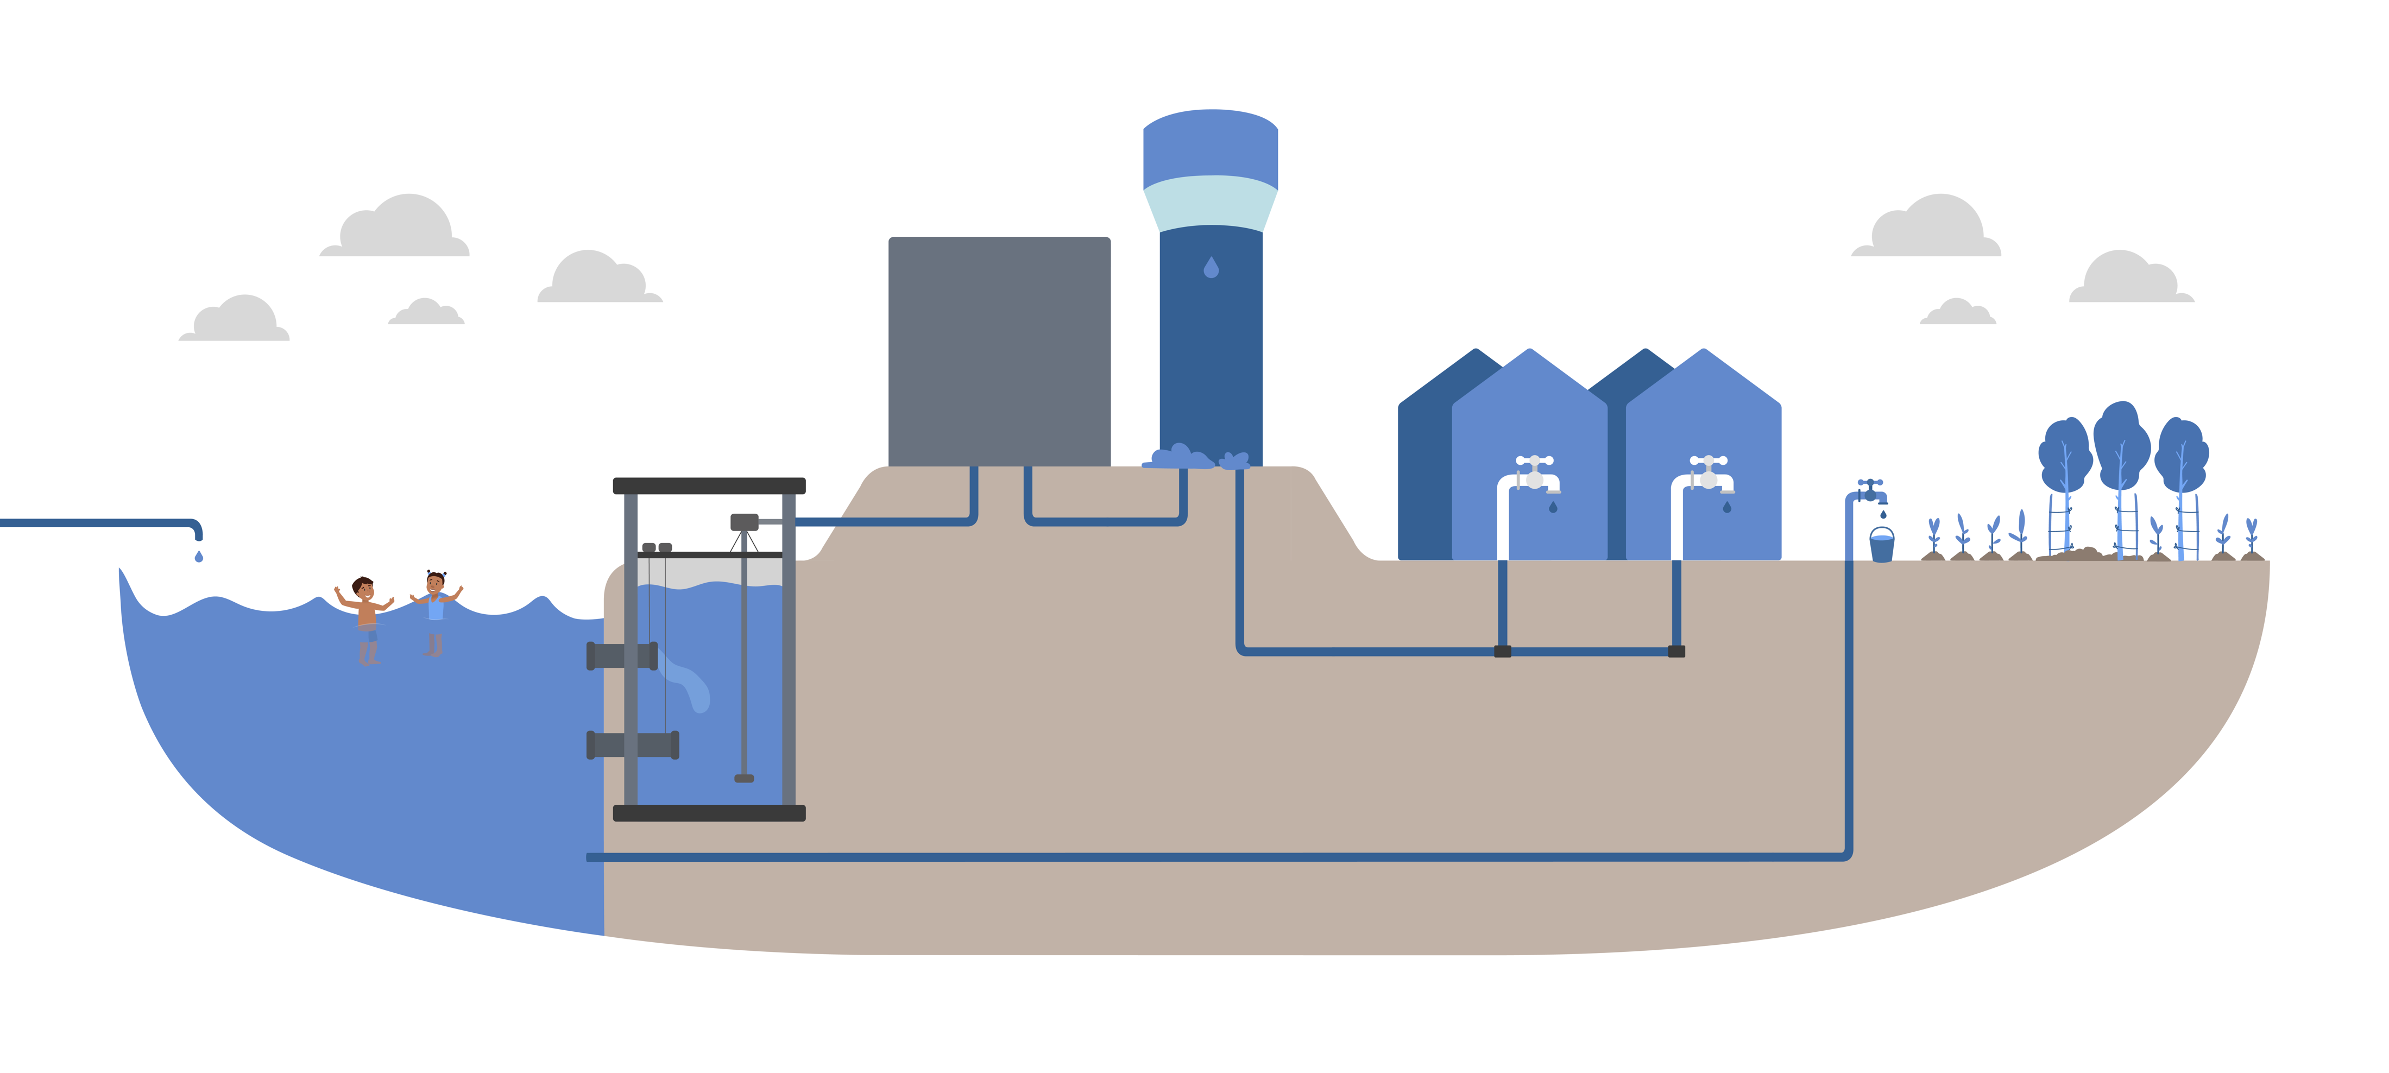
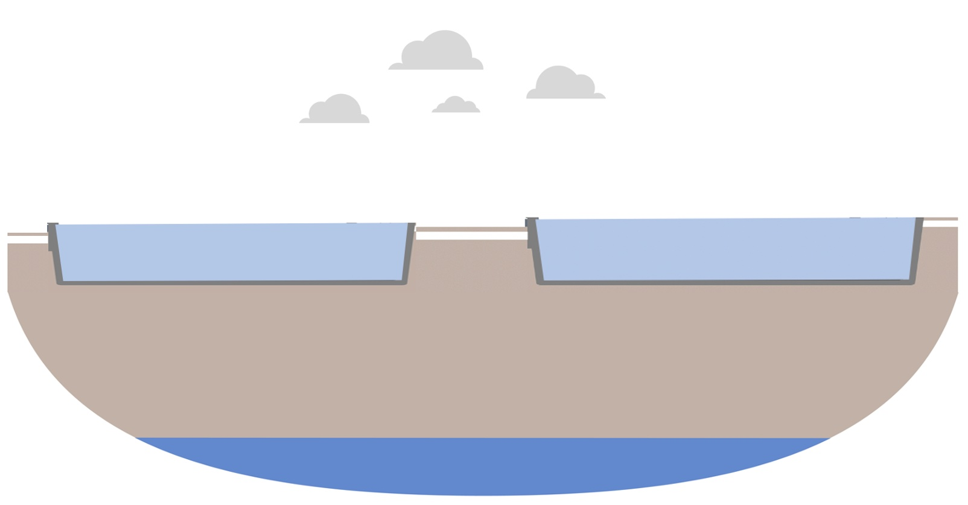

Bagaimana cara kerja SSP?
Alat penilaian dan manajemen risiko:
Memetakan dan mendeskripsikan sistem sanitasi
Mengidentifikasi orang yang terkena dampak atau kelompok paparan (pengguna, pekerja, komunitas, petani, konsumen)
Memahami jalur penularan infeksi terkait ekskresi
mengidentifikasi apa yang bisa salah (peristiwa berbahaya), mengevaluasi risikonya
Prioritaskan risiko kesehatan tertinggi
Menerapkan dan memantau langkah-langkah pengendalian untuk menghindari paparan
Photos: L. Barreto Dillon
Photos: L. Barreto Dillon
Photos: L. Barreto Dillon
Notes:
Just to make it simple: when we apply sanitation safety planning, we map the system, identifying all the sanitation steps and the exposure groups. Here, for instance, we have a flush toilet, connected to a sewer system, with a pumping station, bringing the wastewater to a pond system. Then, the effluent is discharged in a river, and the water is taken downstream by another city as a water source and it is also used by farmers to irrigate agricultural land. We try to understand how these exposure groups get infected with fecal pathogens. Then, we identify what can go wrong, for instance:
-it might be that there is not water to flush the toilets, which might be caused by water scarcity.
-sanitation workers can get exposed to pathogens during maintenance activities.
-leakages from the sewer can cause contamination of groundwater
-pump stations can fail, because of lack of electricity
-treatment systems can be overloaded, causing that the effluents do not fulfill the effluent standards. People swimming there can ingest pathogens.
-water for irrigation might be also contaminated.
Here, is where we analyse the health risk, and decide which are the highest health risks. And for that, we propose control measures.

Slide 5

Pikirkan: dalam kerangka pekerjaan sehari-hari Anda
Dalam situasi apa SSP dapat diterapkan?
Photos: L. Barreto Dillon
Photos: L. Barreto Dillon
Photos: L. Barreto Dillon

Slide 6

Ide!
Dalam proyek baru sanitasi dan yang sudah ada untuk mengidentifikasi kebutuhan investasi.
Di kotamadya yang memiliki persentase besar orang yang tidak terhubung ke saluran pembuangan.
Di daerah perkotaan di mana nasib pengelolaan lumpur feses tidak diketahui.
Dalam sistem sanitasi terpusat, di mana penggunaan kembali limbah yang diolah oleh petani tidak dipantau.
Di daerah di mana penyakit enterik diketahui.
Di daerah padat penduduk menggunakan sanitasi di tempat.
Photos: L. Barreto Dillon
Photos: L. Barreto Dillon
Photos: L. Barreto Dillon
Notes:
Just to make it simple: when we apply sanitation safety planning, we map the system, identifying all the sanitation steps and the exposure groups. Here, for instance, we have a flush toilet, connected to a sewer system, with a pumping station, bringing the wastewater to a pond system. Then, the effluent is discharged in a river, and the water is taken downstream by another city as a water source and it is also used by farmers to irrigate agricultural land. We try to understand how these exposure groups get infected with fecal pathogens. Then, we identify what can go wrong, for instance:
-it might be that there is not water to flush the toilets, which might be caused by water scarcity.
-sanitation workers can get exposed to pathogens during maintenance activities.
-leakages from the sewer can cause contamination of groundwater
-pump stations can fail, because of lack of electricity
-treatment systems can be overloaded, causing that the effluents do not fulfill the effluent standards. People swimming there can ingest pathogens.
-water for irrigation might be also contaminated.
Here, is where we analyse the health risk, and decide which are the highest health risks. And for that, we propose control measures.

Slide 7
Kerja kelompok terakhir Anda
1
Mengidentifikasi ide proyek SSP
Bertukar pikiran dalam kelompok Anda: di proyek, lokasi, area, topik mana, kami dapat menerapkan SSP?
Kelompok 1: Jakarta
Kelompok 2: Yogyakarta
Kelompok 3: Surakarta
Kelompok 5: National level
Kelompok 4: Bekasi
Photos: L. Barreto Dillon
Photos: L. Barreto Dillon
Photos: L. Barreto Dillon
Notes:
Just to make it simple: when we apply sanitation safety planning, we map the system, identifying all the sanitation steps and the exposure groups. Here, for instance, we have a flush toilet, connected to a sewer system, with a pumping station, bringing the wastewater to a pond system. Then, the effluent is discharged in a river, and the water is taken downstream by another city as a water source and it is also used by farmers to irrigate agricultural land. We try to understand how these exposure groups get infected with fecal pathogens. Then, we identify what can go wrong, for instance:
-it might be that there is not water to flush the toilets, which might be caused by water scarcity.
-sanitation workers can get exposed to pathogens during maintenance activities.
-leakages from the sewer can cause contamination of groundwater
-pump stations can fail, because of lack of electricity
-treatment systems can be overloaded, causing that the effluents do not fulfill the effluent standards. People swimming there can ingest pathogens.
-water for irrigation might be also contaminated.
Here, is where we analyse the health risk, and decide which are the highest health risks. And for that, we propose control measures.

Slide 8


2
Tentukan pemangku kepentingan utama Anda (audiens target)
Berkomunikasi sama pentingnya dengan ide proyek!
Otoritas nasional
Regulator
Otoritas wilayah
Otoritas lokal
Lembaga lain
Utilitas
Notes:
To implement it, you all have to go back to your offices, and from Sunday or Monday on, you will need to engage key stakeholders in order to kick-off that broad roadmap. Engaging the right stakeholders and communicating correctly is as important, or more, than good planning. Therefore, you need to package your message in a pitch (or presentation) that captivates and attracts the attention of key stakeholders.
For the purpose of this marketplace exercise, we need you to select a particular key stakeholder, that, without his/her support and commitment, it will not be possible to implement a project idea. Important is that you should select a stakeholder to whom you (as a team) have access to.

Slide 9
Mulai dari mana?
Pilih audiens target Anda untuk langkah selanjutnya!
Kapasitas Anda untuk mempengaruhi
Organisasi Anda
Audiens target
• Mandat Anda/ misi Anda
• Sumber daya manusia Anda
• Sumber daya keuangan
• Keterampilan dan kapasitas Anda
• Minat mereka
• Kapasitas mereka
• Pentingnya mereka
• Kesediaan untuk berkolaborasi
Hubungan Anda
Pilih titik masuk!
Notes:
First you have to look at yourself: what is your mandate, your capacities… etc.
Then, you need to look at your target audience.
Finally your relation, selecting an entry point.

Slide 10

Cara apa yang lebih baik untuk memahami audiens target Anda...
… daripada menempatkan diri Anda pada posisi mereka?

Slide 11
3
Siapkan pitch 5 menit
Bagaimana kami berkomunikasi tentang SSP kepada audiens target kami?
Siapa target audiens kami?
Apa yang kita ingin mereka lakukan?
Pesan
Pendahuluan (jendela emas):
Masalah/Kebutuhan/Kepentingan:
SSP sebagai solusi:
Manfaat:
Cara beraksi (apa yang Anda butuhkan dari mereka):
Notes:
Whenever we are going to communicate about SSP, we should ask ourselves:
Who is our target audience? And what do we want them to do? Communication should always have an objective: what do I want the audience to do with the information that I am communicating? Then, we need to make sure that we catch their attention, that our proposal hooks them, that we solve an existing problem, and that SSP is presented as a solution. We need to mention the benefits and how this target audience can get in action.
Let’s do a short exercise… let choose 1 target audience. I will choose a Water and Sanitation Service Provider or Utility. But how would I know what problem would solve the SSP for them…?

Slide 12
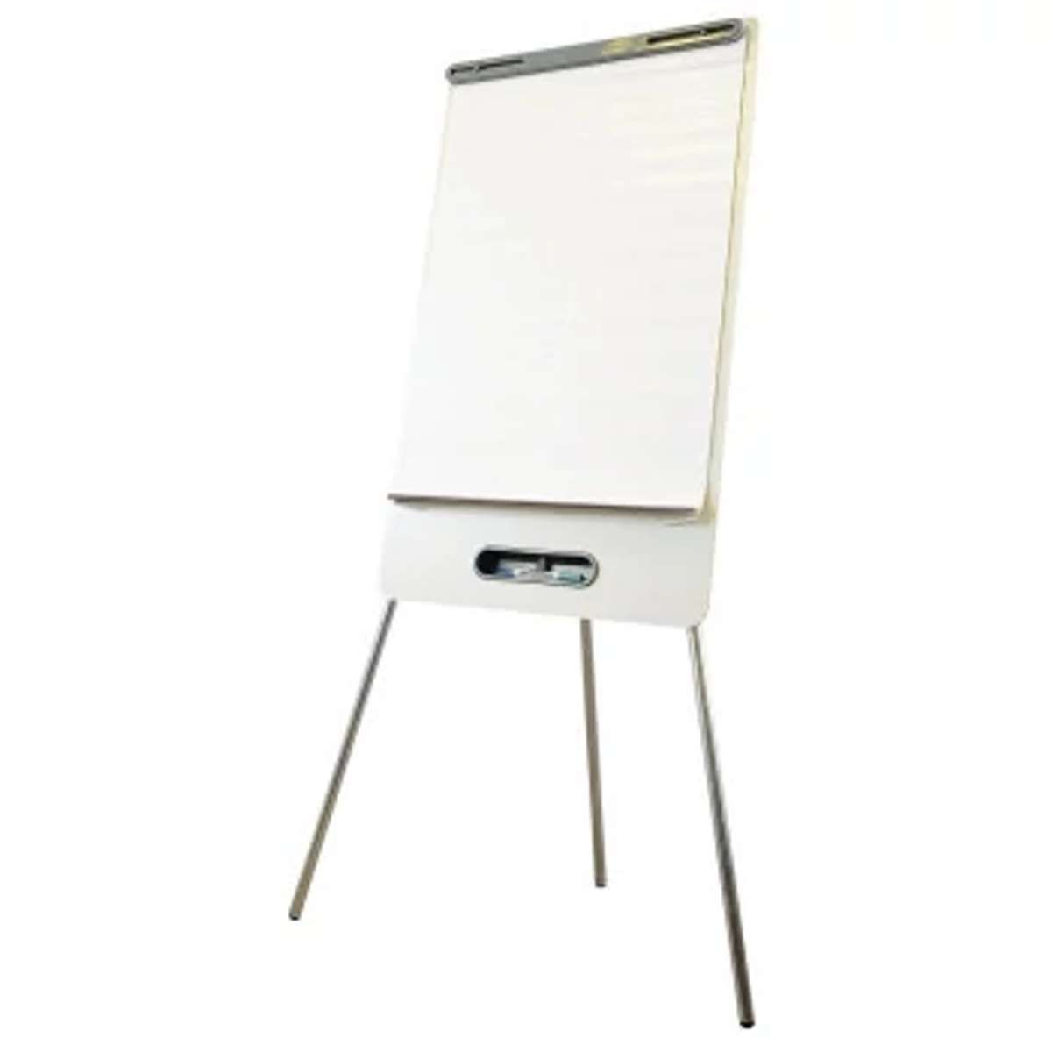
Siapkan flipchart dengan informasi penting untuk mendukung pitch Anda
4
Notes:
Whenever we are going to communicate about SSP, we should ask ourselves:
Who is our target audience? And what do we want them to do? Communication should always have an objective: what do I want the audience to do with the information that I am communicating? Then, we need to make sure that we catch their attention, that our proposal hooks them, that we solve an existing problem, and that SSP is presented as a solution. We need to mention the benefits and how this target audience can get in action.
Let’s do a short exercise… let choose 1 target audience. I will choose a Water and Sanitation Service Provider or Utility. But how would I know what problem would solve the SSP for them…?

Slide 13






Pilih 4 speaker
5
Pembicara putaran 2
Pembicara putaran 4
-Kami akan memiliki 4 putaran “pasar” masing-masing 10 menit.
-Setiap putaran, satu anggota tim harus berada di stand (booth) dan mempresentasikan ide proyek SSP.
-Anggota tim lainnya dapat pergi ke stan orang lain dan berinteraksi dengan peserta lain.
Tim Anda:
Pembicara putaran 1
Pembicara putaran 3
Setiap orang akan memiliki 1 koin SSP
Notes:
Whenever we are going to communicate about SSP, we should ask ourselves:
Who is our target audience? And what do we want them to do? Communication should always have an objective: what do I want the audience to do with the information that I am communicating? Then, we need to make sure that we catch their attention, that our proposal hooks them, that we solve an existing problem, and that SSP is presented as a solution. We need to mention the benefits and how this target audience can get in action.
Let’s do a short exercise… let choose 1 target audience. I will choose a Water and Sanitation Service Provider or Utility. But how would I know what problem would solve the SSP for them…?

Slide 14





6
Marketplace
PUTARAN PERTAMA
Proposed list of contents
-Introduction (use the 30 second golden window)
-Your key learnings from this summit.
-Reflections about the needs of your own country.
-What are you actions and your roadmap
-A call for action (what you request from him/her)
Pembicara putaran 1 pergi ke stand Anda

Slide 15

6
Marketplace
PUTARAN PERTAMA
10 menit untuk mempresentasikan ide SSP Anda kepada peserta lain
Peserta lainnya dapat dengan bebas mengunjungi stand lain

Slide 16
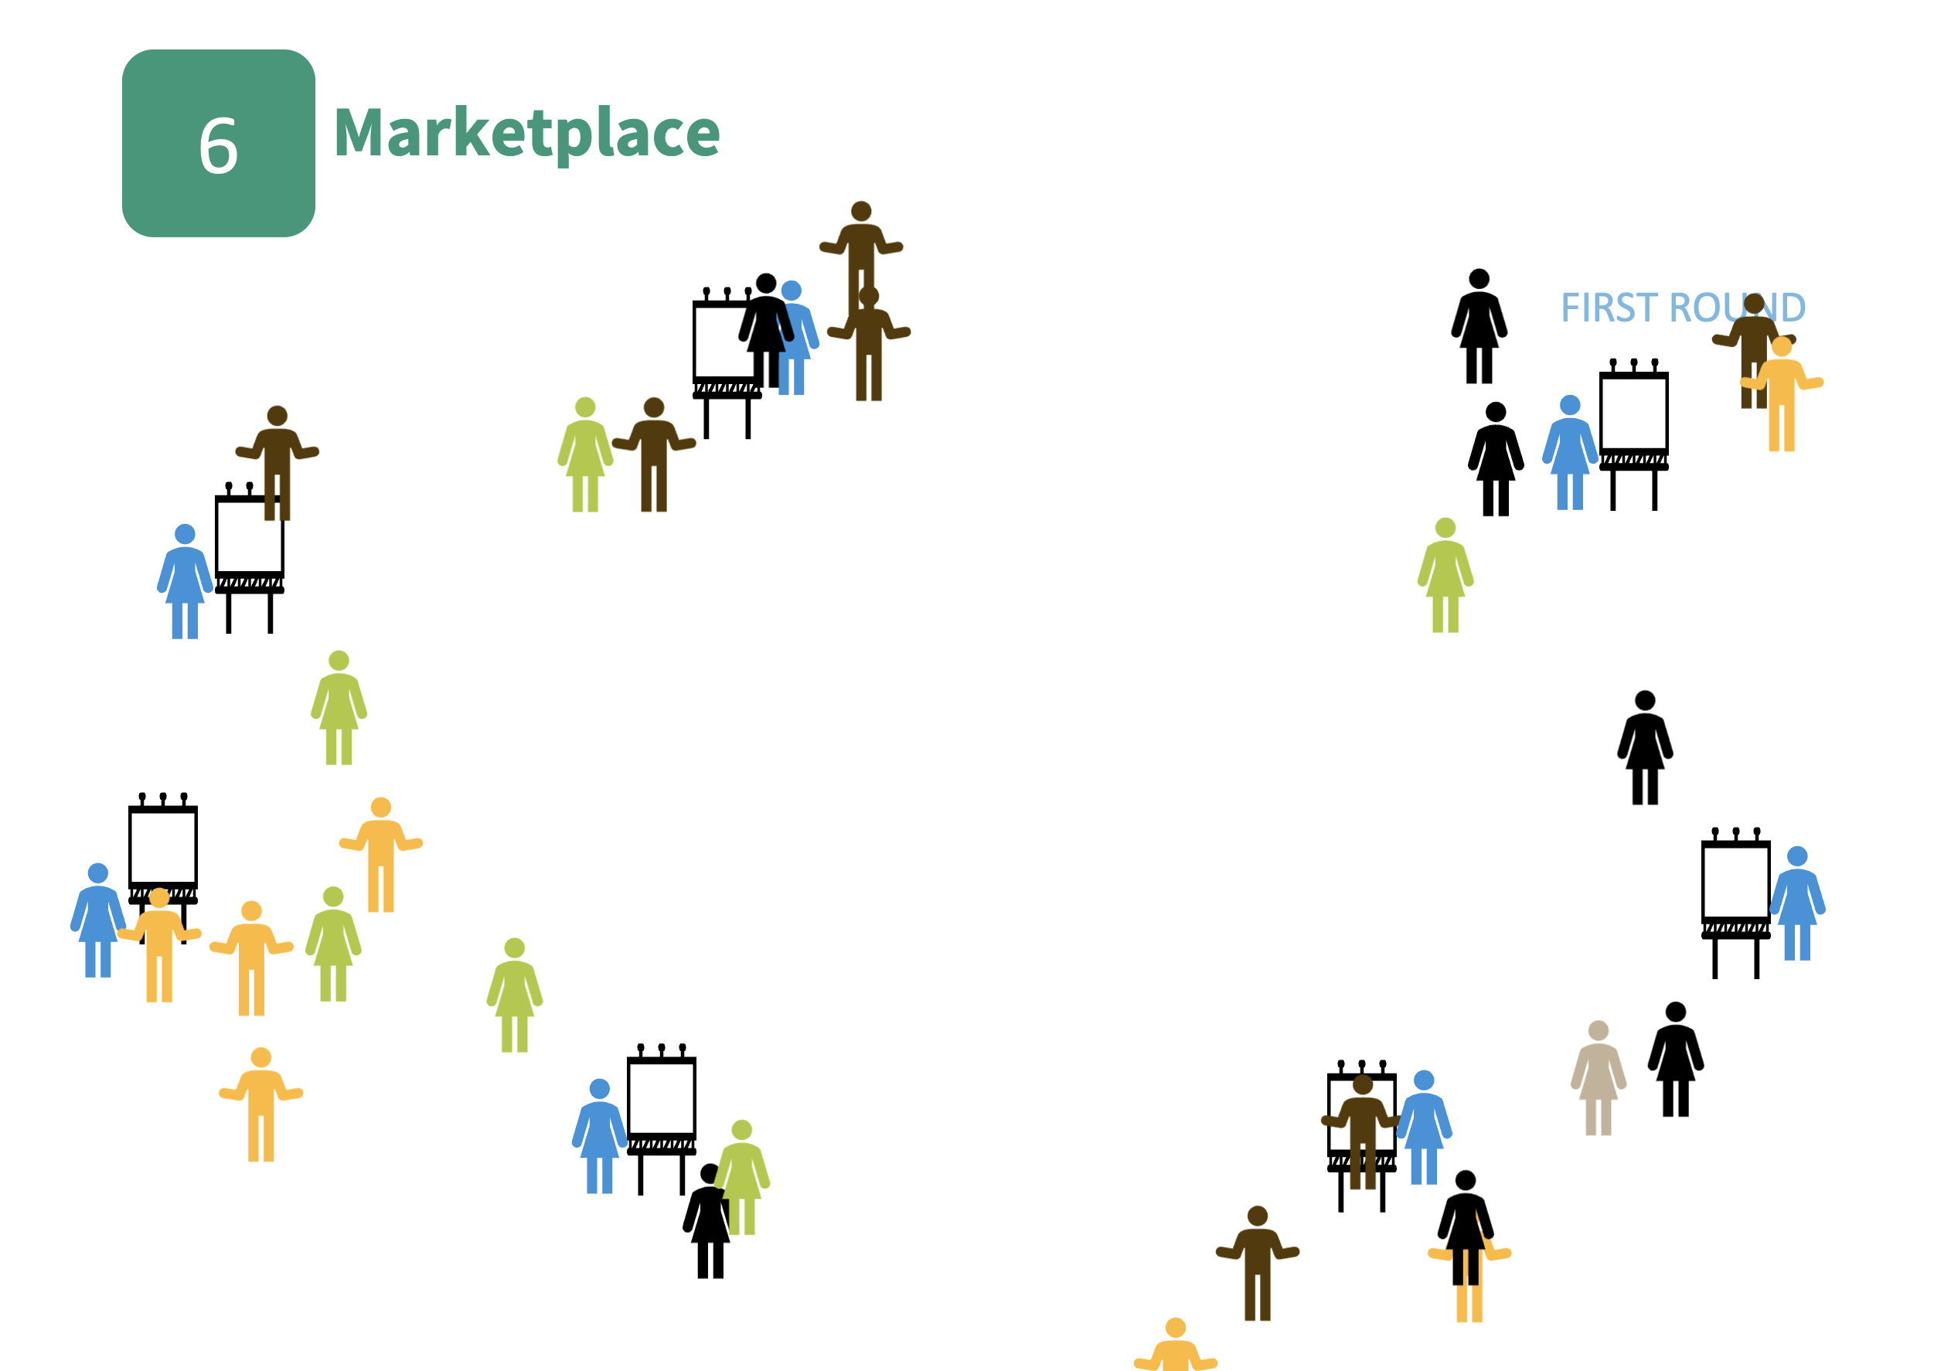

Slide 17

6
Marketplace
PUTARAN KEDUA
Pembicara putaran 2 pergi ke stand Anda
Pembicara putaran 1 bebas pergi dan mengunjungi stand lain
Peserta lainnya dapat dengan bebas mengunjungi stand lain

Slide 18
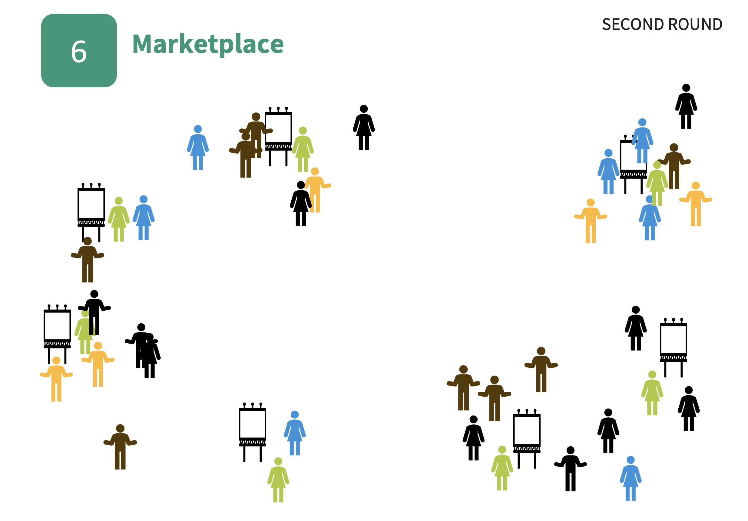
Kami akan melakukan putaran ke-3 dan ke-4

Slide 19
Marketplace
Identifikasi ide proyek SSP.
Tentukan siapa audiens target Anda.
Siapkan pitch 5 menit untuk melibatkan audiens target.
Siapkan flipchart dengan informasi penting tentang SSP dan manfaat untuk audiens target yang dipilih. Ini akan menjadi pendirian Anda.
Pilih 3 speaker: 1 untuk setiap putaran.
Kami akan memulai pasar pada pukul 8:00. Masing-masing dari Anda akan menerima 1 koin SSP. Salah satu tim Anda tinggal di stan Anda, dan yang lain berkeliling stan lainnya. Orang yang tetap melempar dan "melibatkan" peserta lain. Kami mengulangi 3 kali.
Setiap peserta harus memberikan koin SSP ke stan yang paling dia sukai.
Kelompok dengan lebih banyak koin memenangkan hadiah SSP.
K1
K2
Jakarta
Yogyakarta
K3
K4
Bekasi
Surakarta
K5
National level

Slide 20

Dan pemenangnya adalah...

Slide 21
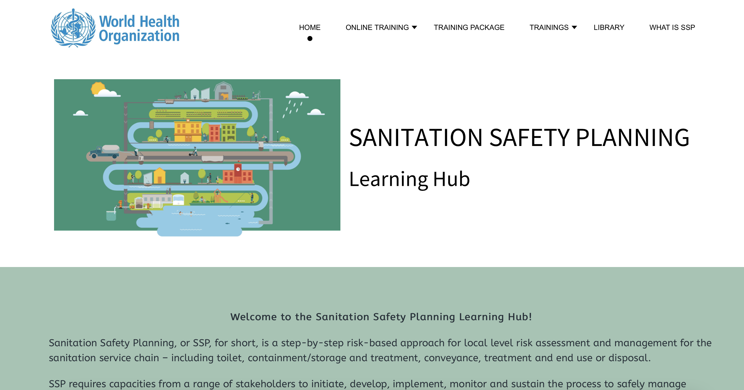
https://ssp-learninghub.creation.camp
Training videos
PowerPoints, Trainers guide, worksheets
Your training
Supporting documents

Slide 22
Refleksi untuk jalan ke depan
Dalam tabel Anda berdasarkan daerah (Jakarta, Surakarta, Bekasi, Yogyakarta dan Otoritas Nasional) bahas :
Apa manfaat yang kita rasakan dari SSP?
Bagaimana SSP dapat diintegrasikan ke inisiatif provinsi/nasional kami?
Apa langkah kita selanjutnya?
5 menit untuk berbagi dalam pleno.
PLENARY DISCUSSION

Slide 23

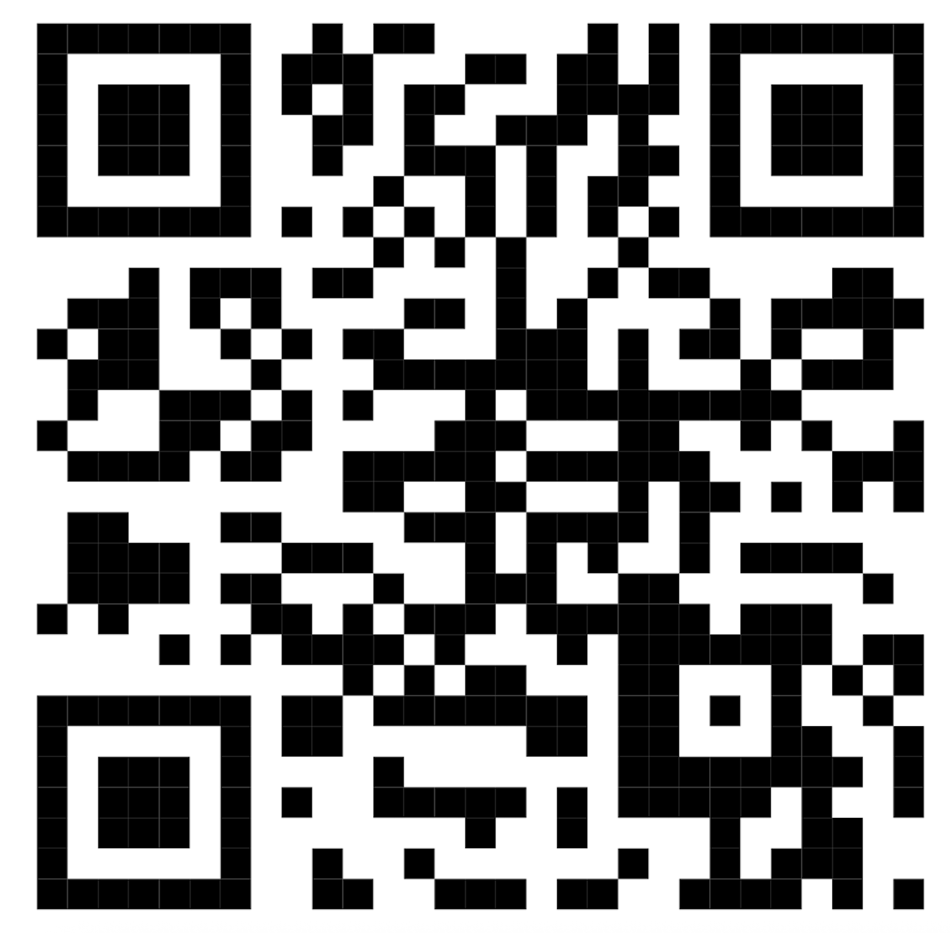
Mari kita lihat apa yang Anda ketahui SEKARANG tentang SSP

Slide 24

Silakan evaluasi pelatihan kami!
Akses formular kami melalui kode QR ini!

Slide 25
TERIMA KASIH

